Slide 1
Water for Farmers and Wildlife
Natalie Pagett
1st February 2018
Notes:
Title slide
Logo only on white

Slide 2
EA and RSPB joint project looking into the feasibility of creating various flood storage/habitat creation techniques that deliver multiple benefits on the inner Humber Estuary/HHLs
Water Management (flood risk and water sustainability)
Farming gains (financial & ecosystem)
Habitat for wildlife
Notes:
Note – this is a feasibility study – we are NOT carrying out trials.

Slide 3
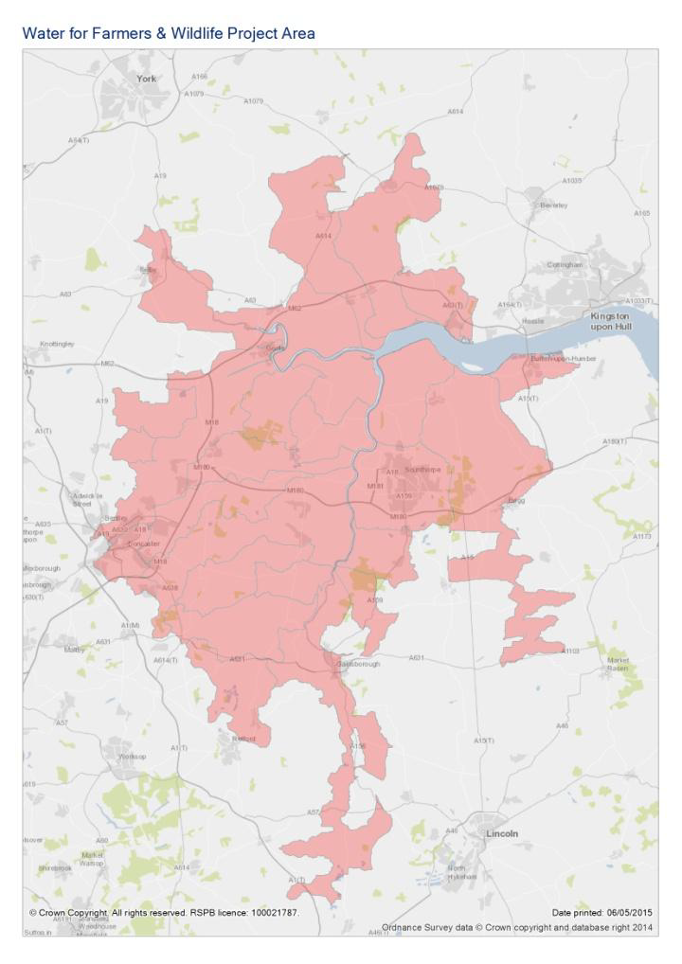

Slide 4
Aims of phase 1
Identify and assess the feasibility of wetland habitat creation/flood storage techniques
Economic analyses
Policy and consenting
Engage with landowners
Identify potential sources of funding
Identify trial sites that could potentially be suitable
Notes:
Note – trial sites for next stage of the project should we get the funding and should the results of the feasibility study be positive.
Focus on functional elements for identifying trial sites – e.g. – need areas at risk of flooding, low lying areas etc

Slide 5
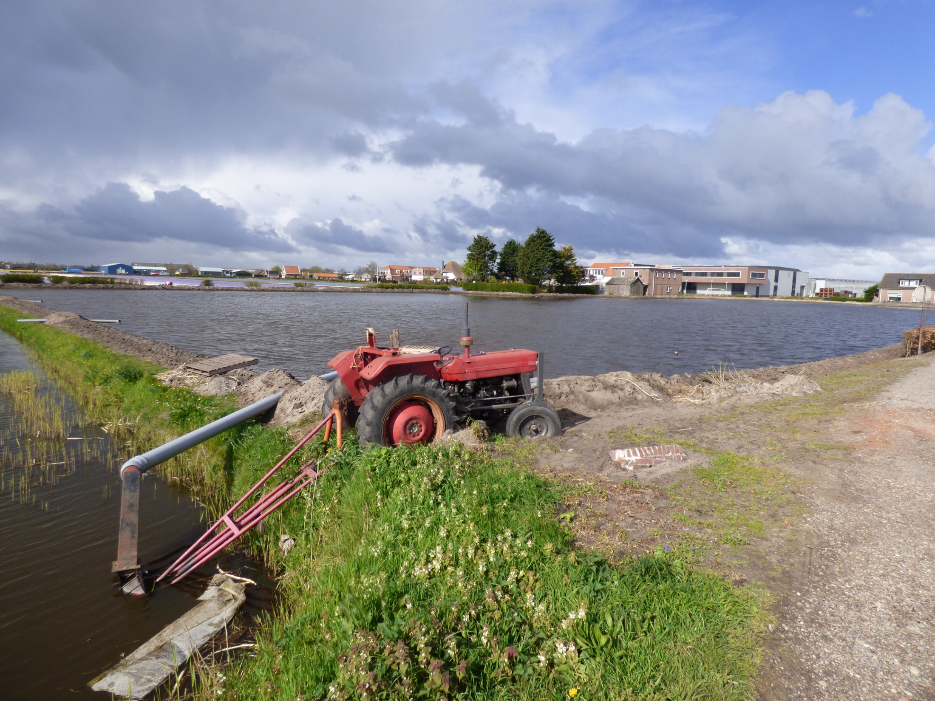

Slide 6
Phase 2
Develop detailed case studies for several landholdings on the Humber Estuary
Scheme designs (TW, Warping)
Consents and permissions
Economics assessment and FRM measures
Biodiversity management plans
Soil and water quality trial/logistics trial
Notes:
Primarily Humber Estuary, but also focusing on several landholdings in the HHLs
Primarily temp wetlands/warping, but including SR designs where applicable

Slide 7
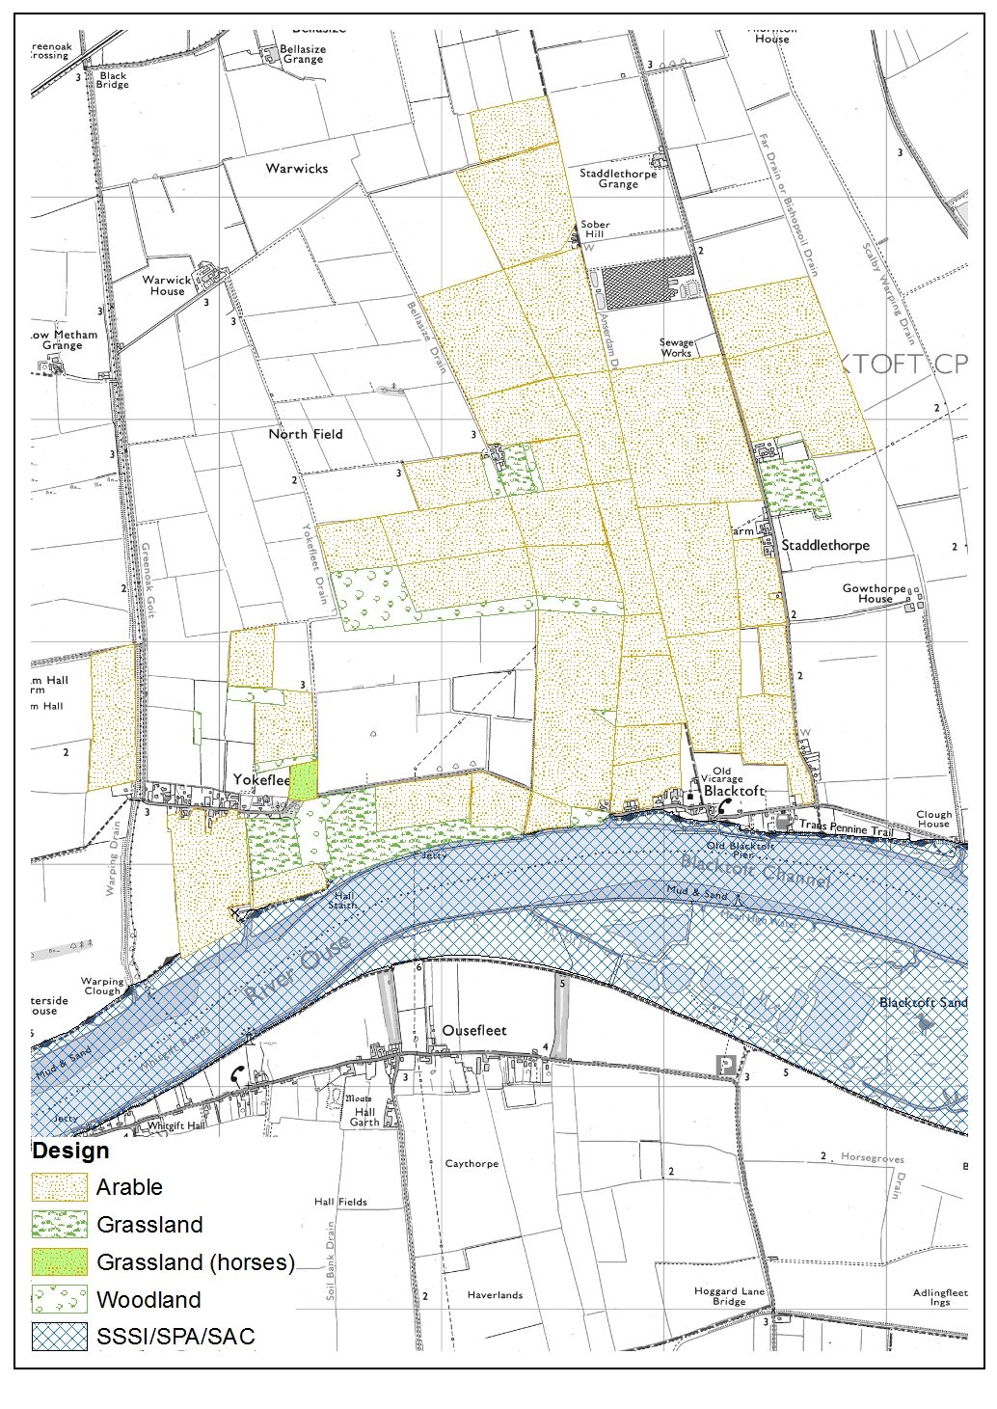
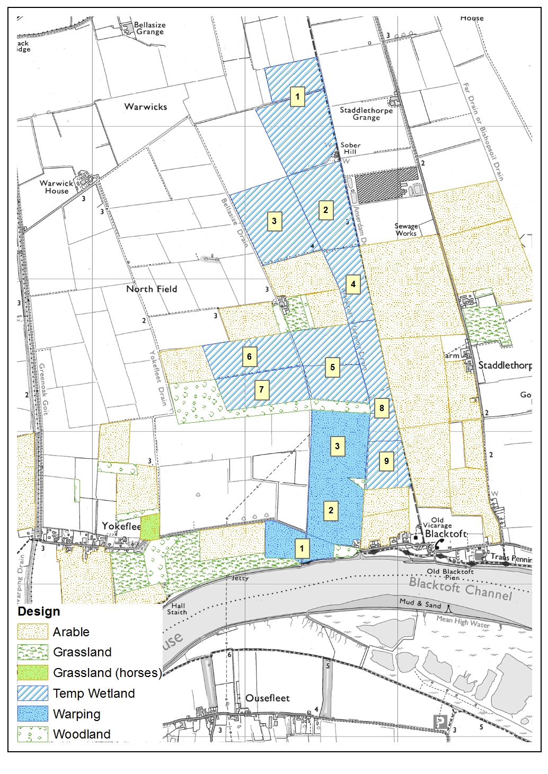
Yokefleet Estate – current & proposed management
Notes:
Make clear not displacing farmland birds – rotational aspect

Slide 8
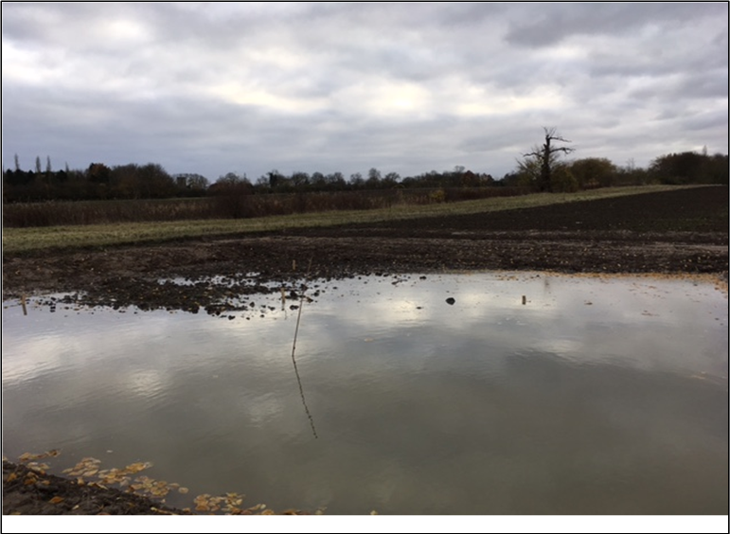
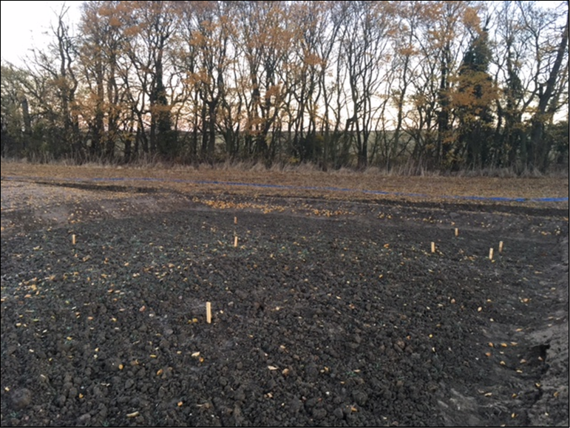
Hope Farm Trials
10x10m plots – two experimental and one control plot
4-6 month flood and soil/water samples taken
What we learned.....

Slide 9
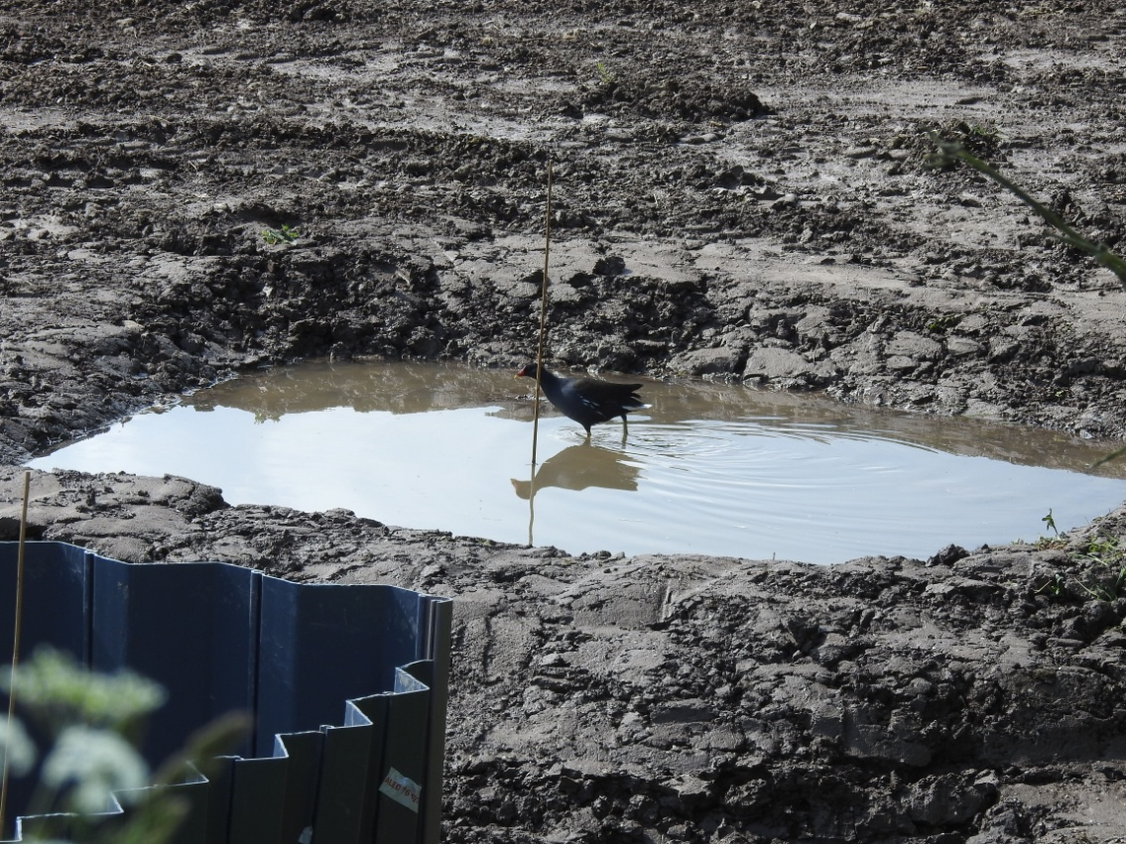
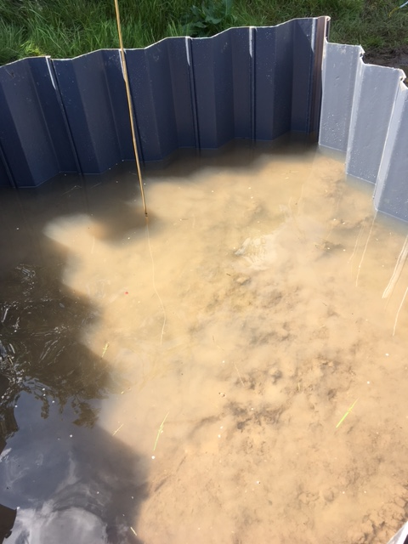
Blacktoft Trials
2x2m plots – one sheet piling, one bunded
Flooded between May & July 2017

Slide 10
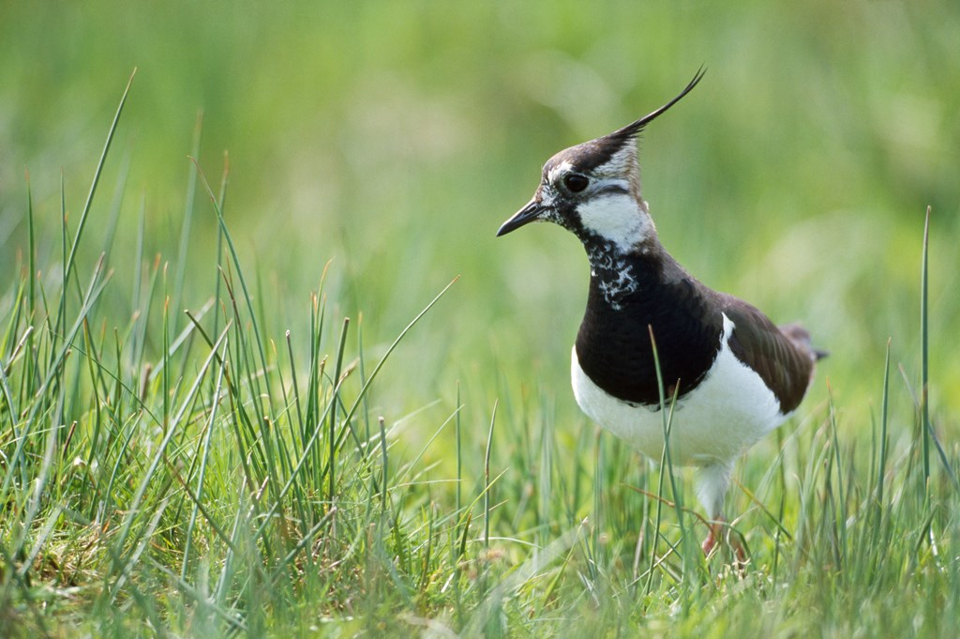
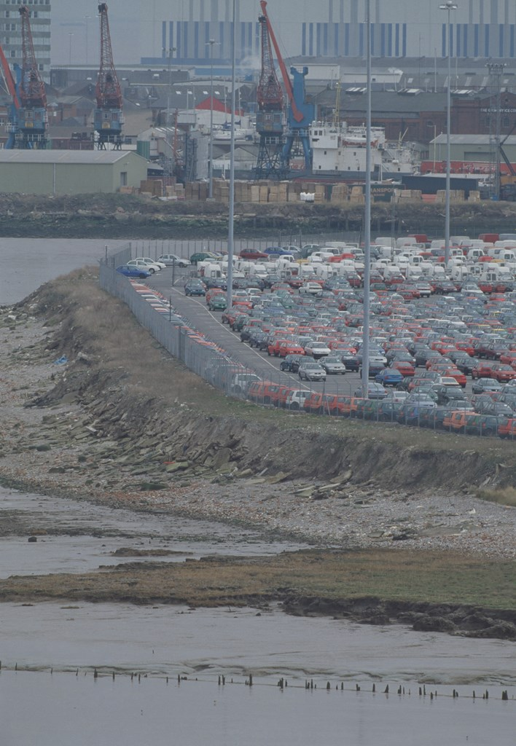
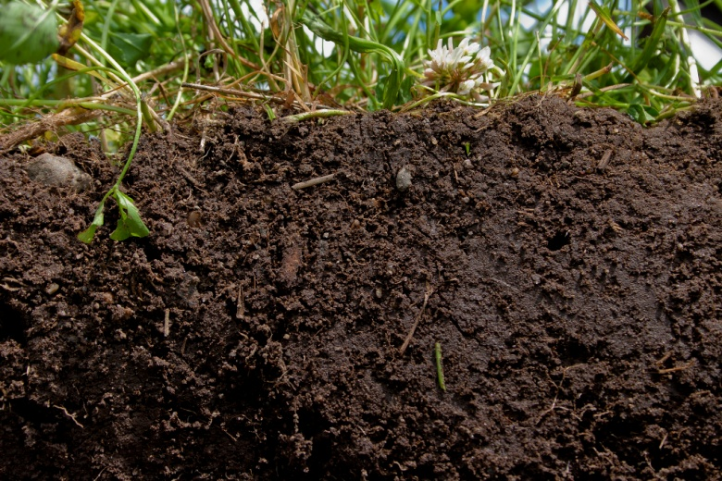
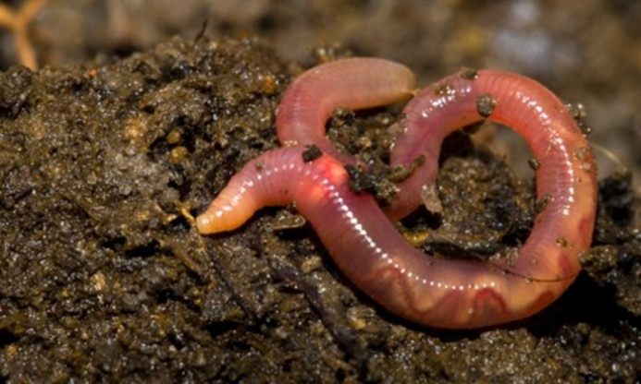
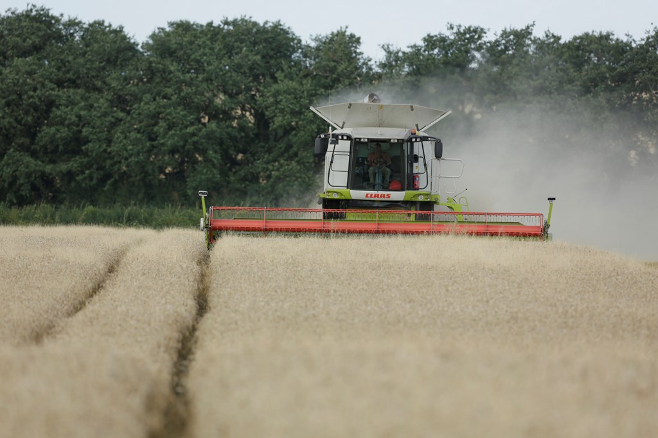
Phase 3 - Trials
Plot-based trials (10x10m experimental plots)
Deliver approx 8 field-scale trials (saline vs. freshwater – 8 months vs. 2 years).
Monitor and evaluate the impacts of the techniques

Slide 11
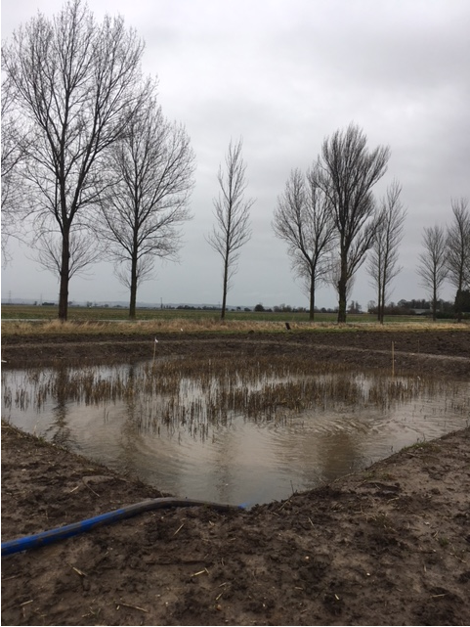
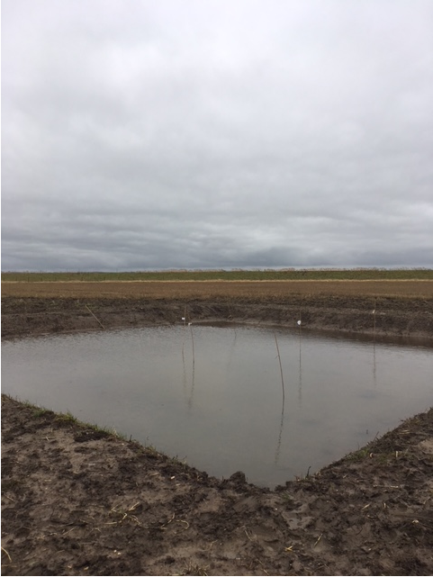
Yokefleet Trials

Slide 12
What we’ve learned so far
Logistics – ditch, bunds, pumps
Consents
Costs
Weather
Retaining water
Underground drainage
Water quality

Slide 13
Next Steps
Soil analysis - Yokefleet
Field scale trials – design, consents, contractors
Ideally 8 fields
Soil fertility/structure & water quality
Water infiltration and water tables
Bird abundance/diversity, aquatic invertebrate presence
Crop yields and pest/weed management

Slide 14
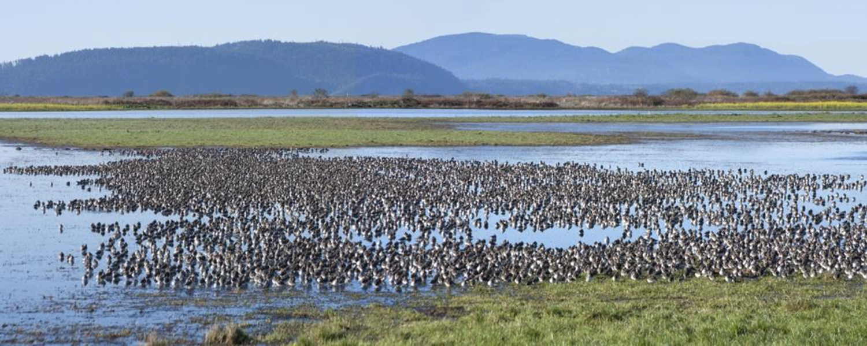

Slide 15
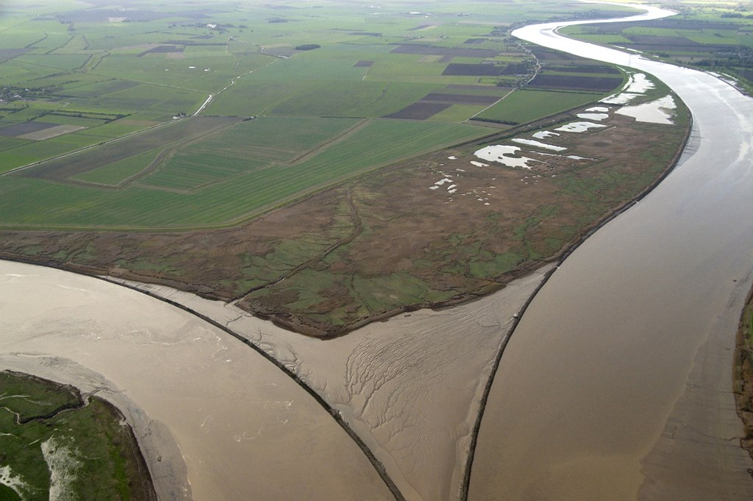
Thank you natalie.pagett@rspb.org.uk

