Slide 1
LWT’s Conservation Strategy: 25 year forward look
Tammy Smalley
Head of Conservation
Feb 2018

Slide 2
Introduction
Introduce myself
LWT as an organisation: vision & mission
Why a new Conservation Strategy?
What next?

Slide 3
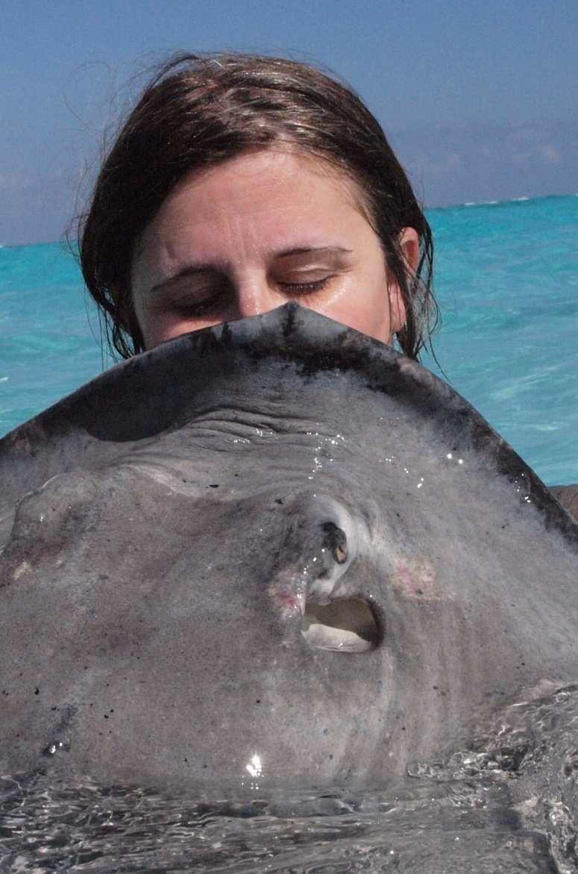
Who am I?
Started with LWT November 2016
7 years Natural England national marine
7+ years Wash Estuary Project Officer based with local authority
Environmental consultant & international research
Also worked in the private sector including farming
Lincolnshire born & bred

Slide 4
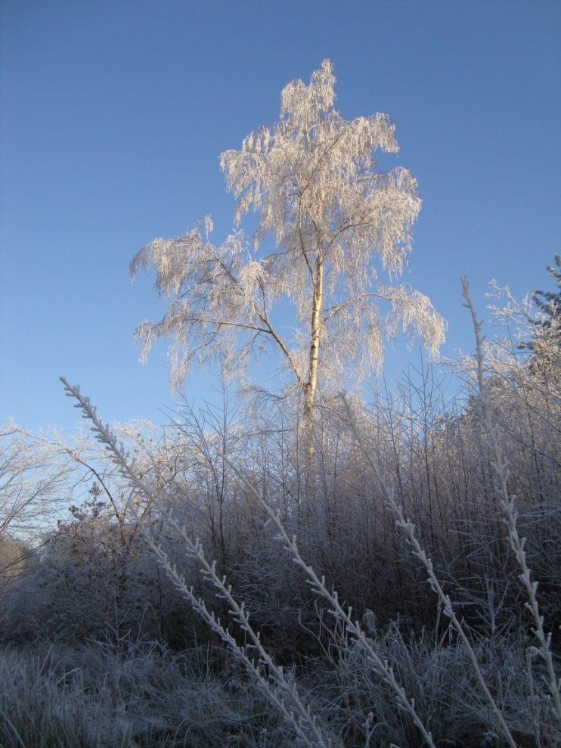
Who is LWT?
Membership based charity with over 28,000 members
Within a family of 47 UK WTs
Around 100 reserves for wildlife in historic Lincolnshire
~ 70 staff
Volunteer organisation

Slide 5
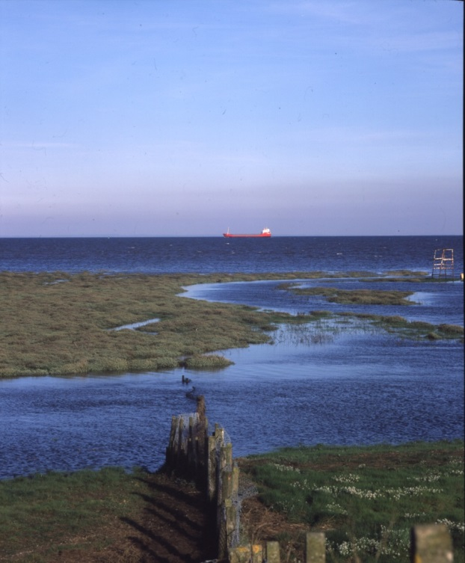
LWT’s Vision
Lincolnshire and the neighbouring sea and estuaries to be rich in wildlife for the benefit of everyone

Slide 6
LWT’s Mission
To safeguard wildlife in Lincolnshire and in the neighbouring sea and estuaries by:
protecting existing wild places as reservoirs of biodiversity
restoring and creating wildlife habitats
sharing this vision with others, particularly relevant decision makers
encouraging more people to enjoy Lincolnshire’s natural environment and to understand the need to conserve it
promoting research projects which lead to a better understanding and appreciation of the natural world

Slide 7
Conservation Strategy?
A framework to deliver towards the vision and mission over a longer timescale, providing a strategic direction of travel
This will then be underpinned by a 3 year rolling work programme, prioritising resources and bidding, but allowing for new opportunities

Slide 8
Informed by
Board, Conservation Strategy Team & Conservation Department
Previous Head of Conservation ‘thoughts for the future’
Visiting and helping to deliver daily work and discussing thoughts with a variety of centre, education and reserves staff
Listening to volunteers, members and the public when out and about
External meetings and discussion with partners
Three workshops held in May and June 2017 with internal and external expertise participating on: Living Landscapes, Living Seas and Data, Evidence & Monitoring

Slide 9
Contents
A sense of place: Lincolnshire - USPs
Links with partners
Data, Evidence & Monitoring (DEM)
Living Landscapes (LL)
Living Seas (LS)
Wider Environmental Advocacy & Policy (WEAP)
Moving Forward

Slide 10
DEM
Agreed standards and protocols for data collection – identified what questions need answering
Set baseline for LWT across their estate then monitor and assess state of the environment and impacts of management
Develop research programme for wider environment with universities and partners
Build ecological expertise across county

Slide 11
LL
More bigger, better & joined up
New: Ancholme, Lincoln, The Wash siltlands and incorporating urban
Red: Clare Sterling
Blue: Mark Schofield
Yellow: Amanda Jenkins

Slide 12
LS
Geographic coverage: to limits of territorial waters and includes both the Humber & The Wash, plus 4 offshore Marine Protected Areas
Responding to relevant planning applications, spatial planning, fisheries management regimes and relevant policy consultations
Tackling local issues through working with both marine partnerships and through delivering marine events including at North Sea level

Slide 13
WEAP
Developing internal policies e.g. biosecurity, climate change, species management & re/introduction, recreation , technology use & impacts
Influencing others through case studies and evidence based on Lincolnshire experiences e.g. changing Government policy and UK legislation, blue/green infrastructure, integration between sea and land, farming & land management, soil & water quality
Communicating simply e.g. how people value nature, ecosystem services and natural capital, farming & land management practices, health & well-being value of nature in making us well and prosperous

Slide 14
Where we are at?
Finalise after an internal meeting next week, plus ensuring hooks into the 25 year ‘A Green Future’
Templates completed in draft for each LL
Key principle agreed e.g. around owning land not just for nature but for multiple benefits
Once complete, a glossary and launch
Department already restructured to facilitate the Strategy

Slide 15
Email: tsmalley@lincstrust.co.uk
Call: 01507 526667
Thanks for listening
Questions?
Notes:
Developing heathland habitat

