Slide 1
Associated British Ports Marine Presentation

Slide 2
Humber Estuary Services
ABP is both the Statutory Harbour Authority (SHA) and Competent Harbour Authority (CHA) for the Humber.
An SHA is a harbour authority, which has been given a range of statutory powers or duties for the purpose of improving, maintaining or managing a harbour. The statutory powers or duties are set out by Acts of Parliament that are specific to each authority in the form of local Acts, or in some cases harbour revision or empowerment orders made under the 1964 Act.
A CHA is an authority with statutory pilotage responsible for managing a pilotage service under the provisions of the Pilotage Act 1987.
Both of these powers are carried out under the guidance and compliance of the Port Marine Safety Code (PMSC).

Slide 3
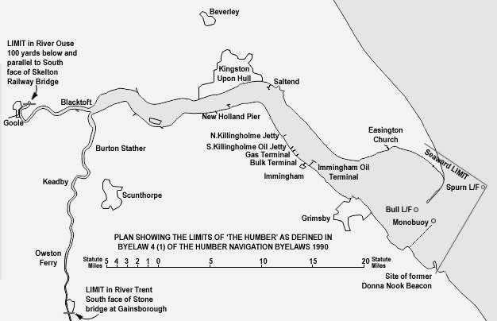
Pilotage
The Harbour Limits – 145 m²

Slide 4
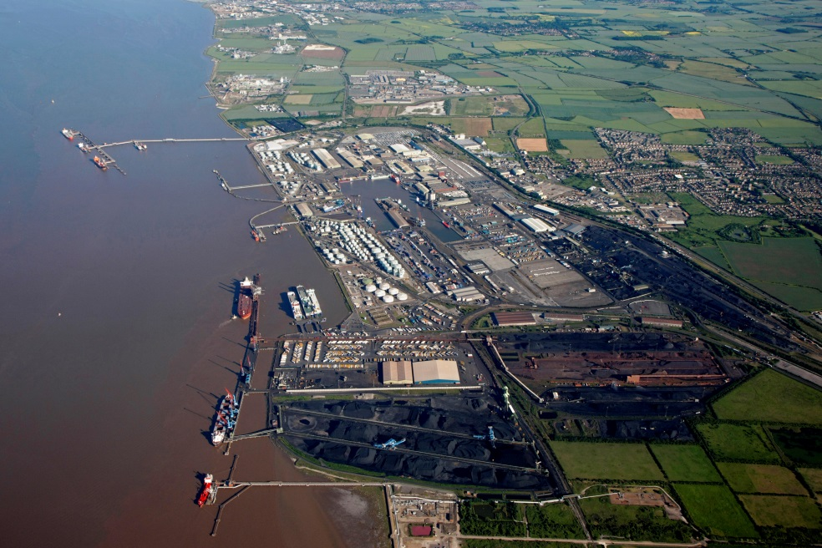
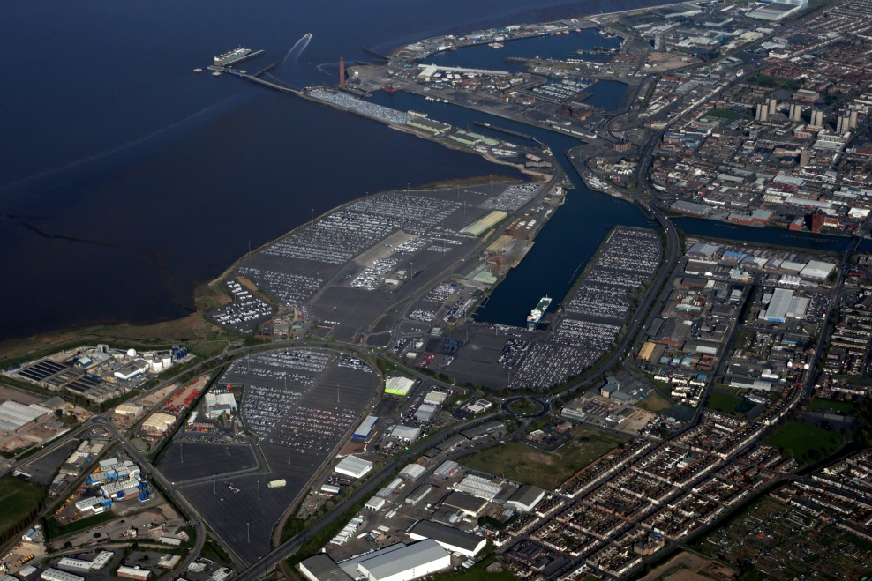
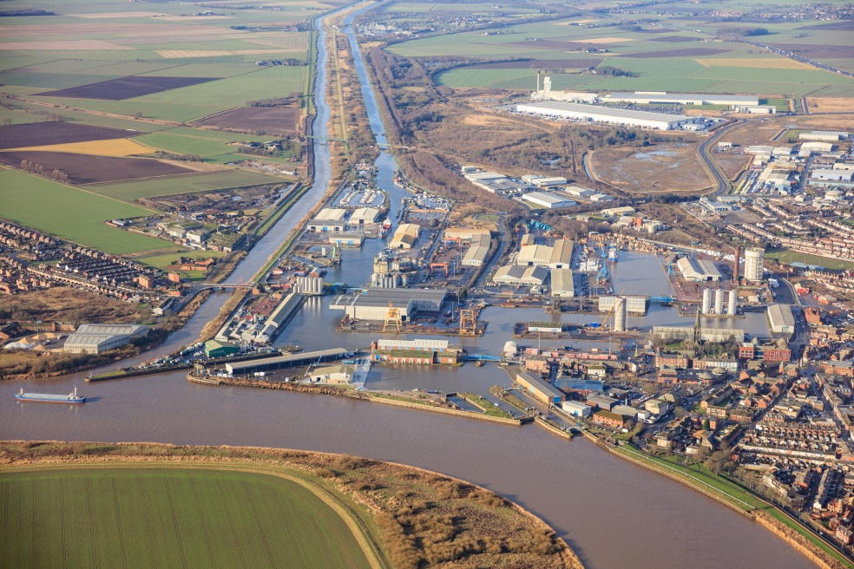
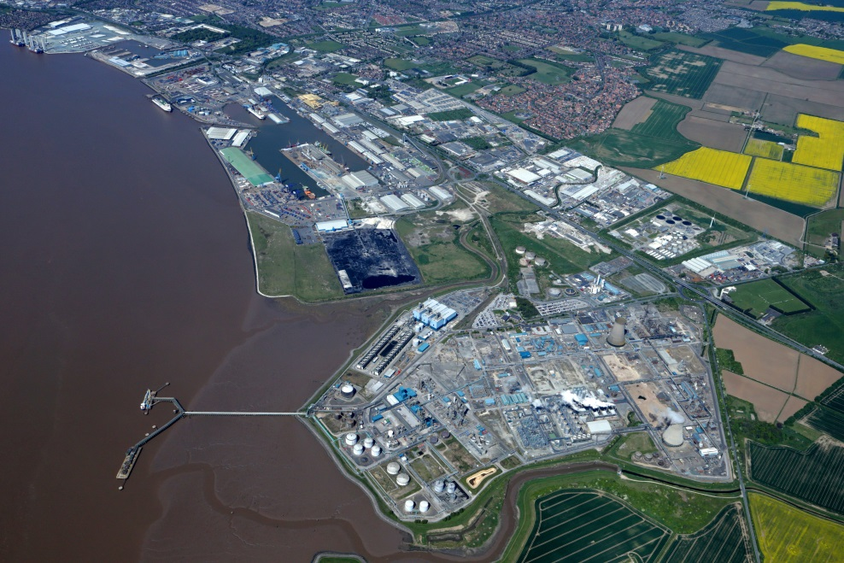
Immingham
Grimsby
Goole
Hull

Slide 5
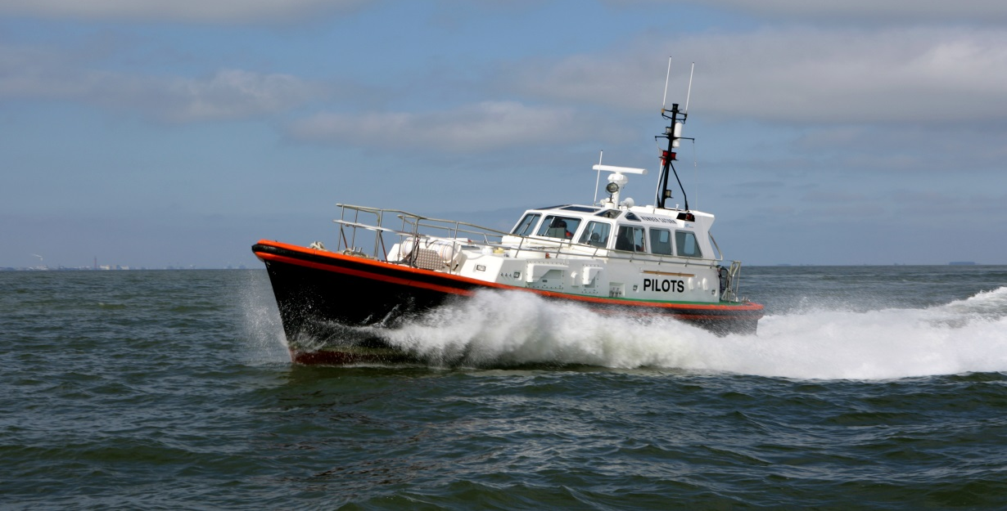
Pilotage
HES operate a pilotage on demand service.
Any vessel over 60 metres in length requires a pilot unless it is covered by a valid Pilotage Exemption Certificate holder.
There are currently 108 authorised pilots and 11 trainees.
Of these, we have 21 dedicated VLS pilots who assist in the safe navigation of vessels in excess of 40,000 dwt or 11 metres in draft.
Currently have 170 authorised PEC holders.

Slide 6
Pilotage Figures
Ship Moves - up by 809
Pilot Moves - up by 1047
PEC Moves - down by 238 ships
 | 2015-2016 | 2016-2017 | Change
ABP Acts | 15984 | 17031 | 6.55 %
VLS Moves | 1020 | 994 | - 2.62 %
Non VLS Moves | 14964 | 16037 | 7.17 %
PEC Acts | 8769 | 8531 | - 2.79%
Total Moves | 24753 | 25562 | 3.27 %

Slide 7
Humber Incidents
Humber Incidents
 | 2014 | 2015 | 2016 | 2017
Bridge Jumper | 13 | 8 | 4 | 4
Man Overboard | 4 | 0 | 1 | 2
Close Quarters (Near Miss) | 10 | 10 | 8 | 5
Contact with Floating Mark | 5 | 4 | 10 | 1
Contact with Structure | 76 | 63 | 35 | 59
Failure to report to VTS | 1 | 0 | 2 | 2
Grounding (Fail to complete) | 10 | 10 | 7 | 7
Grounding (Off in same tide) | 49 | 43 | 11 | 17
Pollution | 8 | 9 | 3 | 7
TSS Contravention | 5 | 2 | 10 | 0
Ship Defect | 196 | 189 | 127 | 245
Incident Statistics, 19 Pilot ladder, 40 Bow Thruster, 186 Reported to MCA.

Slide 8
Key Statistics
In September 2017 the DfT released the
revised UK Port Freight Statistics for 2016.
UK Ports handled 119,000 freight vessel arrivals in total. Of these more than 13,100 were berthed within the Humber Ports.
Comparisons with other UK ports include :
Teesport - 4,000
Liverpool - 6,000
Port of London - 8,000
Only Dover facilitated more freight moves than the Humber during 2016
When including each vessels departure and combining barges, tugs, pleasure craft and ABP vessels – the River Humber handled in excess of 50,000 moves in 2016.

Slide 9
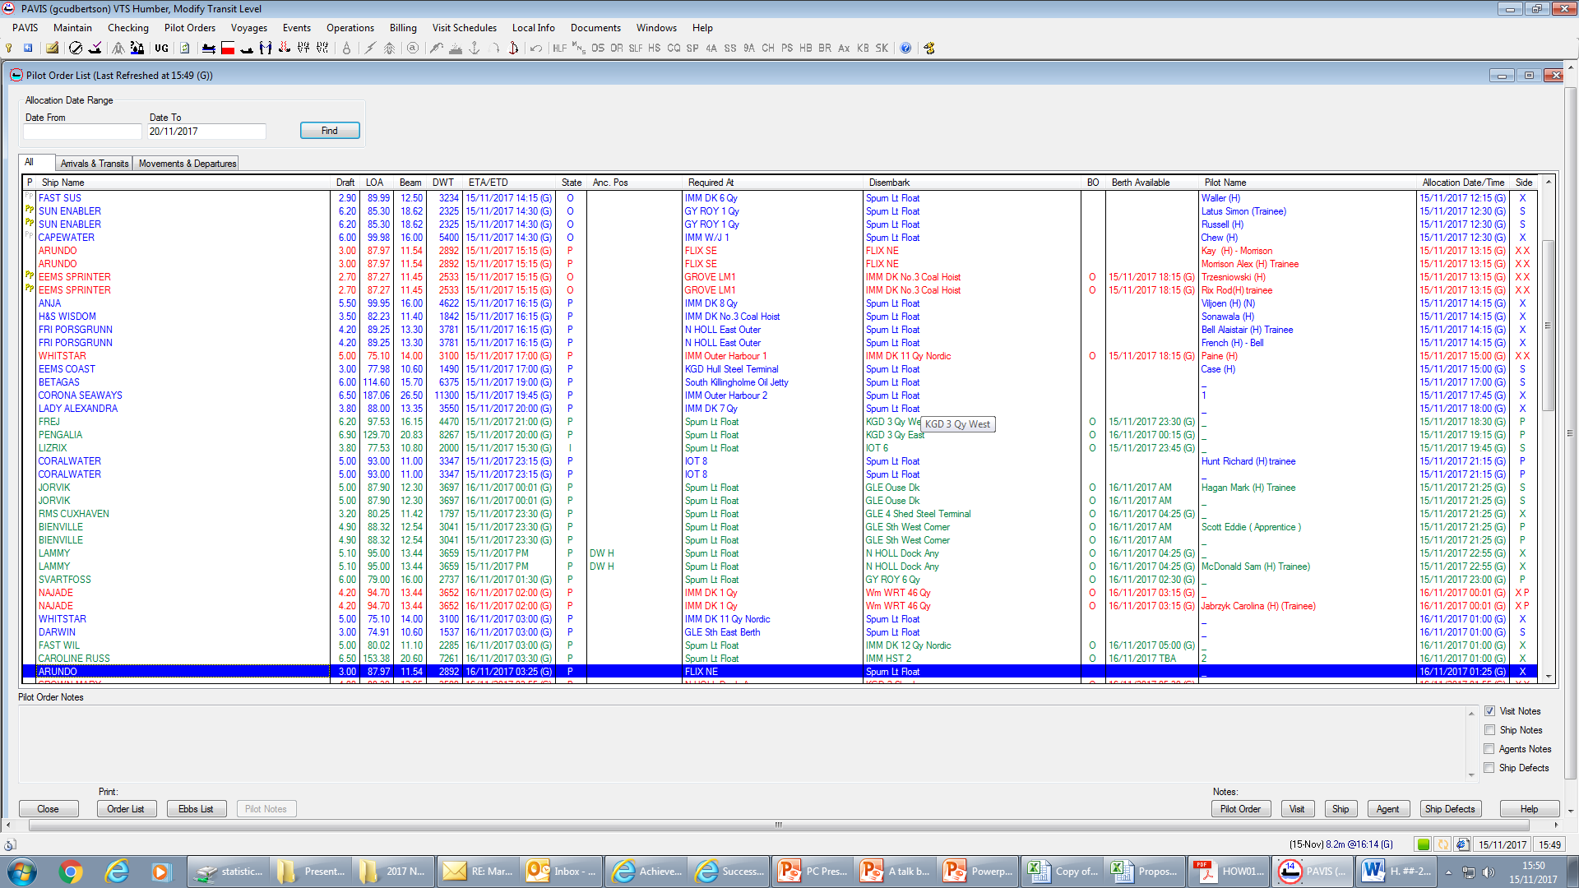
Vessel Traffic Services
Vessel Traffic Services (VTS) and the VTS Data Centre combine for vessel input and updates within PAVIS (Port and Vessel Information System).
PAVIS was introduced in 1998 as the Traffic Management System for the River Humber. Its primary purpose was to facilitate the safe navigation of vessels transiting the River.

Slide 10
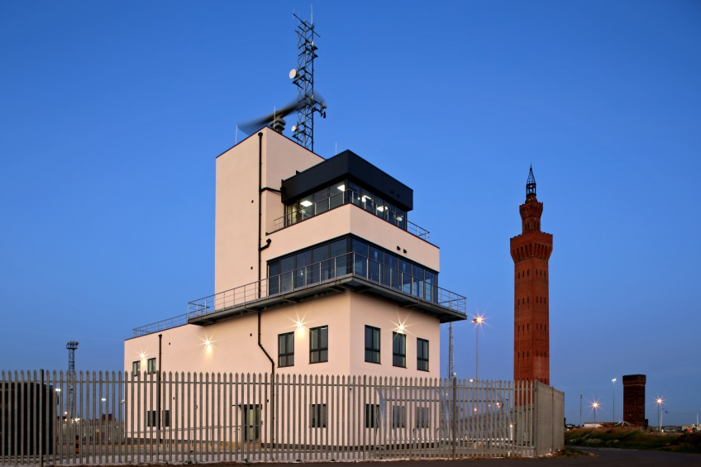
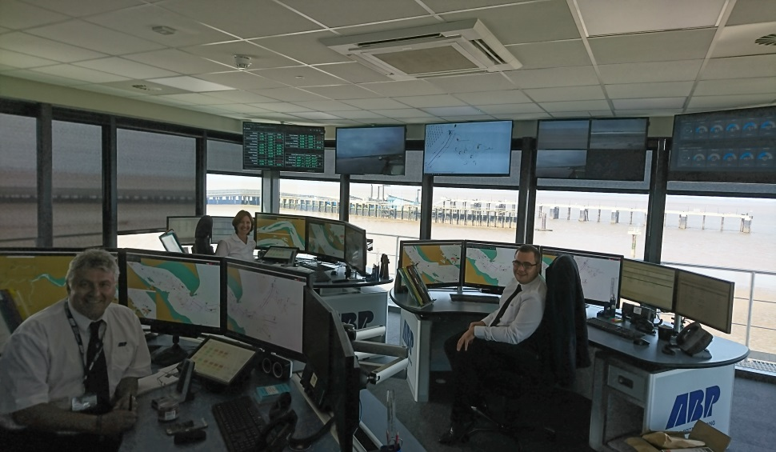
Humber Marine Control Centre
The Humber Marine Control Centre was a £5.2 Million investment from ABP. This is now the home to the Assistant Dock Master for Grimsby, VTS Humber which relocated from Spurn Point and VTS Data Centre which relocated from Hull.
Vessel Traffic Services (VTS) pictured right, contribute to the safety of life at sea, safety and efficiency of navigation, the protection of the marine environment, the adjacent shore area, worksites, and other offshore installations from possible adverse effects of marine traffic.

Slide 11
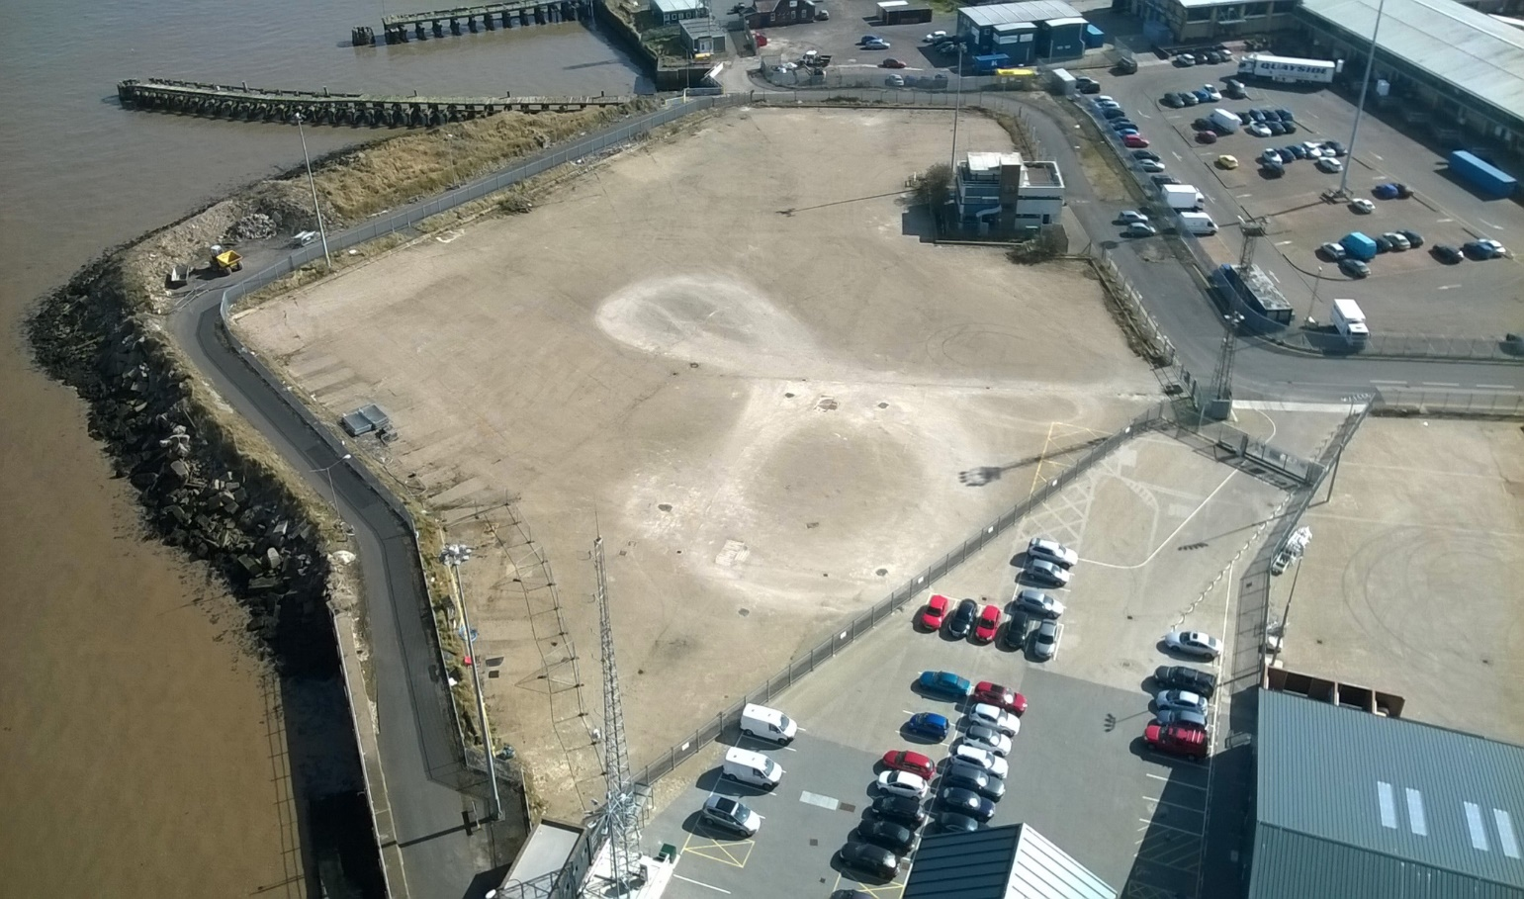
Humber Marine Control Centre
The site was identified between Grimsby Royal and Fish Docks.

Slide 12
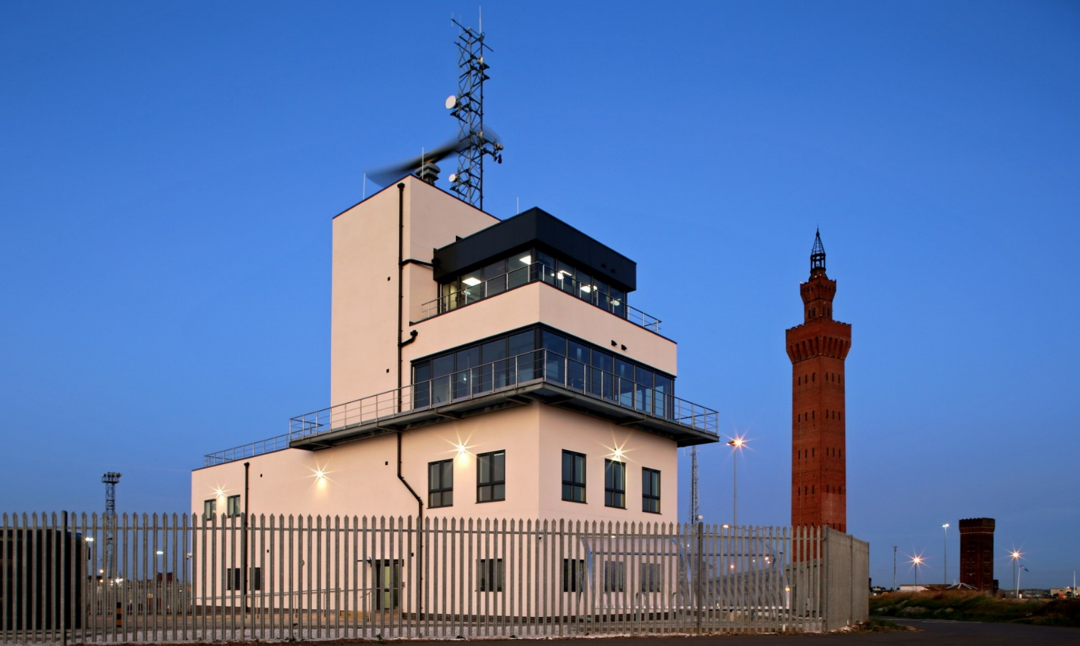
Humber Marine Control Centre
Humber Marine Control Centre was opened on 22nd August, one year to the date of breaking ground.

Slide 13
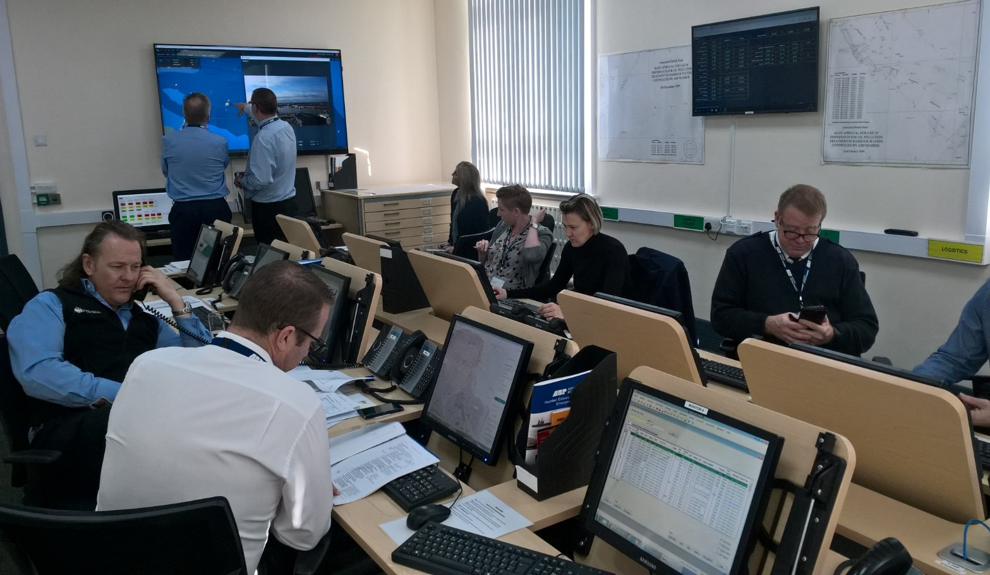
Marine Response Centre
Grimsby Port Office Resilient Suite Marine Response Centre
HUMEX 14 November 2017.

Slide 14
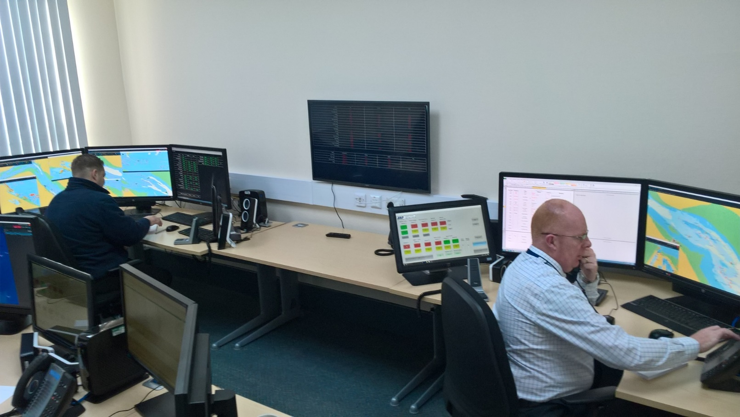
VTS Resilience Suite
Grimsby Port Office Resilient Suite Marine Response Centre
HUMEX 14 November 2017.

Slide 15
Hydrography
3 survey craft: ‘Humber Ranger’, ‘Humber Charter’ ‘Humber Sounder’.
At least 600 million soundings forming 800 individual surveys per annum resulting in 25 km of paper charts being produced.
The Humber drains an area the size of 1/5th of the UK (almost 25,000km²) on each tide with a tidal range of up to 7.4m.
This requires constant hydrographic surveying of which the results are promulgated to Mariners and stakeholders within hours of completion making it potentially the most efficient system in the world.

Slide 16
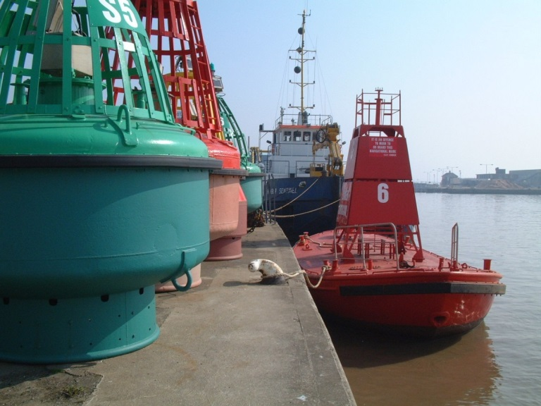
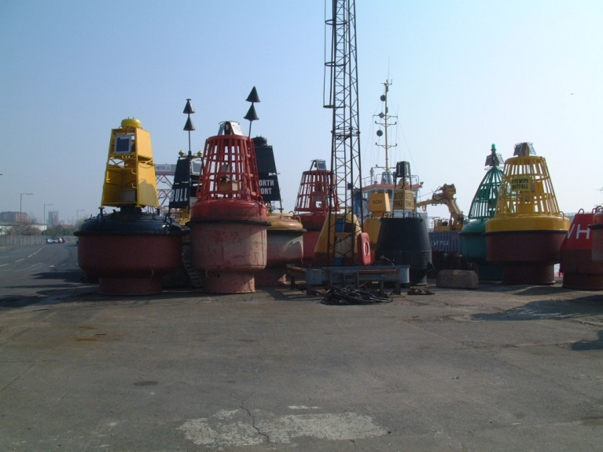
Conservancy
Mariners on the Humber utilise more than 500 Aids to Navigation. These can be lights or buoys . Although we do not own them all, as the Local Lighthouse Authority, ABP has the responsibility to ensure that ALL are monitored, maintained or replaced as efficiently as possible.
HES relies on revenue raised by conservancy dues on vessels entering the Humber from sea to enable it to maintain a safe and environmentally-sustainable harbour for the benefit of all estuary users.
Maintenance and conservation of the Harbour Authority area through dredging, lighting, provision of buoys is funded by charging conservancy dues.

Slide 17
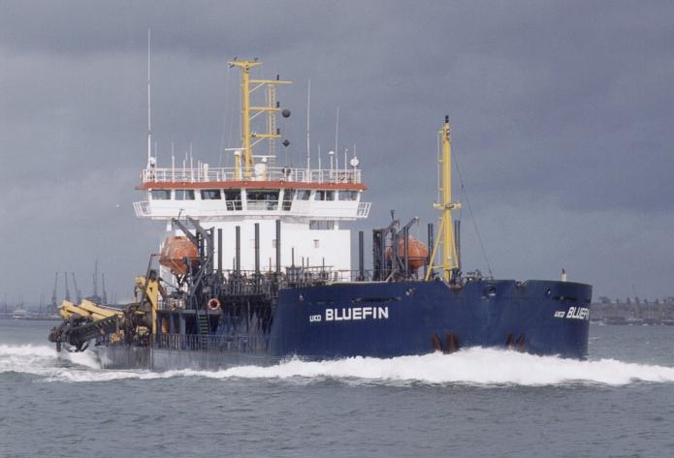
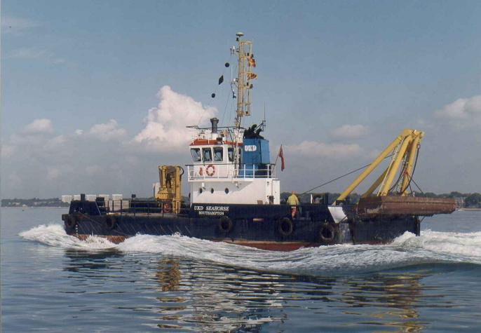
DREDGING ON THE HUMBER
The Noble Art of Moving Mud
ABP has a duty to maintain water depths in our ports and on our jetties to ensure that vessels using the port have the required Under Keel Clearance for the duration of their visit.
In order to meet this commitment we deploy a fleet of dredgers of varying size and capability to take up the challenge of keeping our berths clear, this is a 24 hour, 365 day operation that requires a lot of strategic planning and surveying and involves the movement of enormous quantities of river mud.

Slide 18
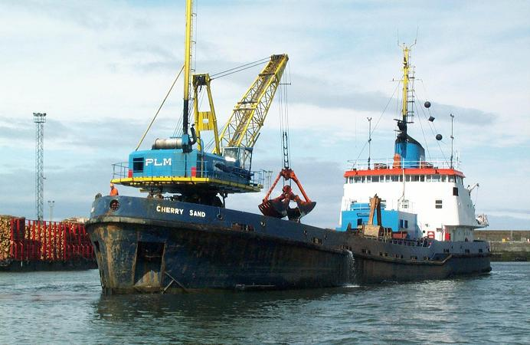
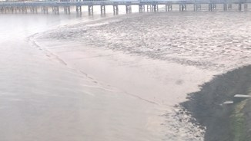
DREDGING ON THE HUMBER
In 2016 we dredged a total of 4,900,000 tonnes of mud.
You may be surprised to hear that the mud we handle is not taken out of the river but is quite literally moved to specific areas within the river designated as disposal sites and allowed to return into suspension thus replenishing the estuary’s sediment budget.
This is due to the environmentally sensitive nature of the estuary which is monitored, licenced and regulated by the Marine Management Organisation and the Environment Agency.

Slide 19
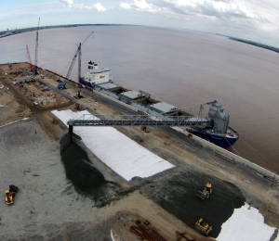
DREDGING ON THE HUMBER
However in one innovative project involving working with the MMO, Environment Agency and the Crown Estate we were able to re-use the dredged material as infill for the Siemens Green Port Hull project

Slide 20
Any Questions?

