Slide 1


WELCOME
HMWG
Humber Estuary Relevant Authorities Group
1st February 2018
OWC LOGO
ABLE – Dave Sargent
Environmental Manager
Notes:
Background to the scheme, not intended to discuss all the specific details

Slide 2
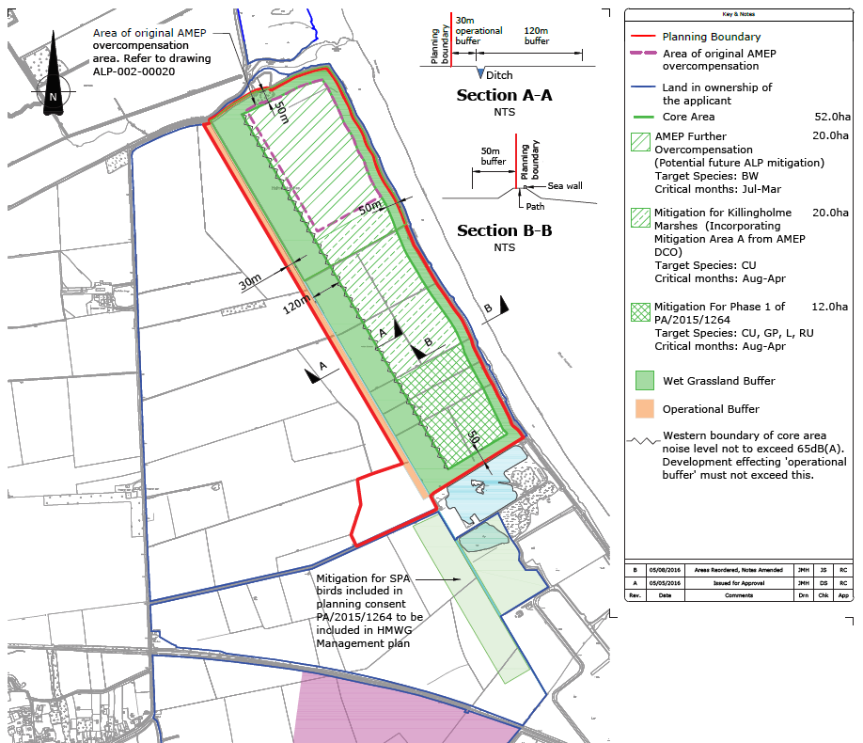
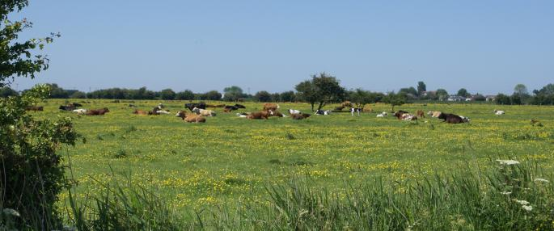
Scheme objectives
SHG requires circa 100ha total area of mitigation for all development
Able Marine Energy Park - Mitigation Area A, Killingholme Marshes
Able Logistics Park – mitigation at Halton Marshes
Potential development of remainder of Killingholme Marshes
Opportunity to provide a single mitigation habitat area
Hatched areas denote the required mitigation AREA for various development options, and do NOT indicate the specific location of allocation, it demonstrates the site is large enough to accommodate the requirements of separate development opportunities
Notes:
Hatched areas denote the required mitigation AREA for various development options, and do NOT indicate the specific location of allocation, it dem,onstrates the site is large enough to accommodate the requirements of separate development opportunities

Slide 3
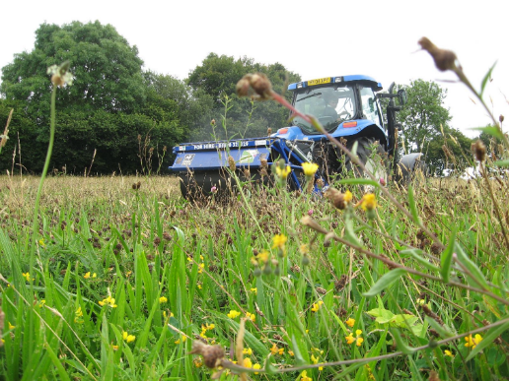
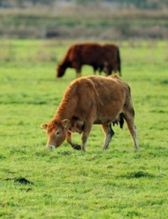
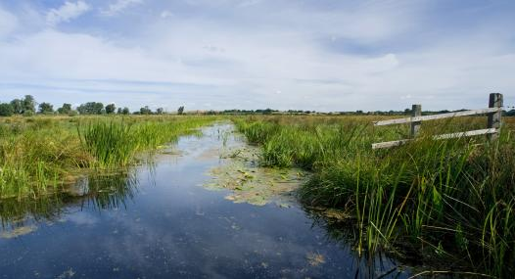
Scheme summary
Creation of circa 90 ha of managed wet “lowland neutral” grassland
~50 ha of scrapes and bunds
~40 ha of undrained grassland
~1500m Hedgerow removal
Annual cover winter seed crops
~1600 m new ditches and hedgebank planting
Notes:
General shots of lowland grazing marsh from internet – so thanks to all the sources
The removal of mature hedgerows doesn’t sit comfortably at all – especially as its acknowledged that 20ha core area is acceptable – and the birds were using this landscape in the form it was previously – hedged!

Slide 4
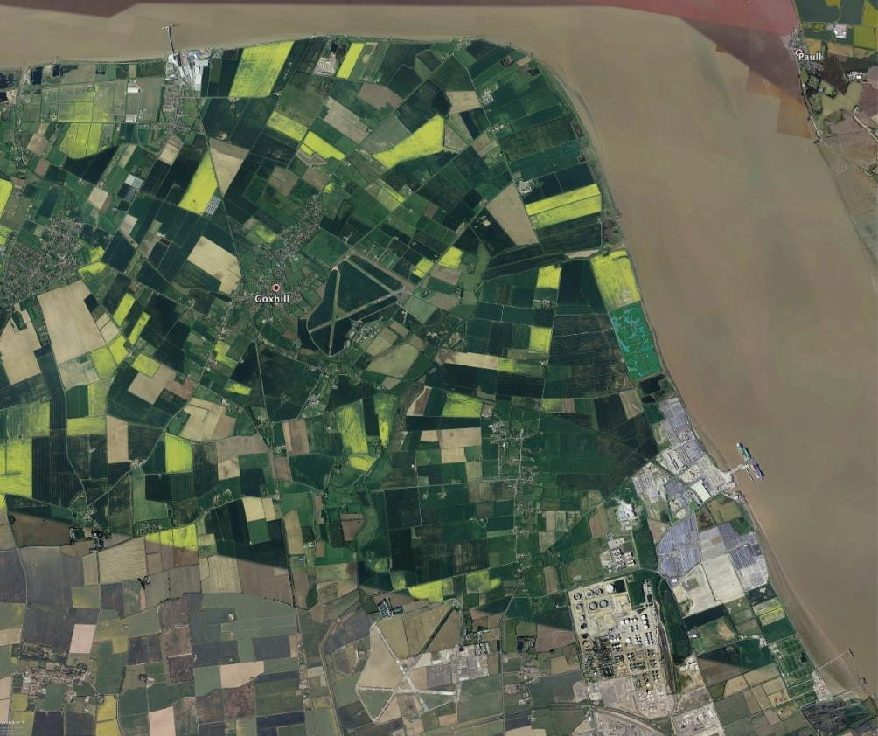
local context
Notes:
Location with north Lincs sits in a currently predominantly agricultural landscape to the north of Humber Sea Terminal

Slide 5
Existing habitat
Notes:
Ok, so for those who are not familiar with the site, we will look briefly at the site features in its current condition

Slide 6
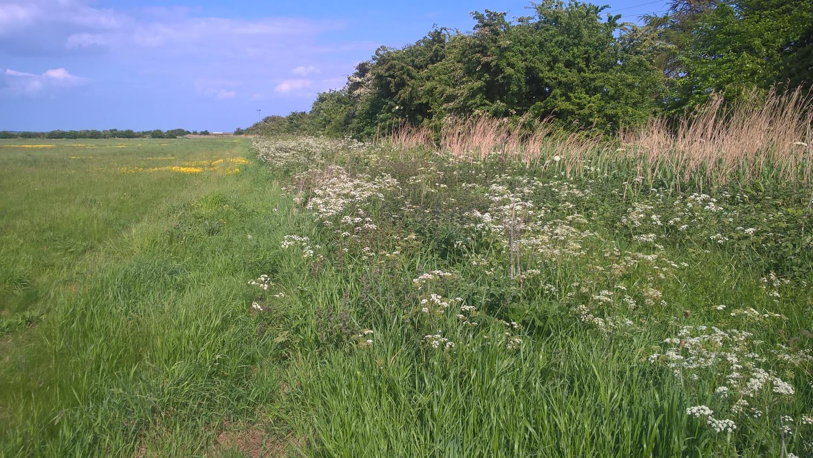
Current condition
Southern boundary hedge
Notes:
Southern boundary hedge alongside “winters pond” will be retained

Slide 7
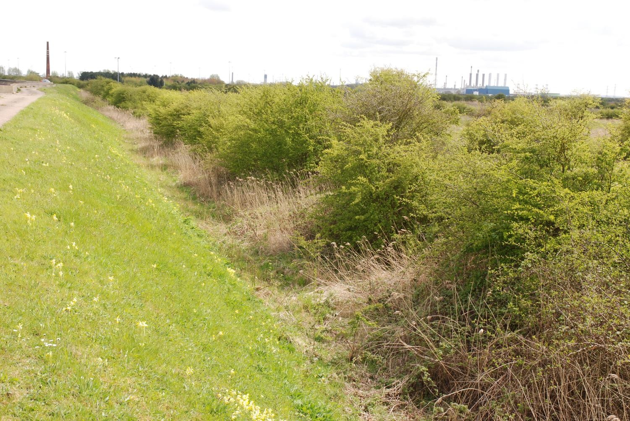
Current condition
Soke dyke hedge
Notes:
Southern end of the eastern boundary – flood wall, soke dyke and hedge. Existing vegetation acts as screen to and from the proposed wet grassland site.
Soke dyke to be selectively cleaned out and vegetation transplanted in new northern ditch

Slide 8
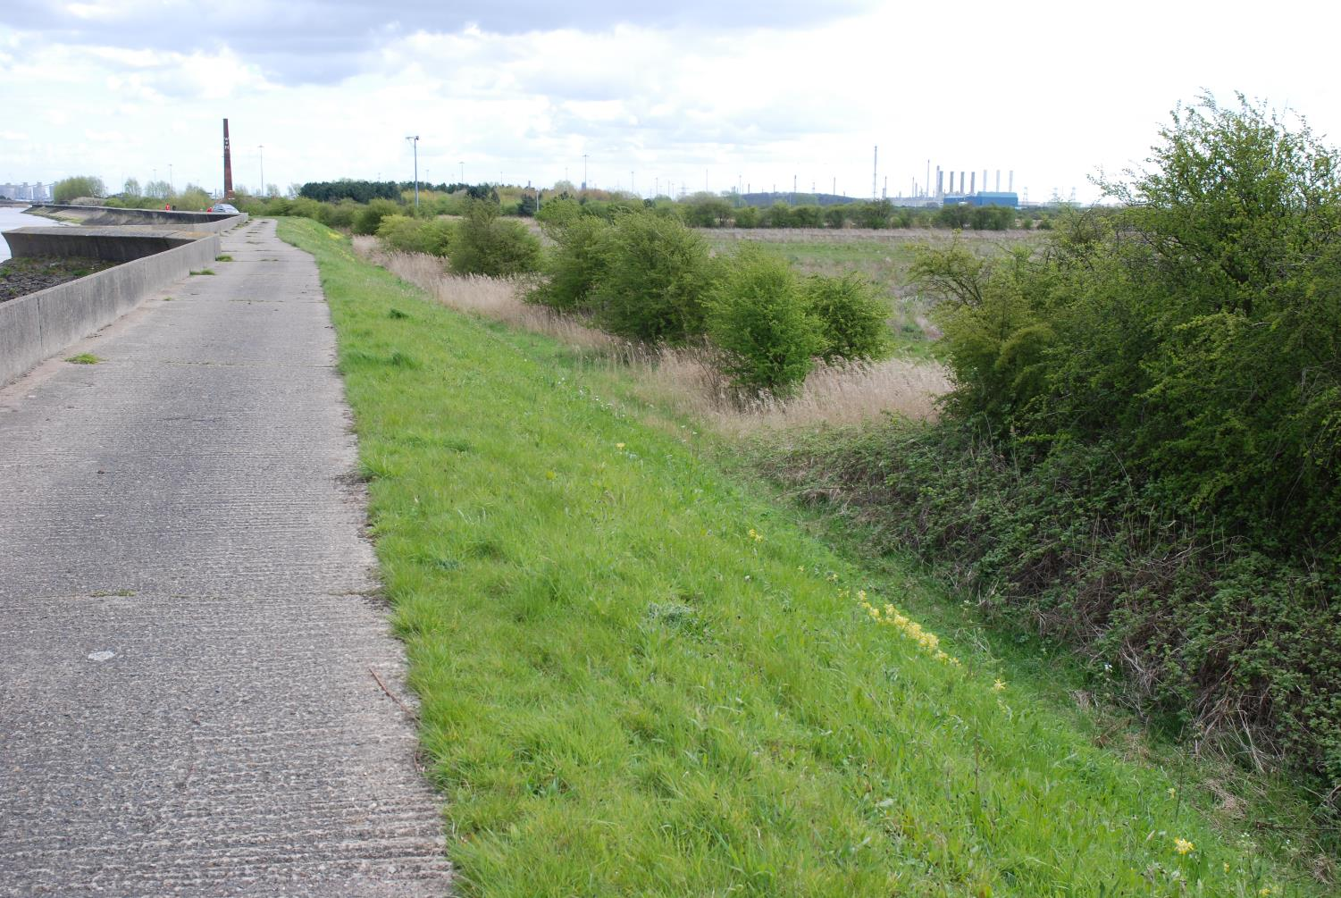
Current condition
Soke dyke hedge

Slide 9
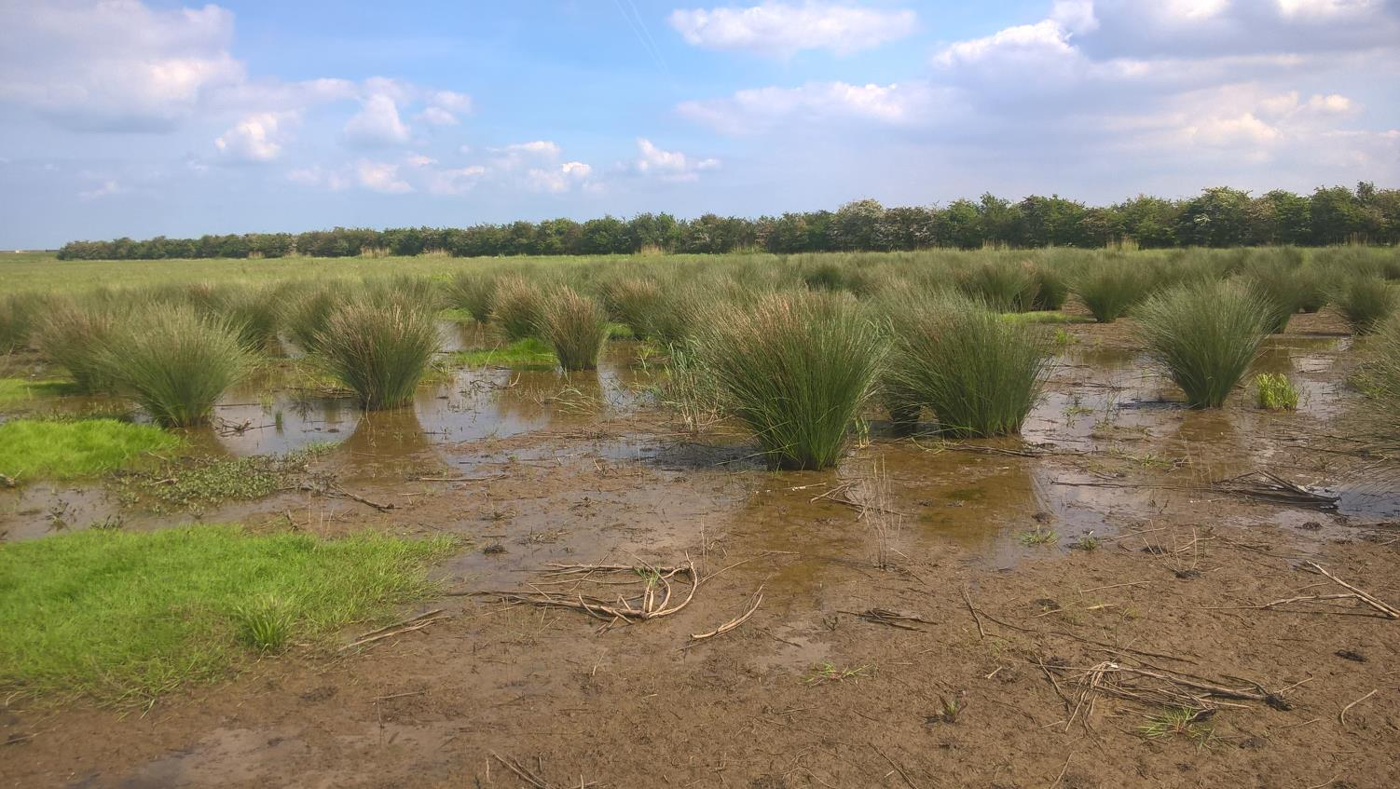
Current condition
Possible artesian water
Notes:
Year round wet ground and associated rush vegetation in Northern Field is believed to indicate artesian water escaping through a historic tube well installed for stock water supply. Development planning condition is to locate and formally de-commission this and any other wells found during excavation work.
Hedge in background is the retained cross hedge – originally planned to lay , but at quotes of around £15k, this option will not be viable – alternative will be to “pollard” and/or “coppice” with interplanting as required.

Slide 10
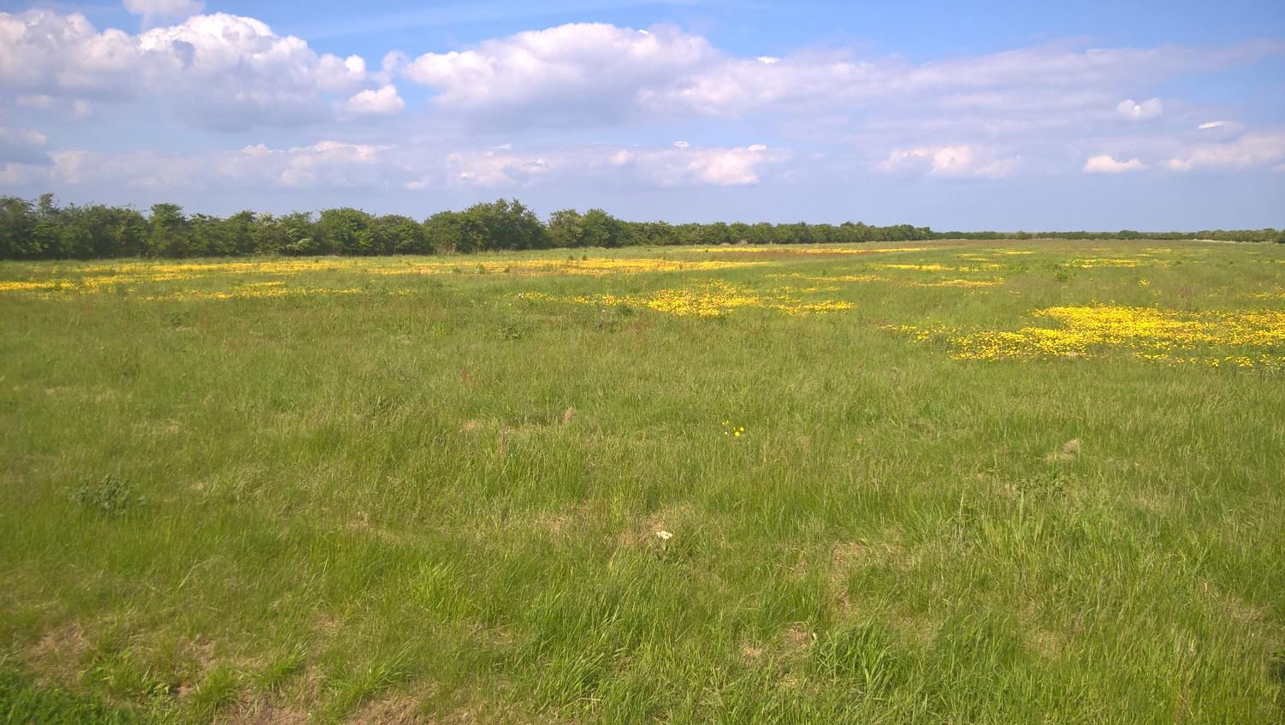
Current condition
Existing sward
Notes:
Without intervention, other than recent annual mowing, the arable fields have reverted naturally to an increasingly diverse neutral grassland

Slide 11
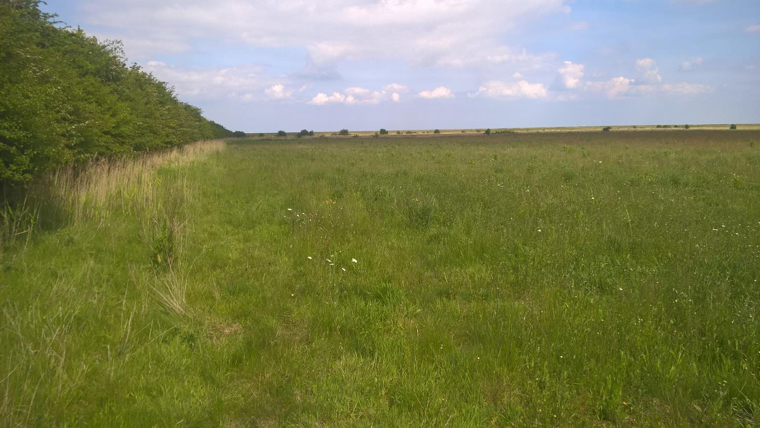

Slide 12
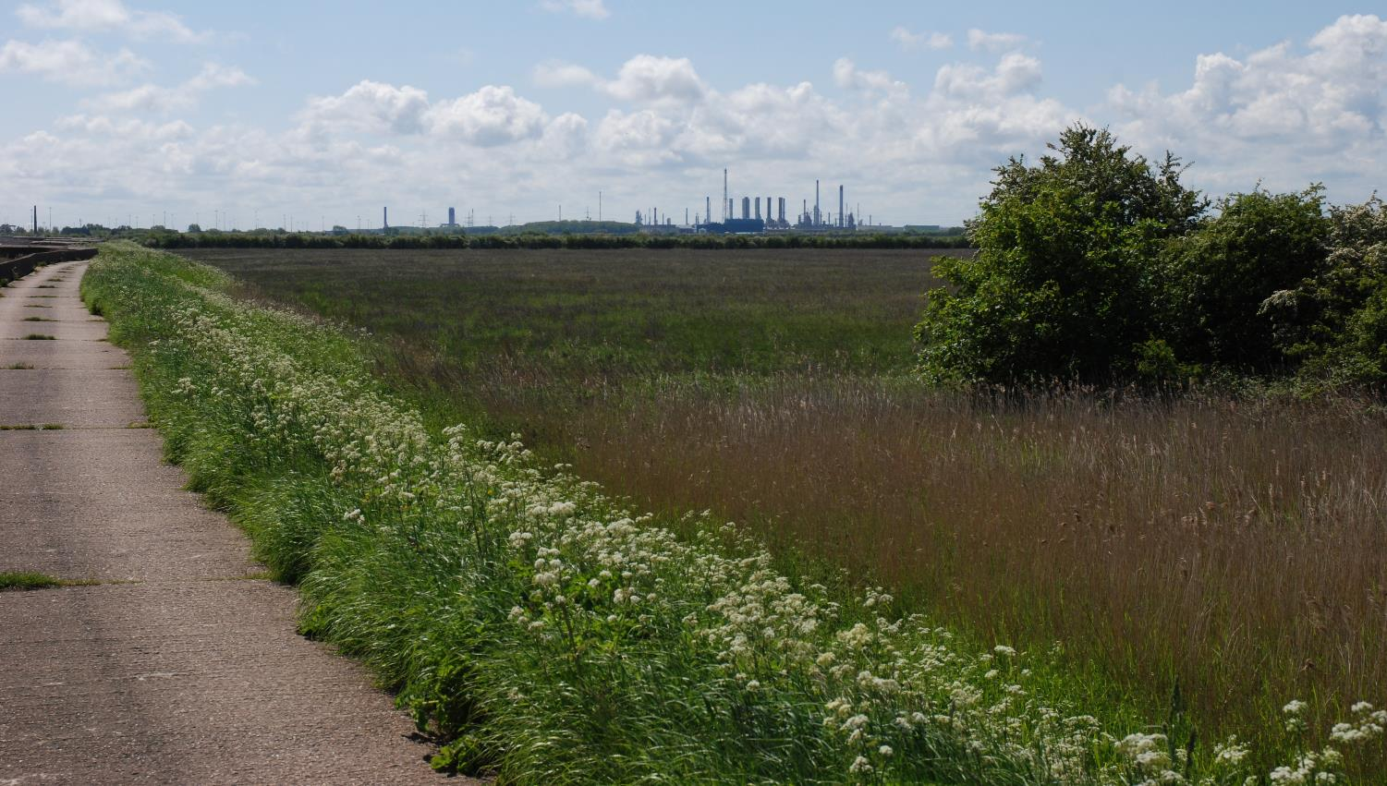
Current condition
Northern field

Slide 13
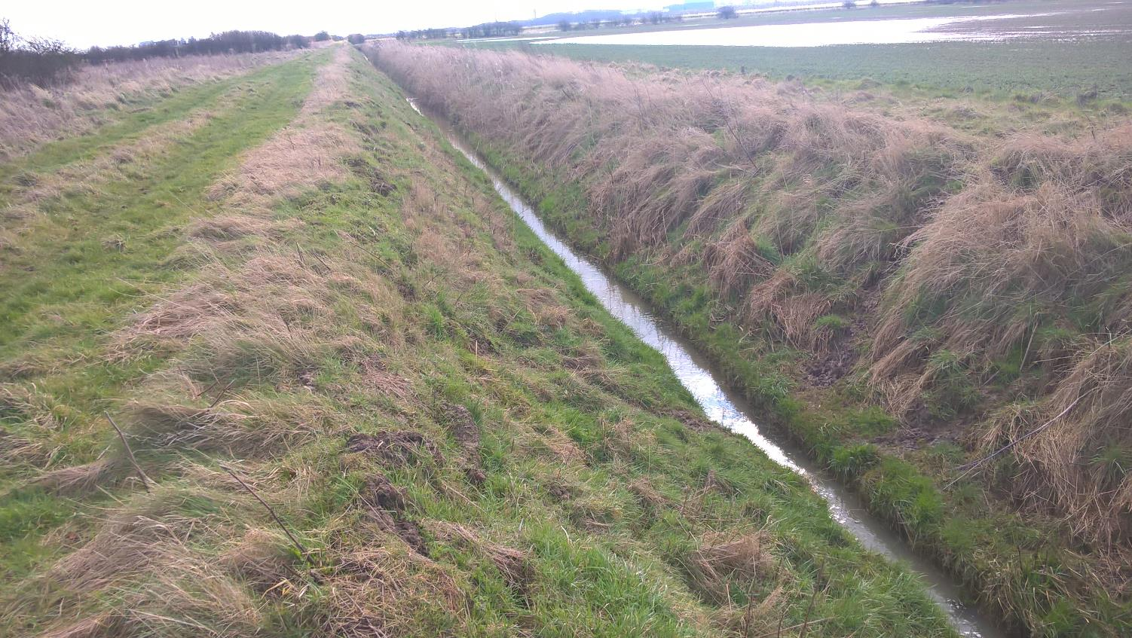
NELDB ditch on western boundary

Slide 14
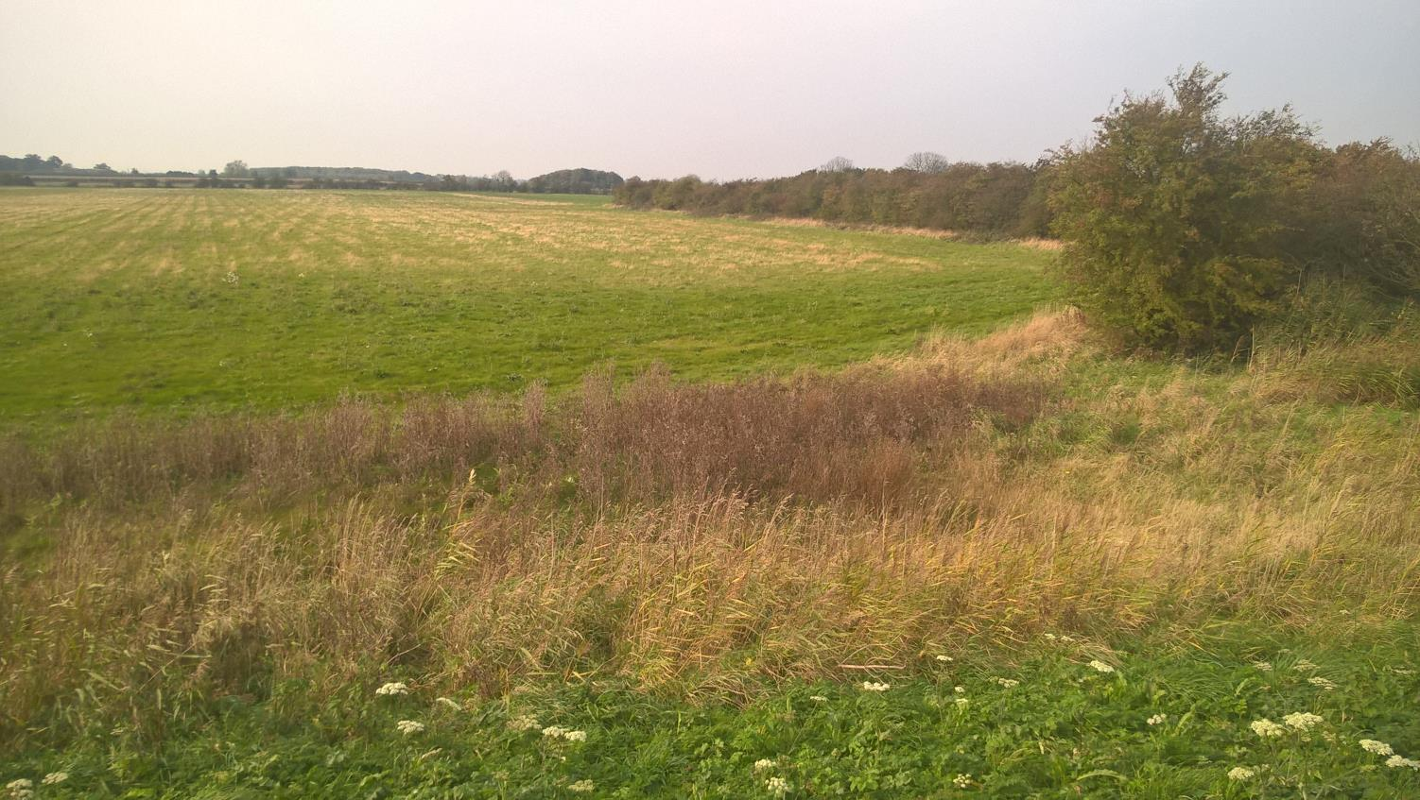

Slide 15
Local Ecological context

Slide 16
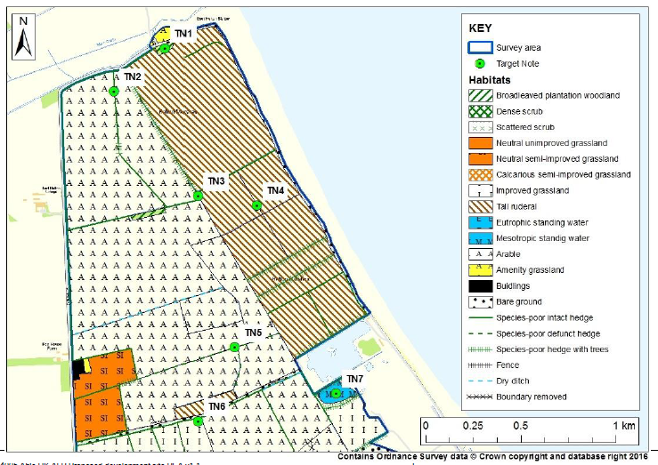
PEA undertaken in 2016 to assess validity of original assessments
Concluded that the basis of ecological mitigation remains consistent with the original application

Slide 17
Which Targets to set ?

Slide 18
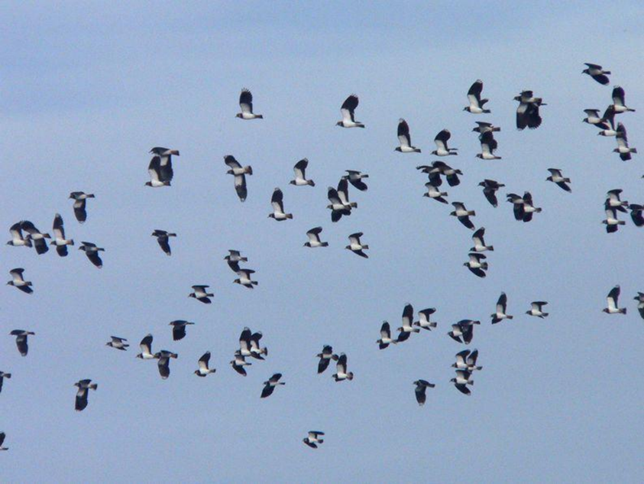
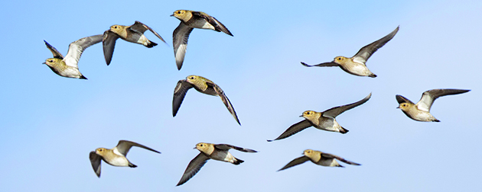
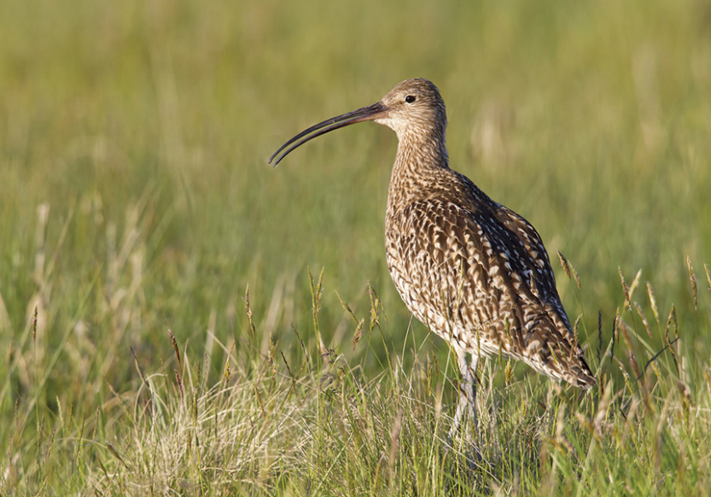
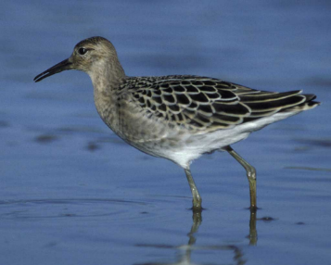
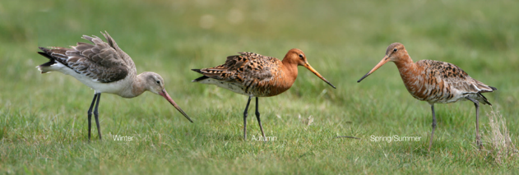
The emphasis is provision of habitat for passage, migration and overwintering
Any breeding benefits are “incidental”
5 key SPA Species were chosen
Lapwing
Golden plover
Curlew
Ruff
Black Tailed Godwit

Slide 19
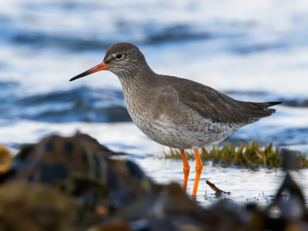

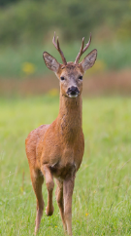
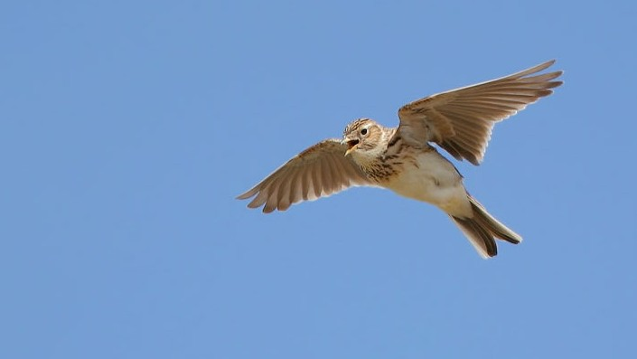
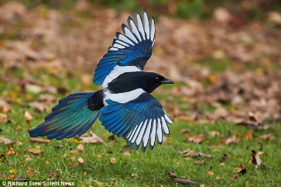
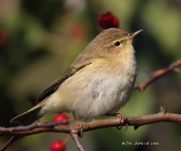
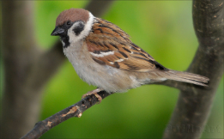
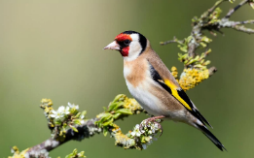

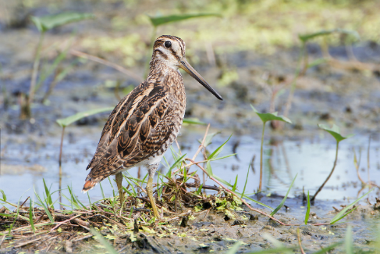
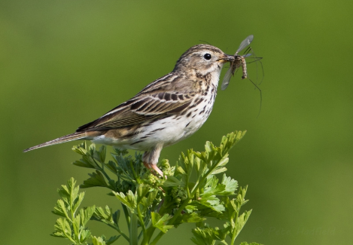
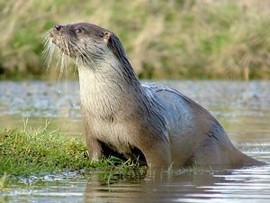
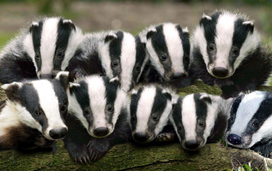
Which other species will benefit?
The list of beneficial species is extensive and is part of the formal management objectives
Specific requirements for “farmland birds”
Bats and otters will benefit
But so might nesting birds “pest species” such as corvids and badgers

Slide 20
Halton Marshes Wet Grassland : detailed design

Slide 21
LIDAR data shows low lying ground which are utilized within the design
Notes:
LIDAR data shows low lying ground which are utilized within the design

Slide 22
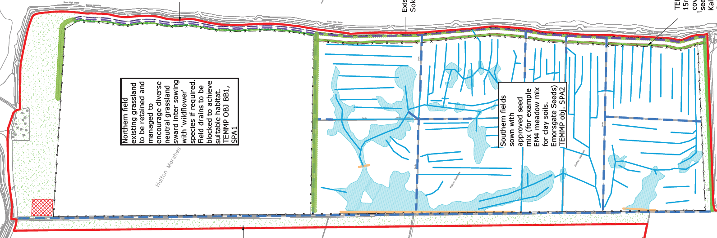
15m wide wild bird coverstrip. Species to be seeded include: Kale
Quinoa
Mustard and
Oilseed
New boundary ditch and hedgerow bank
Existing vegetated soke dyke and boundary hedgerow
Northern field existing grassland to be retained and managed to encourage diverse neutral grassland sward. Inter-sowing with wildflower species if required.
Field drains to be severed / blocked to increase soil moisture
Southern fields to be reseeded only in areas of bare ground following completion of the works. Seed mix to be agreed by NLC
30m operational buffer to be seeded and managed for diverse neutral grassland

Slide 23
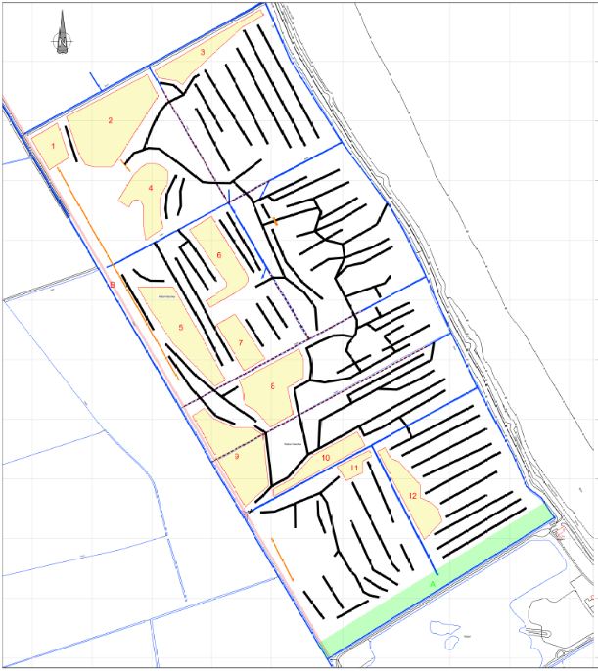
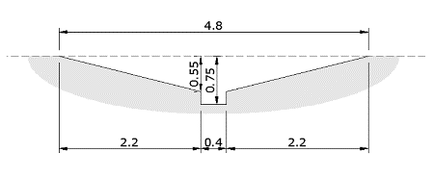

HMWG : extent of earthworks
Scheme has been designed with a balanced “cut and fill”
~10 km of scrapes
Material arising from scrapes remains on site
Yellow areas are for deposition, typically 125mm depth
Creates additional habitat diversity
Cross section of scrape

Slide 24
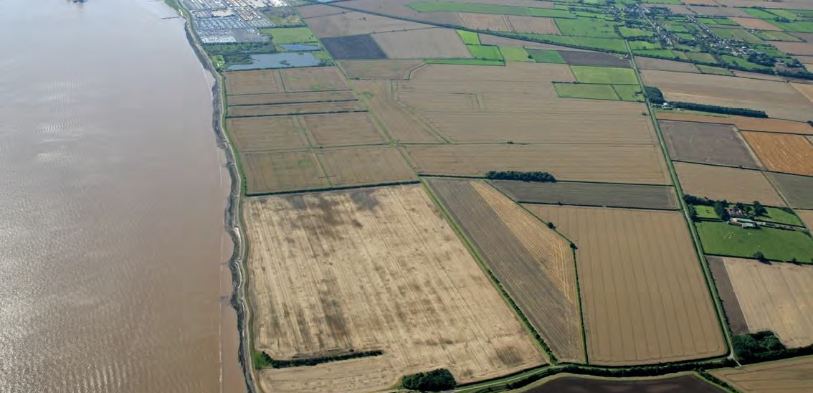
The site
Site management
HMWG application site
Management plan will also include the Local wildlife site within Able ownership
East Halton Clay pits Local wildlife site – Able controls shooting rights

Slide 25
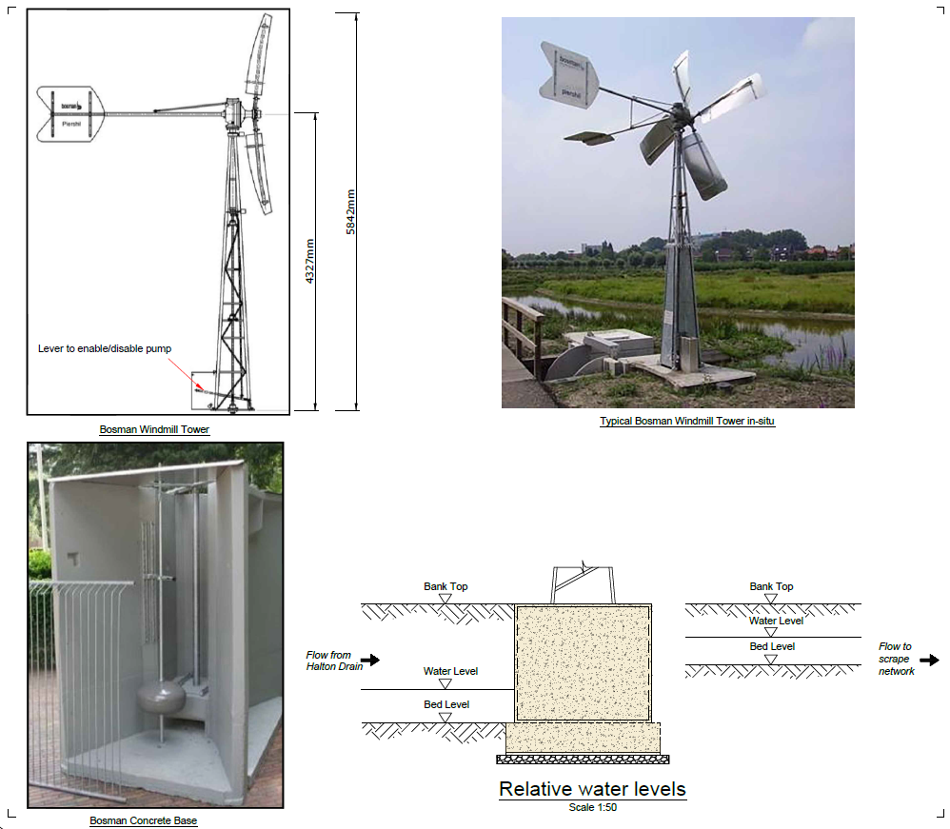
Year round abstraction licence obtained
2mm eel screen between 1st May and 31st October
9mm eel screen between 1st November and 30th April
33,000m3 per annum
2,856 m3 per day
119 m3 per hour
33 litres per second
  ~11.5 days

Slide 26
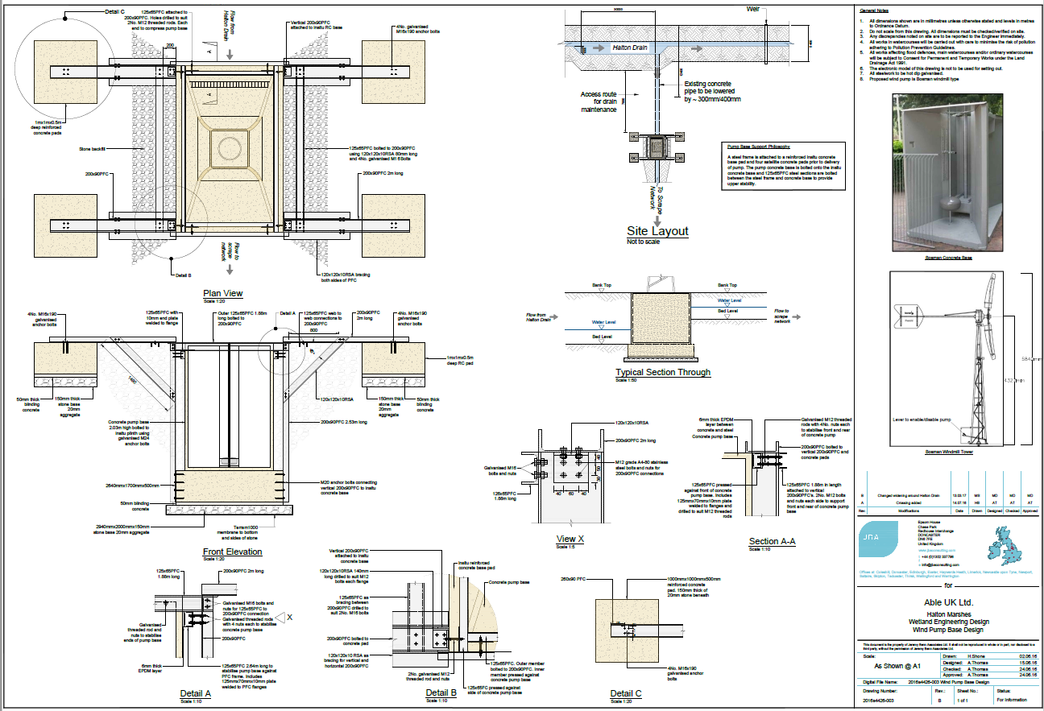

Slide 27
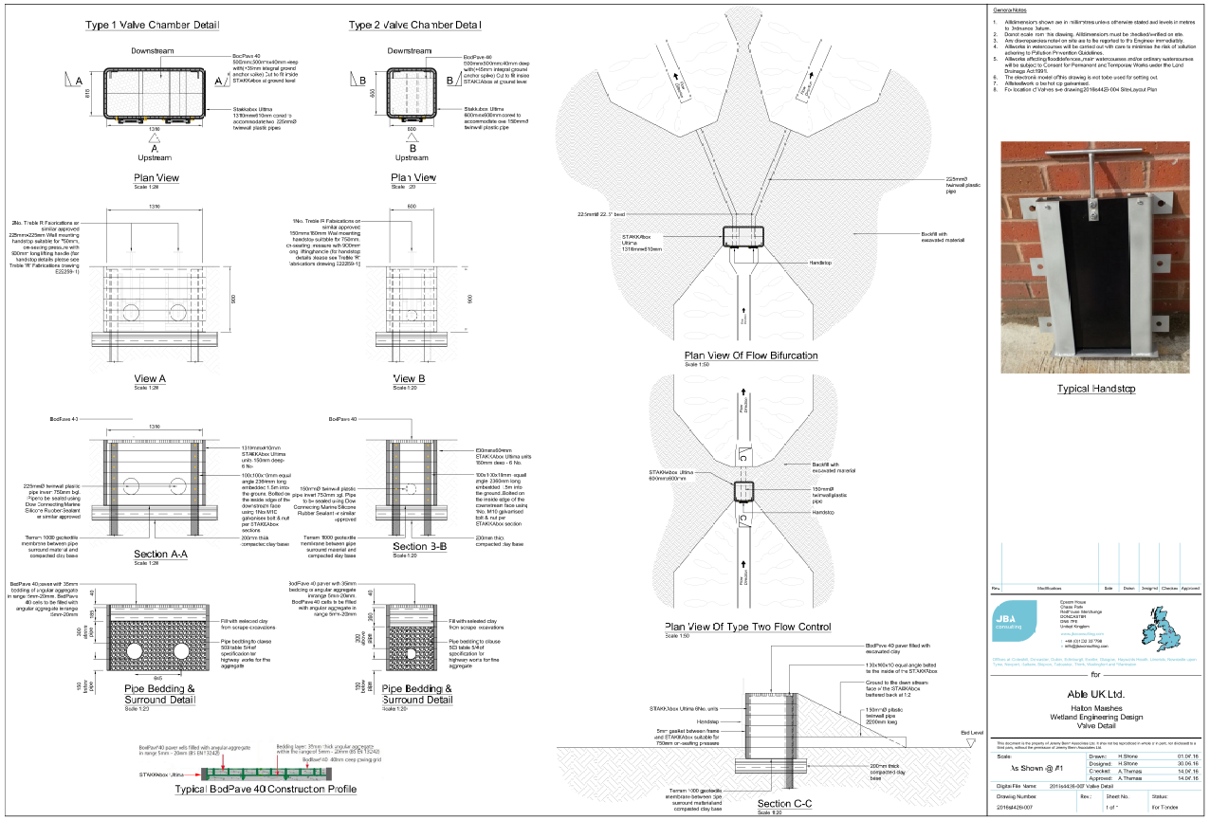

Slide 28
Ongoing surveys and investigations

Slide 29
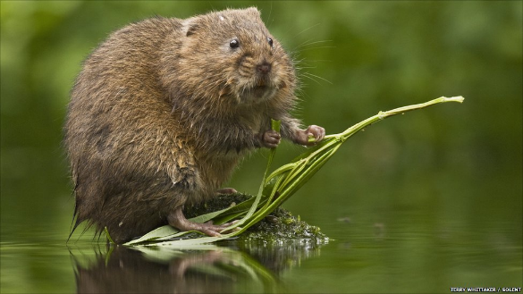
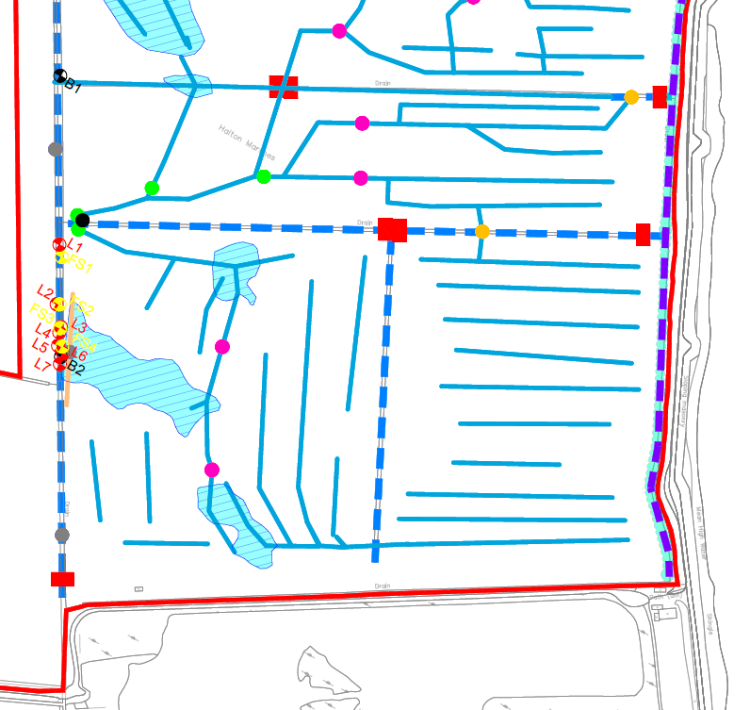
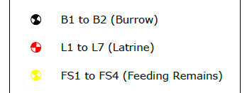
Water voles
Full season watervole survey undertaken in 2017
Small population in north end of NELDB ditch away from work
No burrows recorded in vicinity of works – further investigation to be undertaken
“strimming deterrent” in vicinity of work appears to have had opposite effect!

Slide 30
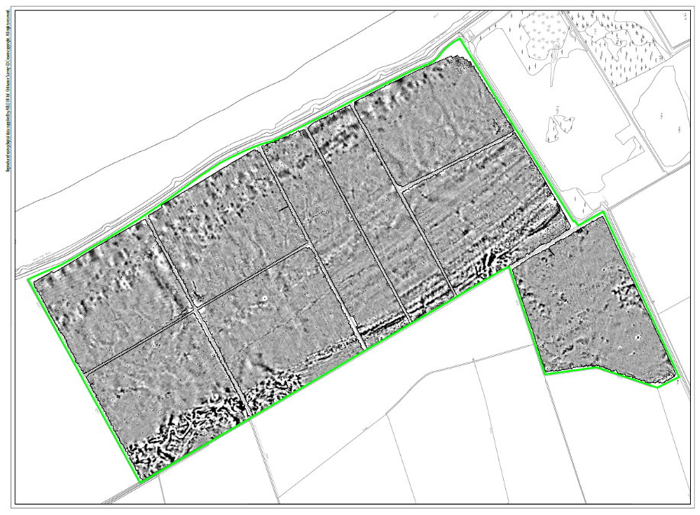
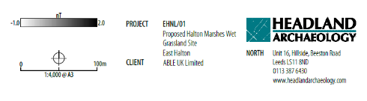
Archaeology – geo-phys
100% geo-phys survey November/December 2017
Used to guide watching brief requirement
Features of interest along western boundary
Wavelines/beaches??
Paleo channel

Slide 31
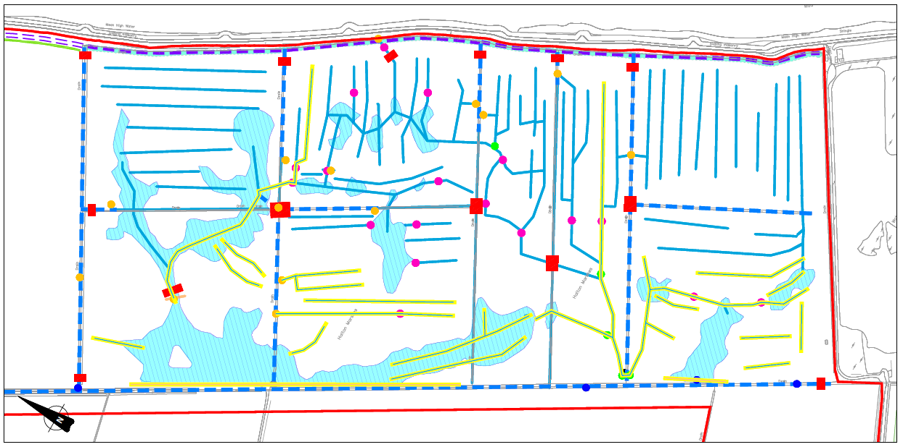
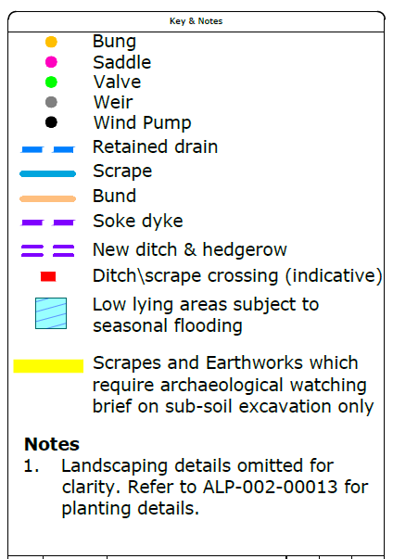
Excavation inspection/watching brief

Slide 32
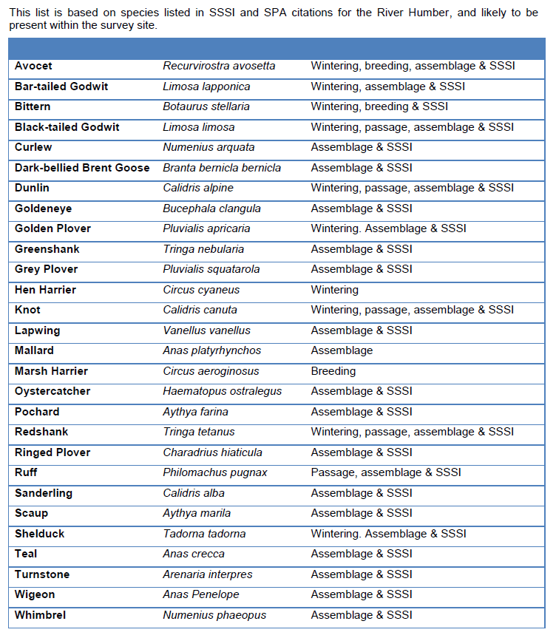
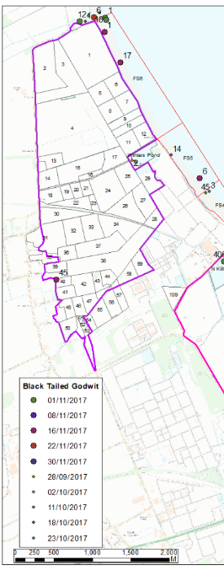
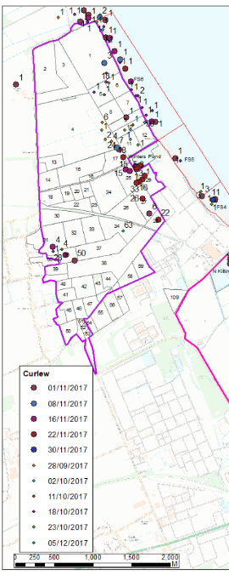
SPA Bird surveys
NE brief states that passage surveys should be weekly, between the beginning of September and the end of November for Autumn, and from the beginning of March to mid-May for Spring. Winter surveys are to be bi-monthly between the beginning of October and the end of March.

Slide 33
Halton Marshes Wet Grassland - Programme
Planning application submitted on 6th May 2016
Planning permission granted in May 2017
intend to remove vegetation this

