Slide 1
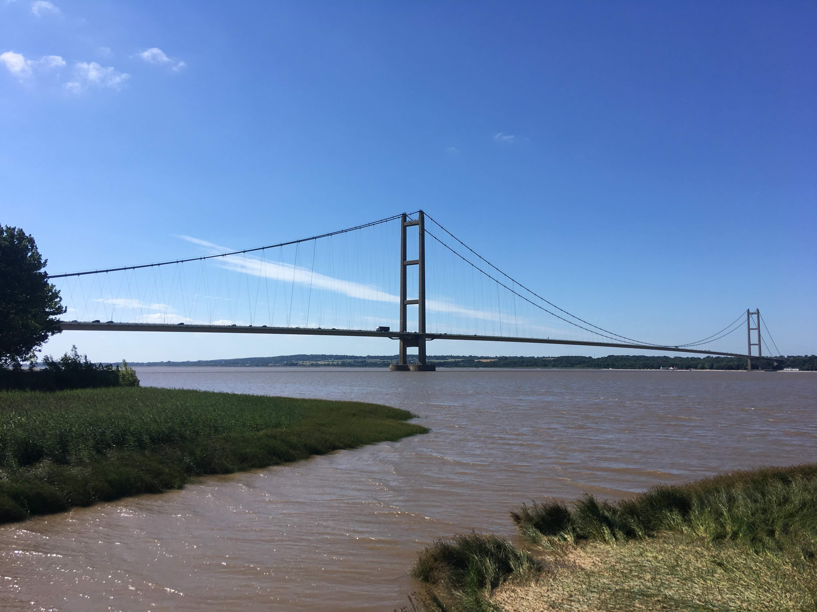
Working Strategically on the Humber
Tackling complex environmental pressures with strategic, joined-up action
Claire Argent, Principal Manager
Katharine Carson, Senior Project Manager

Slide 2
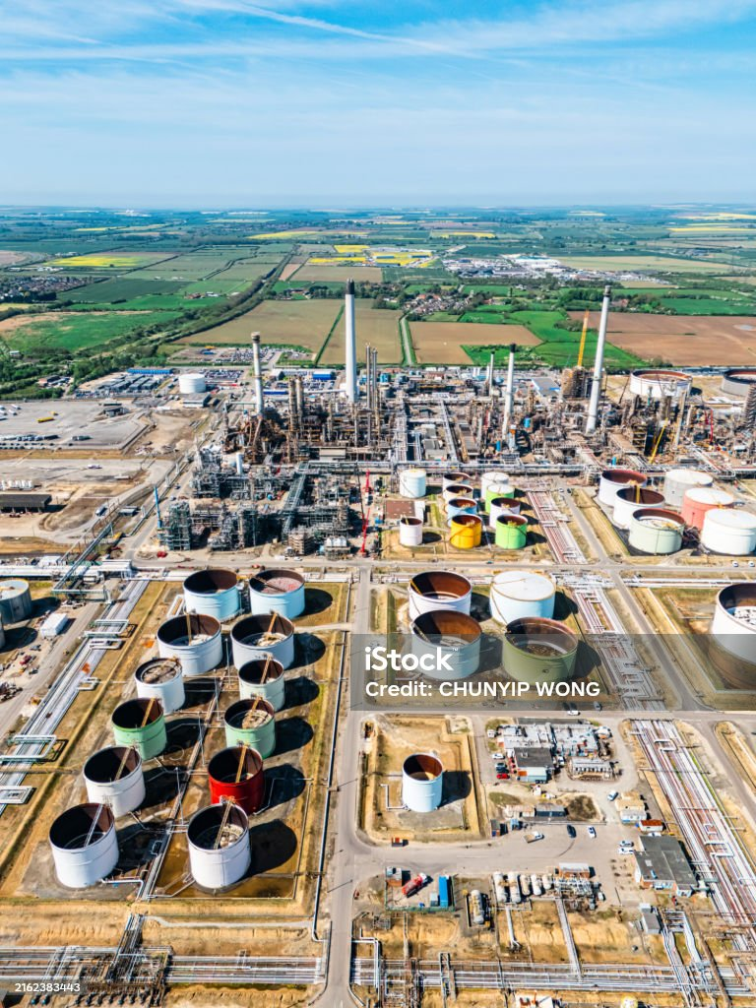
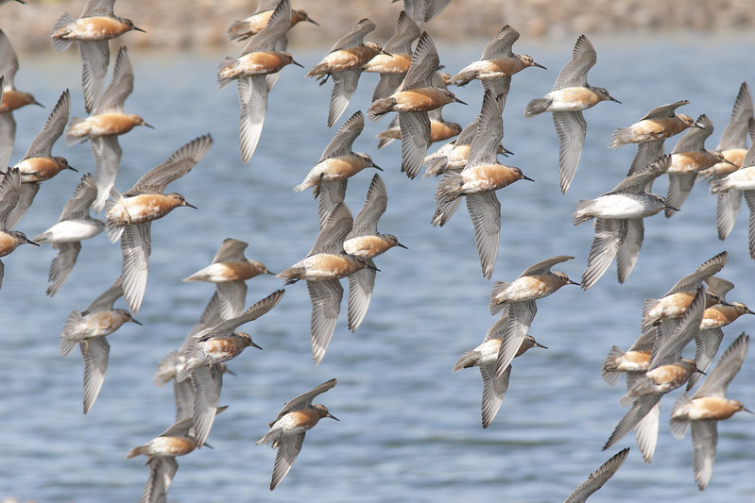
Why the Humber Needs Strategic Action
Supporting sustainable growth by building places that work with and for nature, not against it.
Responding to complex pressures with joined-up, landscape-scale solutions.
iStock – credit: Chunyip Wong
Knots – NE Flikr

Slide 3
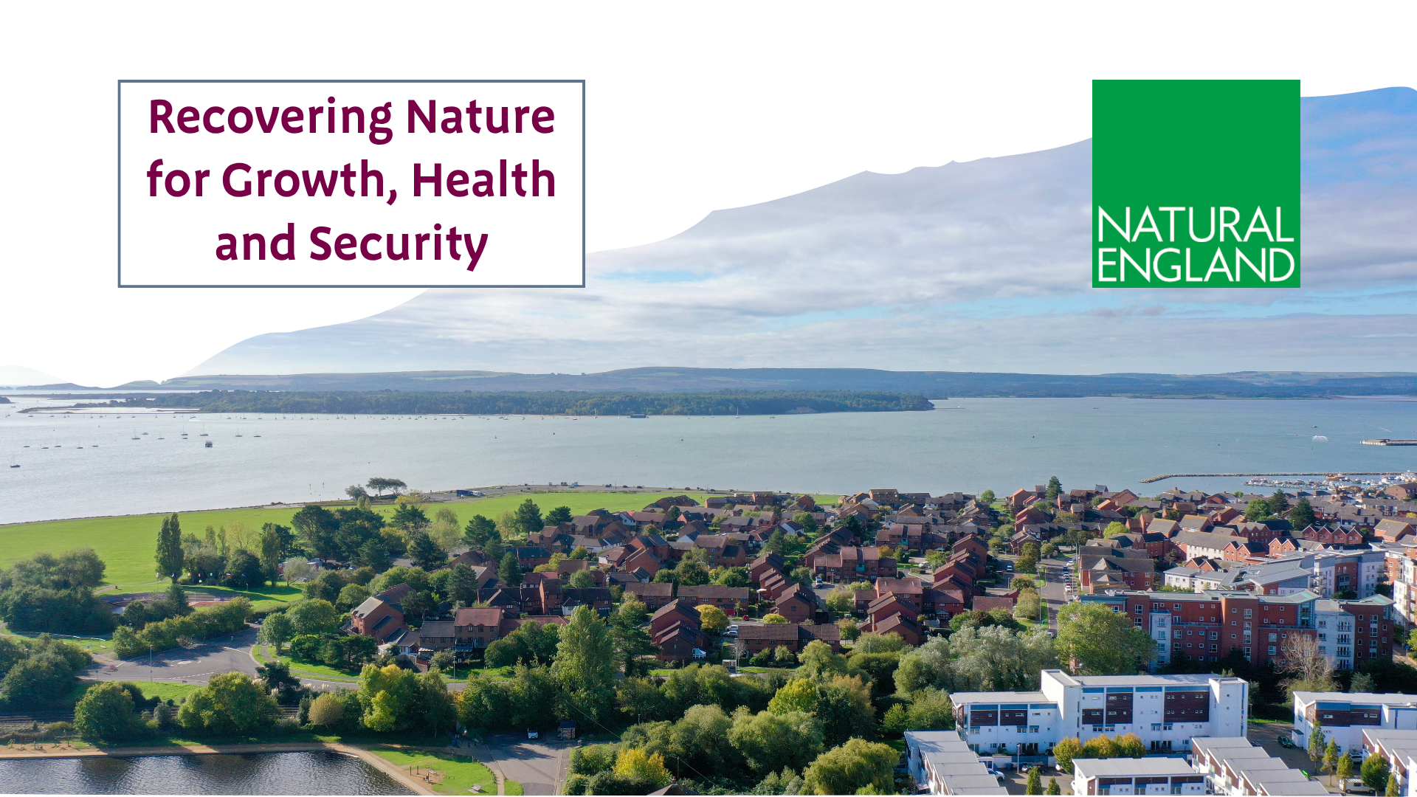
Natural England’s Strategic Shift
From reactive responses to proactive, landscape-scale solutions

Slide 4
Strategic Mitigation across the Humber
Strategic Approach to Recreational Disturbance.
Collaborative partnership working.
Providing developers with strategic mitigation options to support the delivery of a network of bigger, better and more joined up habitat.

Slide 5
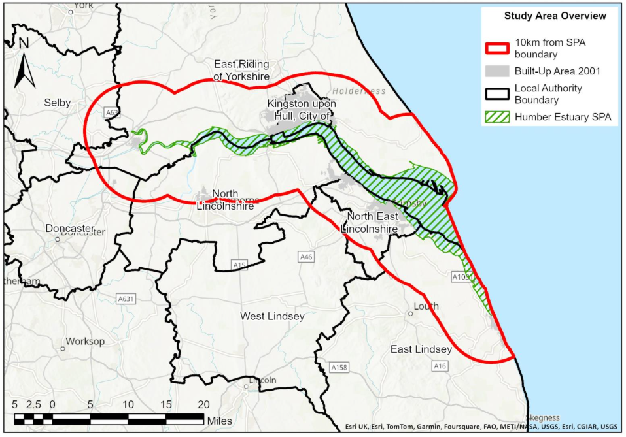
Expanding Strategic Approaches – Functionally Linked Land

Slide 6
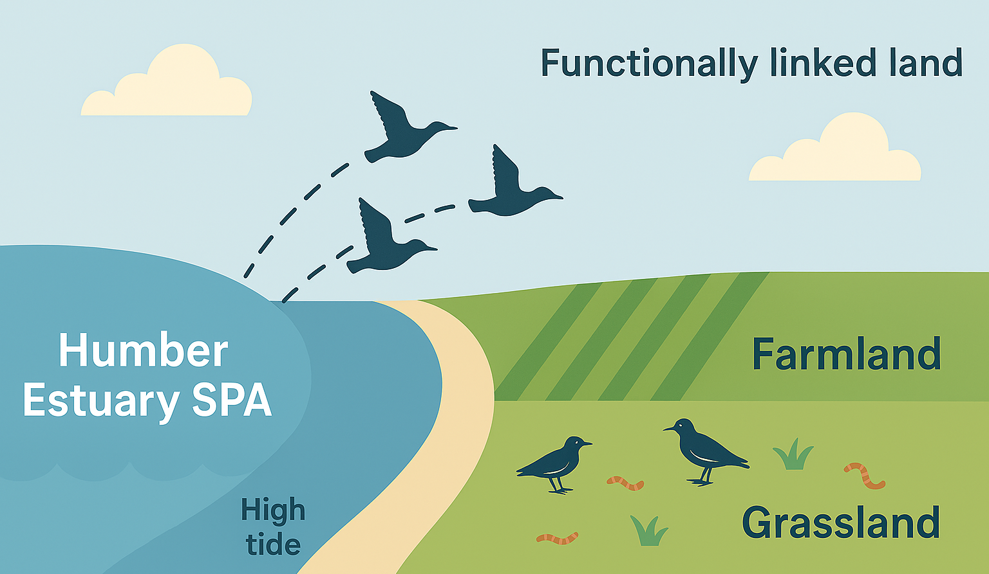
What is Functionally Linked Land
Functionally Linked Land (FLL) is land outside the Humber Estuary SPA that provides essential resources (e.g., feeding or roosting areas) for SPA bird species.
Birds rely on surrounding farmland, wetlands, and grasslands for food and safe resting sites.
These areas are critical for survival, especially at high tide or in harsh weather.
Protecting FLL helps maintain the ecological integrity of the SPA.

Slide 7
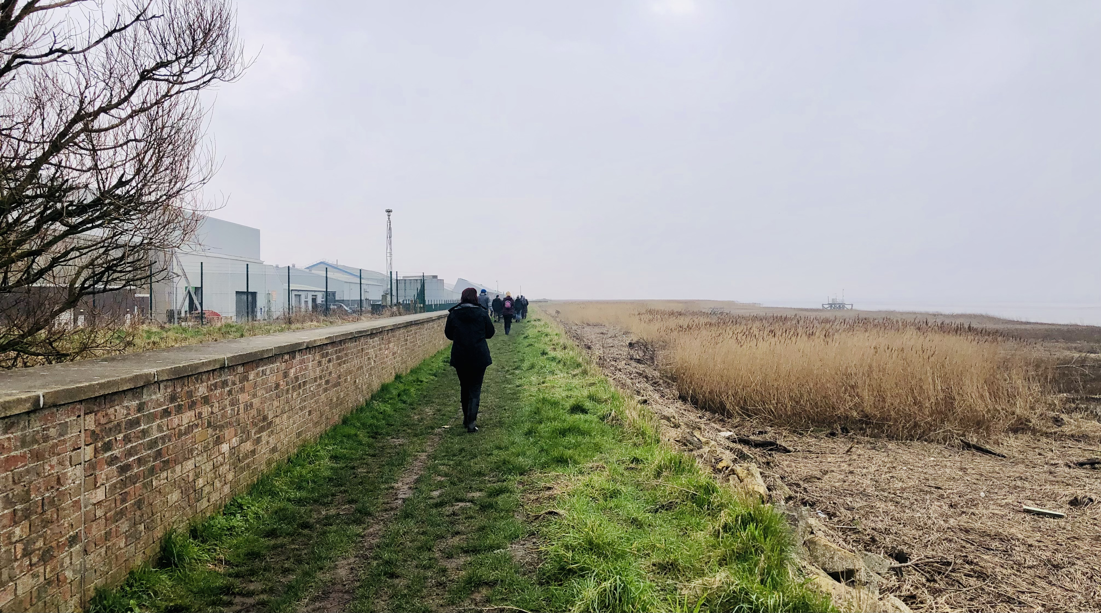
Conservation beyond boundaries

Slide 8
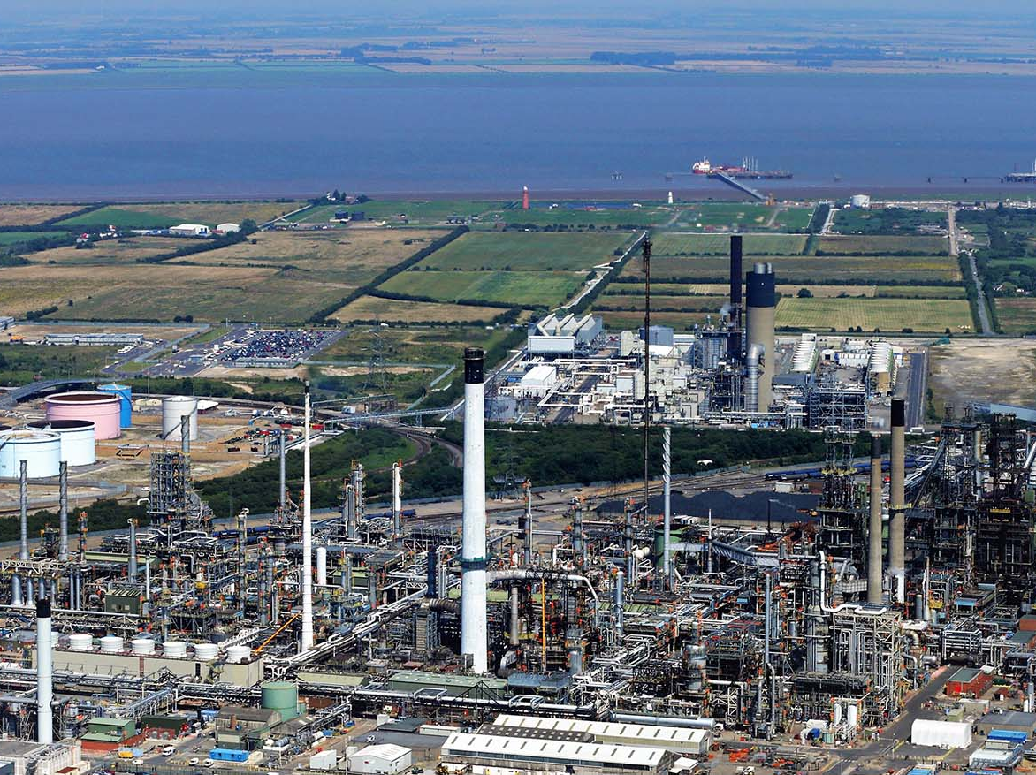

Slide 9
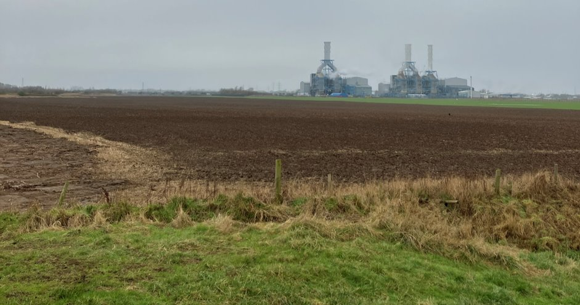
Functionally Linked Land & Development
Understanding FLL is key for planning and mitigating impacts from development near the SPA.

Slide 10
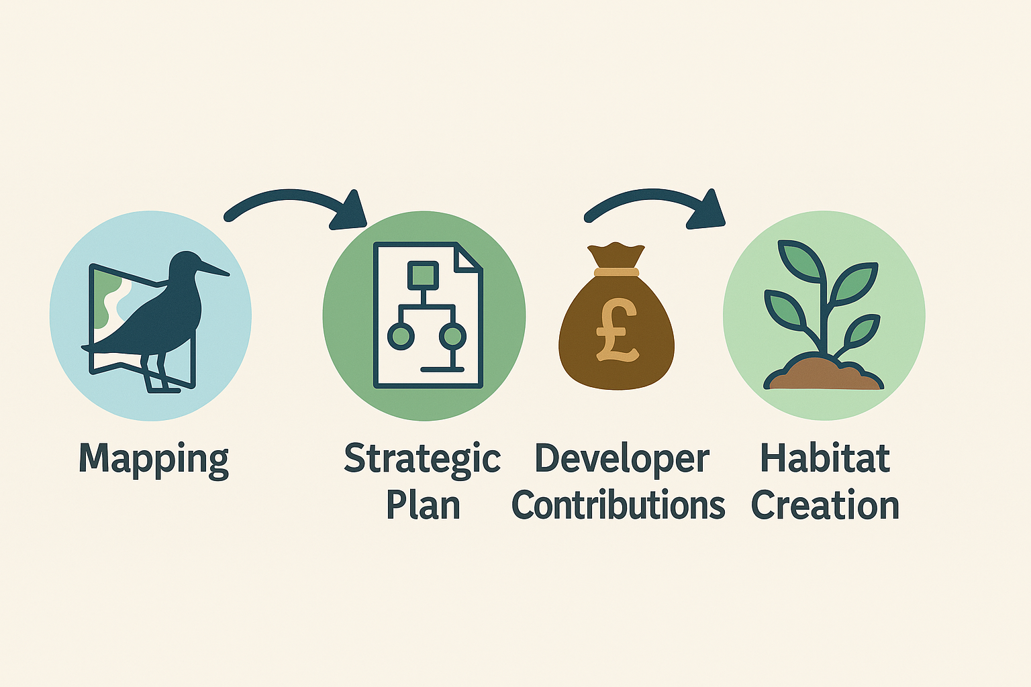
Strategic Ambition for FLL
Moving from case-by-case to a strategic approach
Develop a strategic management plan that could include:​
Mapped Evidence - clarity on where FLL is
Strategic Mitigation - pooled developer contributions
Business Opportunities - CSR/ESG investment potential
Mapping & Evidence
Strategic Plan
Developer Contributions
Habitat Creation

Slide 11
Partnerships Driving FLL Research
Collaboration is key to building the evidence base
Phase 1 (Current Phase)
Phase 2
Establish evidence base
Develop evidence- based solutions
Draft Strategy for consultation
Phase 3
Key Research Areas
Mapping & Modelling – Habitat suitability and FLL identification
Identification Metric – Developing a consistent method for FLL classification
Mitigation Design Guide – Practical solutions for SPA birds
Technology & Tracking – Trialling GPS tagging and exploring aerial surveys

Slide 12
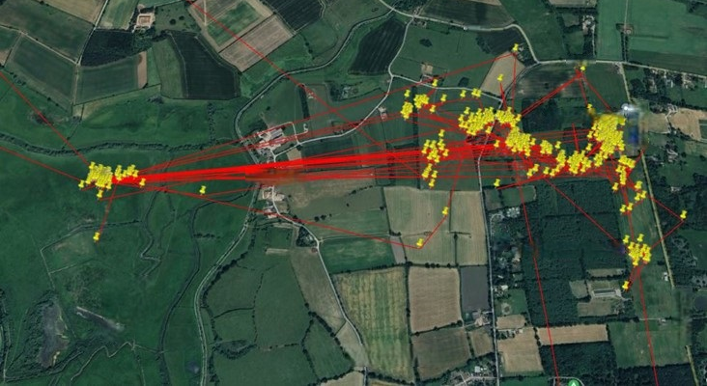
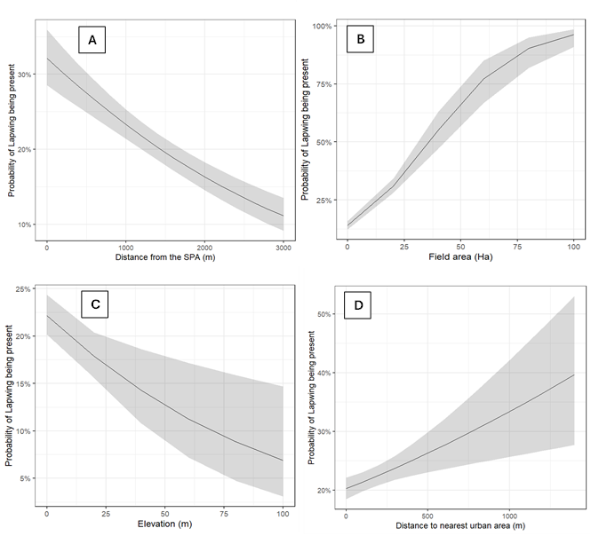
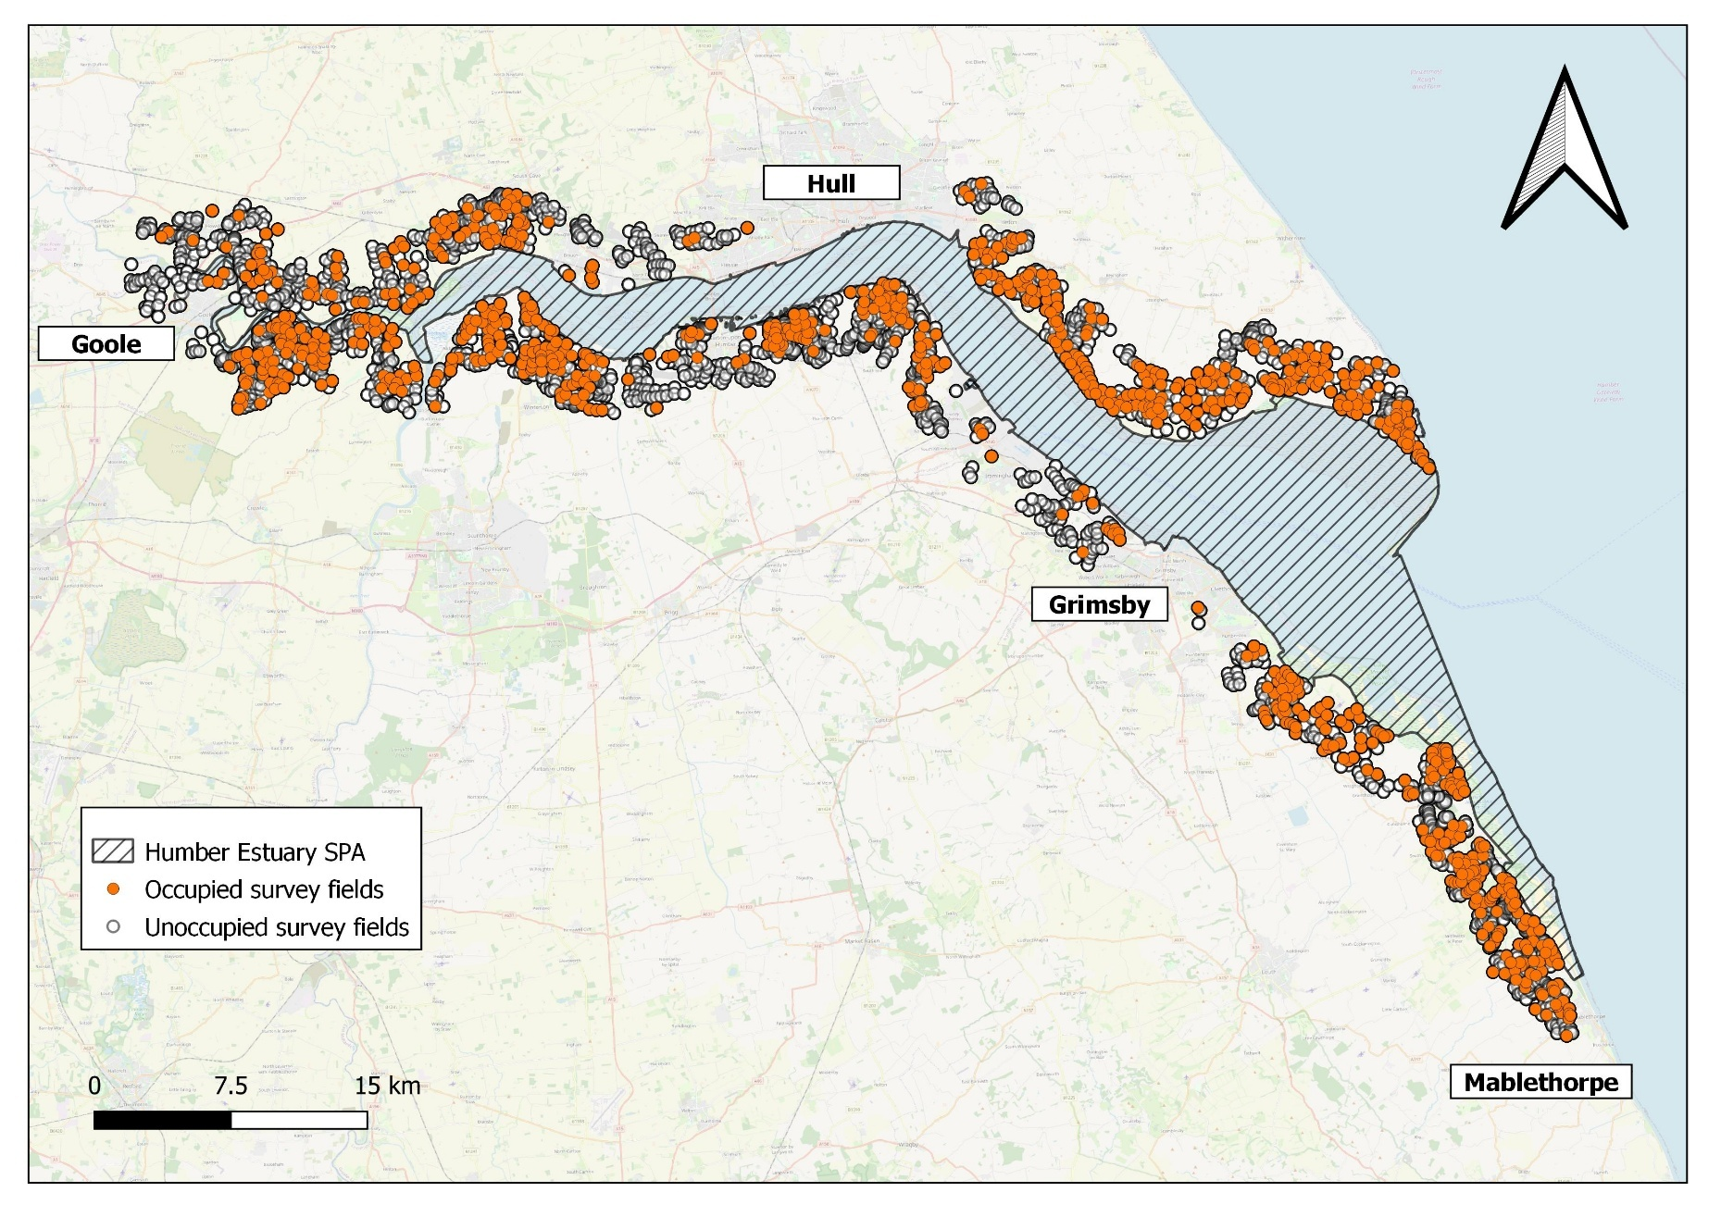
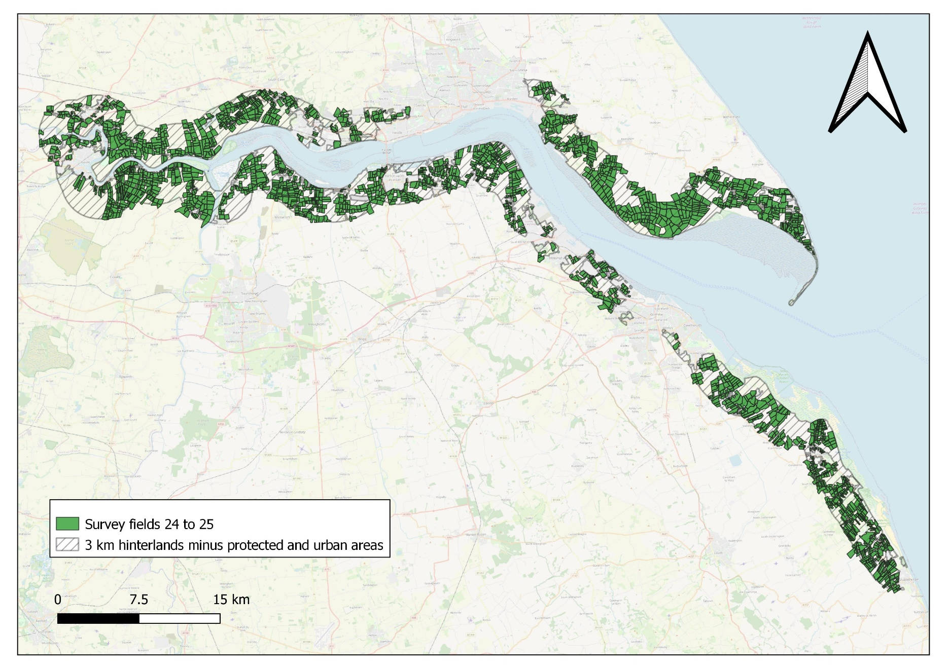
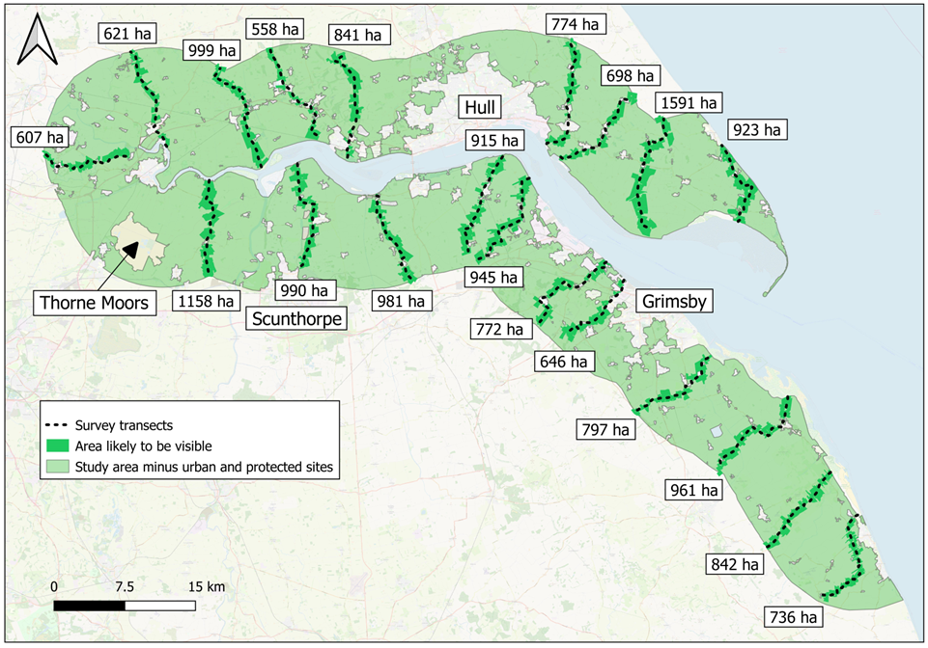
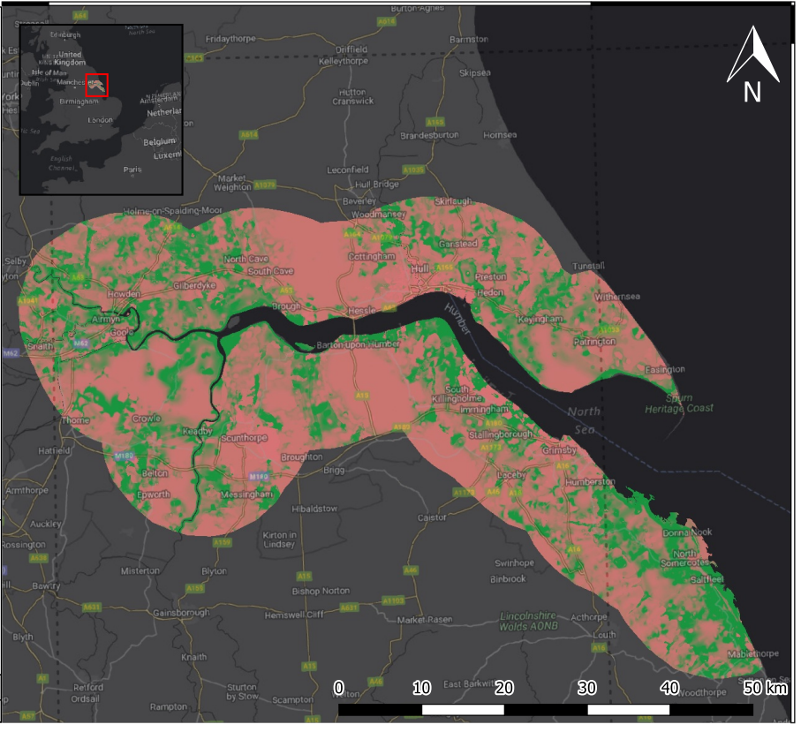

Slide 13
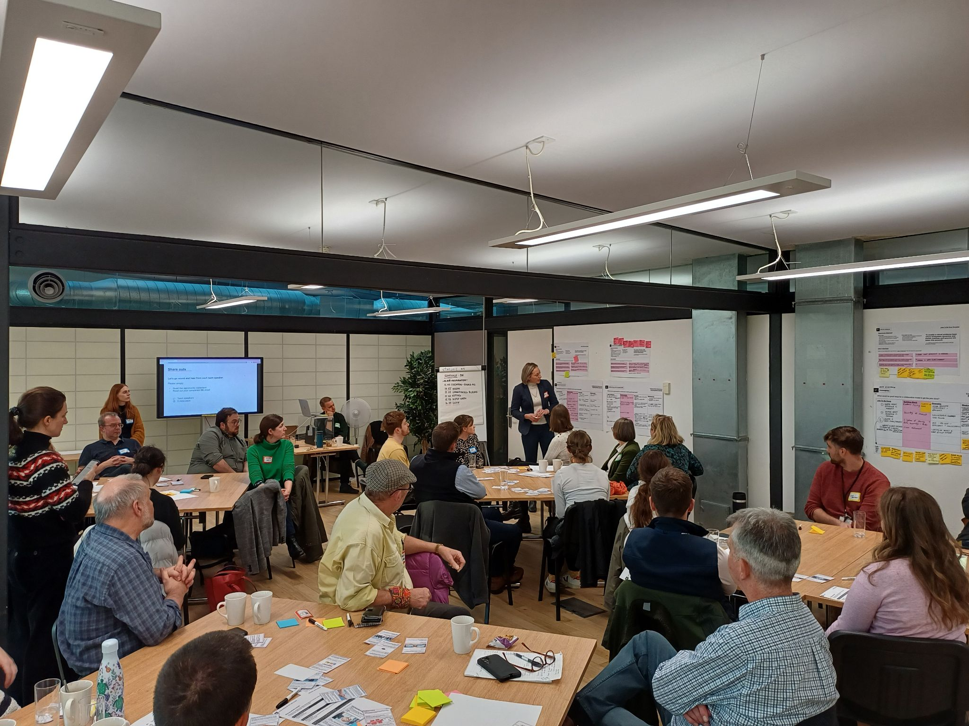
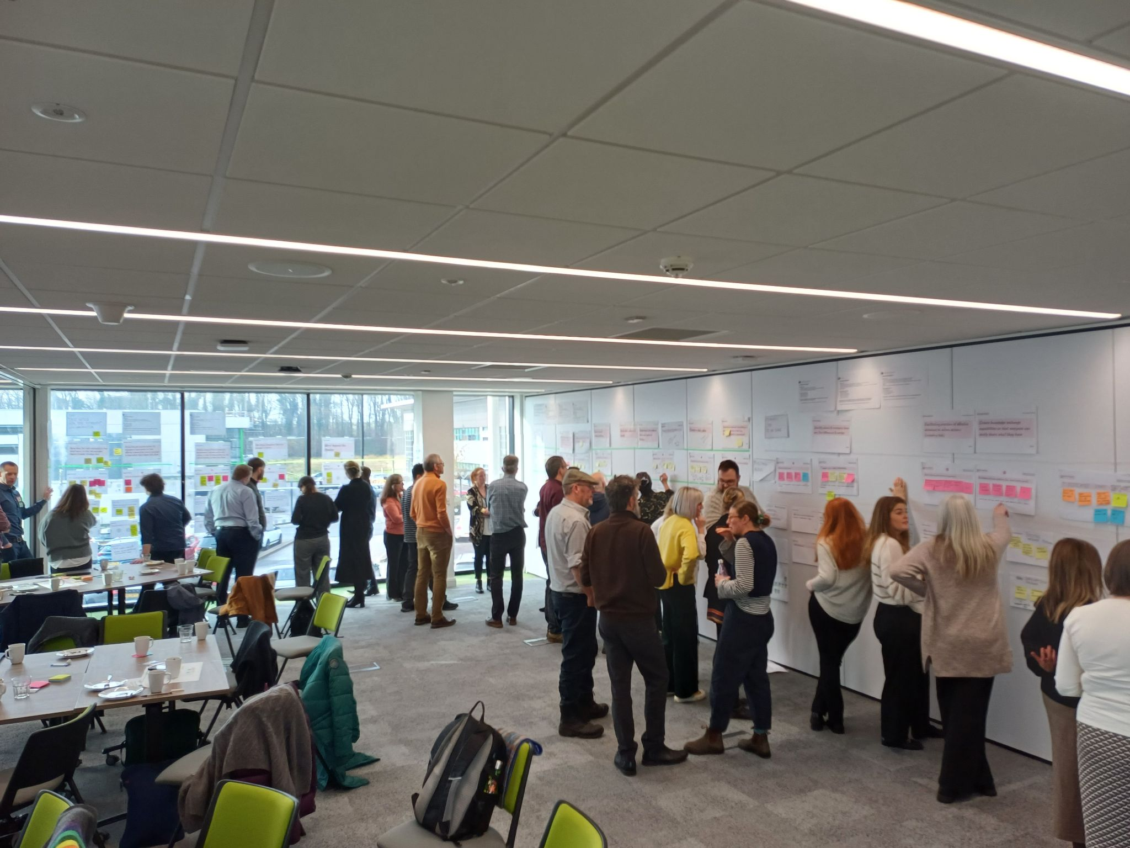
Governance Model for the Humber
Developing multistakeholder partnerships and suitable governance models for strategic approaches on the Humber. The ambition is to establish a collaborative model (or models) that would engender cross-estuary land-use management decisions, long-term.

Slide 14
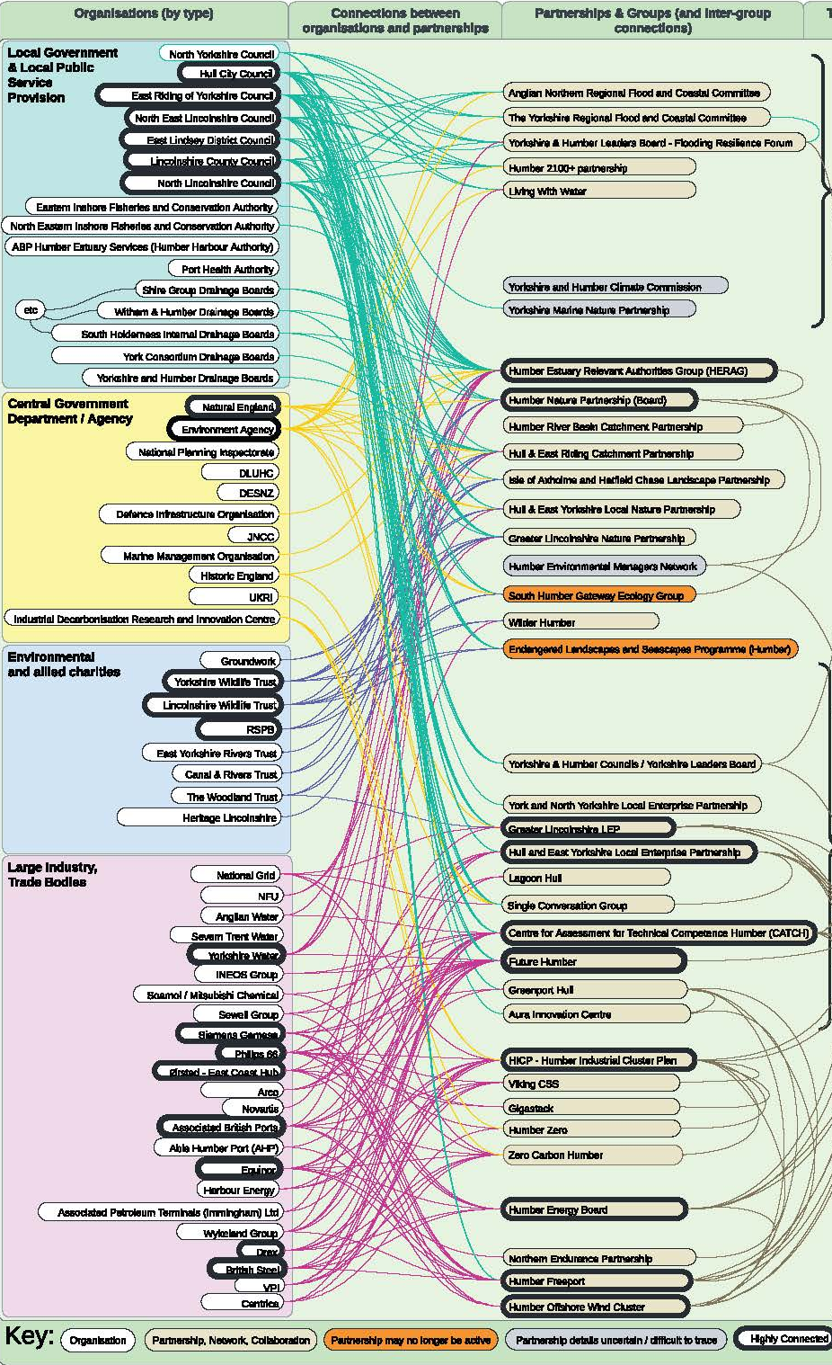
Can the current system support strategic delivery?
The Humber has many governance arrangements doing valuable work.
As we shift to more strategic delivery, we’re asking: Is the current system fit for purpose?
This isn’t about a full overhaul, just understanding what works and what might need support.
Over the past two years, collaborative workshops highlighted key themes.

Slide 15
Current system not fully aligned for strategic delivery
Strong appetite for more integrated, collaborative approaches
Focus on adapting existing structures—not adding new layers
Outputs:
  Roadmap to Better Decision Making (4 priorities: data, collaboration, communications, strategic planning)
  Draft Governance Model (Steering Group + Task & Finish Groups)

Slide 16
Next Steps
Finalise and share workshop outputs.
Invite organisations to reflect and discuss internally.
Plan a follow-up workshop in the new year.
We welcome ideas and suggestions.

Slide 17




Final Reflections
Strategic partnership is essential for the Humber’s future
The Humber faces complex environmental pressures that cannot be tackled in isolation.
Collaborative, strategic approaches are more effective than reactive, piecemeal responses.
Natural England is shifting toward proactive, landscape-scale solutions.
Partnership is key.

