Slide 2

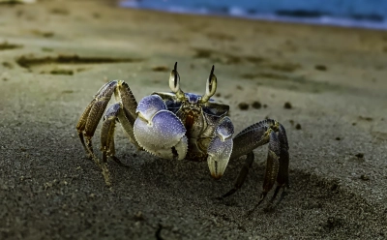
What We Will Cover
Introduction – who are APEM?
Examples
Summary
Marine Net Gain and importance
Current Status of MNG
MNG vs compensation
Challenges of MNG
Policies
Notes:
2

Slide 3
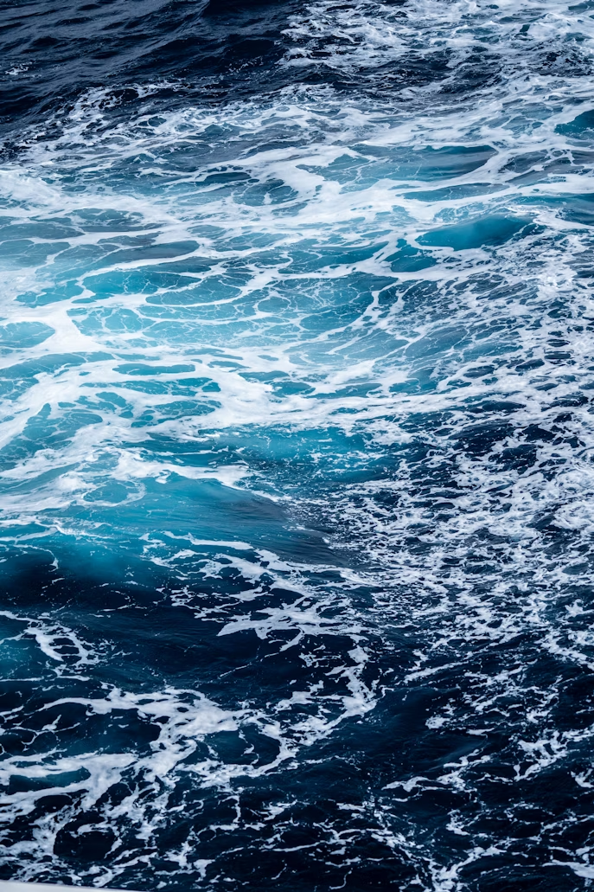
Introduction
APEM are leading specialists in marine, freshwater, and terrestrial ecology.
The APEM Group Includes: APEM Ltd, APEM Inc, Woodrow, AQUAFACT, GoBe Consultants, Macro Works, NASH Maritime, Aspect Ecology, Biosis, Attexo, and AARC Environmental Solutions.
Within APEM Group, the Marine Infrastructure Services (MIS) division focus on marine planning, renewables, and coastal infrastructure projects with various expert areas e.g. EIAS
APEM has extensive experience in nature enhancement, particularly through our environmental assessment work.
APEM have also developed a comprehensive catalogue of enhancement measures and advised numerous clients on relevant legislation and policy around enhancement and restoration in the marine environment.
Notes:
Expertise includes digital aerial wildlife surveys, remote sensing, surveys and laboratory analysis, marine ecology (including Benthic, Fish, Marine Mammals and Ornithology teams) and Environmental Impact Assessments (EIAs).
3

Slide 4
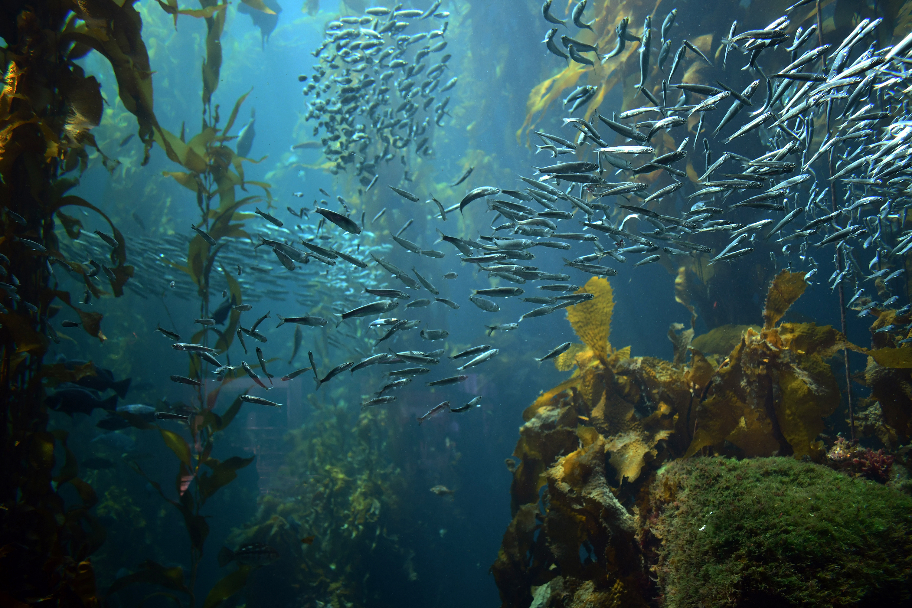
What is Marine Net Gain, and why is it important?
Marine Net Gain (MNG) is a concept aimed at improving marine environments post-development.
The aim of MNG is to ensure marine developments leave the environment in a measurably better state than before, through a system of habitat restoration, enhancement and creation.
MNG builds on the concept of biodiversity net gain used in terrestrial planning to include impacts on both habitats and species within the MNG assessment framework. MNG will apply to all developments in English waters.
Marine ecosystems are under severe pressure from overfishing, pollution, infrastructure development and climate change.
MNG actions can be nature-based solutions as they’ll actively restore and enhances ecosystems which are being lost, while supporting sustainable development.
Notes:
Broadly speaking, marine net gain (MNG) is a concept that aims to put the marine environment into recovery and prioritise activities that will leave the marine environment in a measurably better state than it was previously.
Net gain has been identified as a potential approach to development which can contribute to reversing biodiversity loss by leaving the natural environment in a measurably better state than before.
It’s a key tool for achieving climate resilience, protecting marine life, and ensuring long-term benefits from marine industries.
Healthy marine habitats like seagrass beds, salt marshes, and kelp forests store carbon and buffer coastlines against extreme weather.
With rising demand for sustainable infrastructure, and marine developments becoming more common offshore and on coastlines, MNG is a nature based solution because it actively restores
4

Slide 5

Current Status on MNG Progress UK
Currently, there is no formal requirement for MNG as part of marine development or Nationally Significant Infrastructure Projects in the marine environment.
Consultation on MNG in England ended of 2023. There has been no update to legislation, or guidance on a MNG assessment yet. Many elements of the framework have yet to be decided or agreed.
MNG will operate alongside existing planning policy and practice, to ensure current environmental standards are implemented and maintained.
Government are proposing that MNG will apply to economic activities that can be considered ‘development’:
construction or installation of new infrastructure (including significant extensions or improvements to existing infrastructure)
extraction (such as aggregates).
Fisheries will not be included.
© Cordis - EU
Notes:
and the Government’s responses was completed at the
Very much still in development. The introduction of MNG in England is being progressed through the UK Government’s legislative programme, with enabling powers set out under the Environment Act 2021. Secondary legislation is expected to be brought forward via statutory instruments in Parliament, following public consultations and the development of detailed policy and guidance. Defra is leading on policy development.
However, the government intends for MNG to operate alongside existing planning policy and practice, including on environmental assessments, to ensure current environmental standards are implemented and maintained, including application of the mitigation hierarchy.
In terms of delivery, the Marine Management Organisation (MMO) will play a central role in administering and enforcing MNG within the marine licensing process, while Natural England (NE) will support ecological assessment and advice, and The Crown Estate (TCE) will influence implementation through its role in seabed leasing and long-term stewardship.
Further legislation will be needed to implement a mandatory approach if that is decided however it doesn’t appear to be the preference from the government responses to the consultation.
The government are hoping for MNG to apply to economic activities that can be considered ‘development’, namely those that involve construction or installation of new infrastructure (including significant extensions or improvements to existing infrastructure) or extraction (such as aggregates). The government will not include fisheries within the scope of MNG requirements.
Government suggest marine recovery fund (MRF) could be used to manage financial contributions as part of a contributions-based approach to MNG
5

Slide 6

Global and UK Legislation and Policy
Global commitments:
The United Nations (UN) Sustainable Development Goals (SDGs)
UN Decade on Ocean Science (2021–2030)
The Paris Agreement
The OSPAR Convention (1992) & North-East Atlantic Environment Strategy 2030
UK:
The Marine and Coastal Access Act 2009
Environment Act 2021
UK Marine Policy Statement (2011)
Marine Strategy Framework Directive (MSFD) - Good Environmental Status (GES)
Local Authority Led Plans
MNG applies to English waters only; Scotland, Wales, and Northern Ireland are developing their own approaches to marine biodiversity enhancement, and close coordination will be essential to ensure consistency and alignment across UK waters.
Notes:
The United Nations (UN) Sustainable Development Goals (SDGs): SDG 14 (Life Below Water) Protect and restore marine ecosystems.
UN Decade on Ocean Science (2021–2030) - encourages sustainable ocean management and restoration., and
The Paris Agreement: Recognises blue carbon habitats (e.g., seagrass, saltmarsh) as vital for climate mitigation and adaptation and links marine restoration to global climate goals.
The Marine and Coastal Access Act 2009
This provides the UK-wide framework for marine management, while devolved authorities oversee planning, licensing, and conservation within their waters.
Marine Strategy Framework Directive (MSFD) - Good Environmental Status (GES)
Under the Marine Strategy Regulations 2010, the UK aims to maintain healthy, productive marine ecosystems through 11 GES environmental descriptors. Restoring habitats is a key mechanism to achieve Good Environmental Status through several descriptors.
The OSPAR Convention (1992) & North-East Atlantic Environment Strategy 2030
commit the UK to halt biodiversity loss, restore ecosystems, and integrate blue carbon habitats into climate policy, placing restoration on equal footing with protection.
Environment Act 2021
The Environment Act 2021 provides for net gain by way of amendments to the Town and Country Planning Act 1990 (TCPA) and the Planning Act 2008. Development on land and in intertidal locations, down to the mean low water mark, will therefore be required to deliver a mandatory biodiversity net gain (BNG). MNG will only apply to developments below the mean low water mark. The Environment Bill cites BNG, but there are also references to ENG by policy makers, and it is assumed that this will become clearer as policy on Net Gain, and MNG in particular, is prepared by Government.
UK Marine Policy Statement (2011)
Provides the overarching policy context for Marine Plans across the UK. Promotes sustainable development and integration of biodiversity enhancement within marine decision-making.
Local Authority Led Plans (local nature recovery strategies, Habitat Action Plans)
Marine Plans – integrate ecosystem-based management and restoration within the plans on a voluntary basis. In England you have Regional Plans with specific biodiversity policies. In Wales, they have just released the WNMP Technical Statement - ENV-01
6

Slide 7

Is MNG Compensation?
MNG goes beyond compensation by aiming to improve the marine environment, not just offset damage.
Compensation is a regulatory requirement that is triggered when an adverse impact on an MPA cannot be ruled out by a development under the Habitats Regulations.
Compensation is reactive; MNG is proactive and restorative.
Notes:
Marine net gain will require the delivery of activities that improve the state of the environment. A separate requirement to provide compensatory measures can be triggered when an adverse impact on an MPA cannot be ruled out but a development that has gained consent in line with the requirements of the Habitats Regulations. Marine net gain will be a new requirement for developers, it will not replace or supersede existing requirements relating to environmental protection and so is not intended to mitigate the impacts of a development.
7

Slide 8
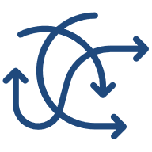
Challenges surrounding MNG
Biodiversity Net Gain (BNG) does cover the intertidal zone down to the Mean Low Water Mark.
However, MNG has unique challenges associated with the marine environment, especially compared to terrestrial environments where BNG is applied:
Not as accessible as terrestrial environments
Dynamic, interconnected, and fluid boundaries.
Limited baseline studies especially seasonal variations
Have highly mobile species.
Terrestrial BNG strategies are relatively well-established, marine restoration techniques, such as seagrass planting and reef creation, are less mature, often still in trial phases, with uncertainty over expected outcomes and timelines.
These factors make it challenging to monitor marine environments over the long term and to accurately measure the benefits achieved.
Notes:
It is worth saying that BNG does cover the intertidal zone, down to the Mean Low Water mark. This captures the vital interface between land and sea, including areas that are covered and exposed by water during different tide states. However, BNG does not extend to the marine environment beyond this zone.
Marine ecosystems present unique challenges for BNG due to their vast, fluid nature and are largely unseen. Generally speaking, land habitats are familiar, well studied, have clear boundaries and are comparatively easier to monitor due to access. However marine environments are largely hidden beneath the surface, and many habitats are interconnected making baseline data collection and long-term tracking more difficult and much more expensive - Limited by visibility and weather also for collection not just access.
A major challenge is whether marine biodiversity loss and gain can be measured accurately enough for regulation. The dynamic nature of marine ecosystems, shaped by such factors as seasonal changes and species migrations, can add additional challenges to establishing a reliable baseline.
8

Slide 9
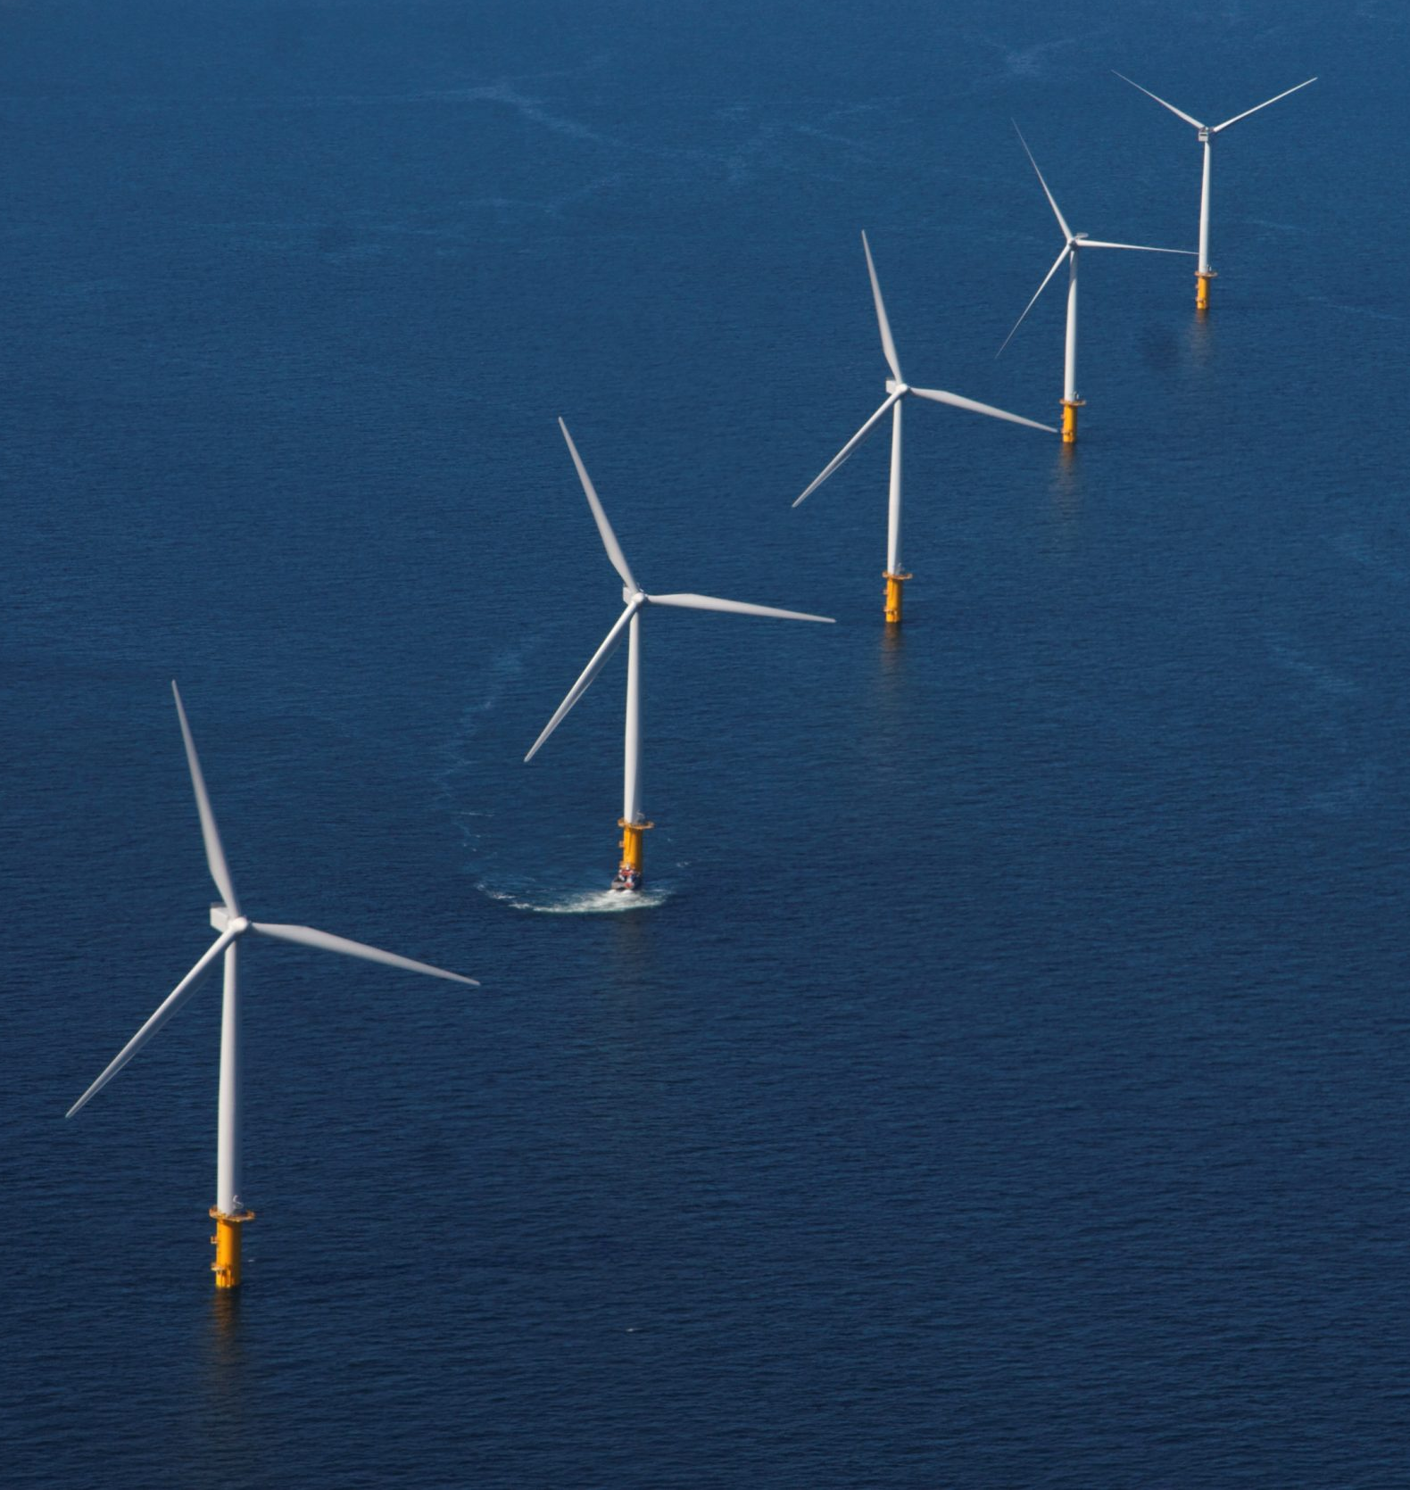
International Equivalents
Australia uses environmental offsets for sensitive habitats like the Great Barrier Reef.
The U.S. enforces a “no net loss” policy as part of the Clean Water Act, for wetlands and intertidal zones, supported by mitigation banks – i.e. privately managed lands, restored to compensate for habitat loss. Developers can offset their impacts by purchasing credits from these banks.
Canada’s Fisheries Act mandates habitat compensation for impacts on fish and intertidal zones.
New Zealand applies biodiversity offsets for marine developments under its Resource Management Act.
The EU integrates restoration and compensation into marine spatial planning through frameworks like the Nature Restoration Law.
e.g. Netherlands marine biodiversity enhancement measures are a key factor in Offshore Wind auctions.
Notes:
Globally, there are similar concepts to MNG already in place. However, they mainly focus on offsetting impacts instead of creating net gain.
9

Slide 10
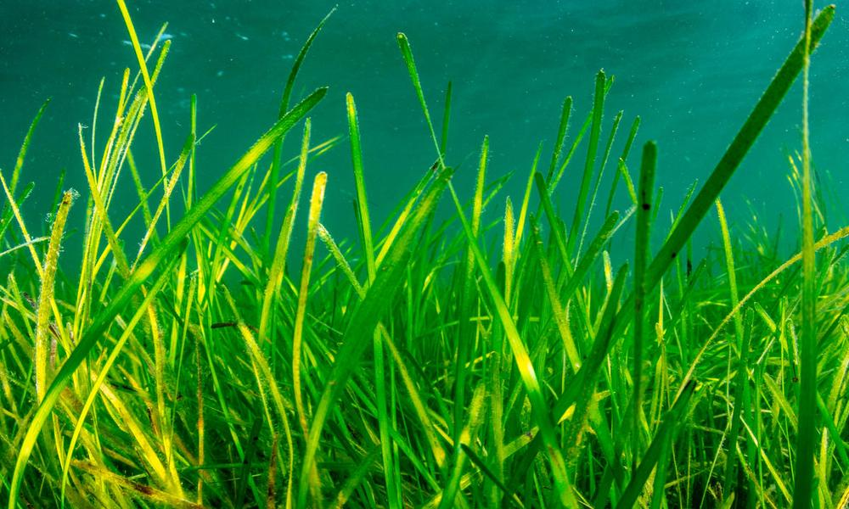
Examples & Opportunities
Even without formal legislation, many developers around UK are actively pursuing initiatives to achieve positive ecological outcomes
Offshore wind farms are incorporating habitat restoration and artificial reefs
Reef cubes and graded granite and rock material around turbines and cables to mimic natural habitats, creating refuges and breeding grounds for marine species. These ‘nature-inclusive’ designs help enhance local biodiversity and support commercially important species such as lobsters and crabs by forming artificial reefs.
Habitat restoration such as seagrass restoration, saltmarsh restoration, native oyster restoration or more recently kelp restoration has become more common around the UK, with funding form developers helping organisations e.g. Project Seagrass.
© WWF
Notes:
Even without formal legislation, many developers are actively pursuing initiatives to achieve positive ecological outcomes, often driven by their own sustainability targets and intuition on nature-inclusive design.
These examples can be used as strategies for MNG
10

Slide 11

Future of MNG
The short-term approach to developing a framework for MNG involves making decisions within the consenting process that focus on ecological targets.
An effective framework must balance ecological ambition with feasibility, ensuring meaningful outcomes without unnecessary complexity or administrative burden.
It is likely that MNG will mirror BNG, potentially requiring marine developers to leave the environment in a better state than before by, for example, a 10% net gain.
A key unknown at this time is how success would be measured. However, emerging thinking points to measuring improvements in marine biodiversity, including the extent, condition, and function of habitats and species compared to a defined baseline.
Notes:
This requires consistent, proportionate assessments of how a project’s impact relates to these targets, using available techniques and evidence. While the natural capital evidence base is not yet robust enough to quantitatively measure ecological change for regulatory purposes, it remains valuable for understanding the ecological, social, and economic value of different gain measures. It can also guide decisions on how to best achieve strategic environmental goals and should be further developed in this contextt
This process would require a collaborative, multi-stakeholder approach involving industry, conservation organisations, and local communities.
This proactive approach is particularly pertinent as the offshore wind and other marine industries continue to expand, emphasising the need for sustainable development practices that contribute positively to marine biodiversity.
This would involve demonstrating clear ecological gains, supported by robust, quantifiable metrics and monitoring tools. Success also depends on the meaningful involvement of stakeholders, such as local communities and industries, alongside clear governance frameworks and effective implementation. Long-term resilience, including the permanence of ecological gains and their adaptability to climate change, is essential to ensure that net gain outcomes are sustained well into the future.
11

Slide 12
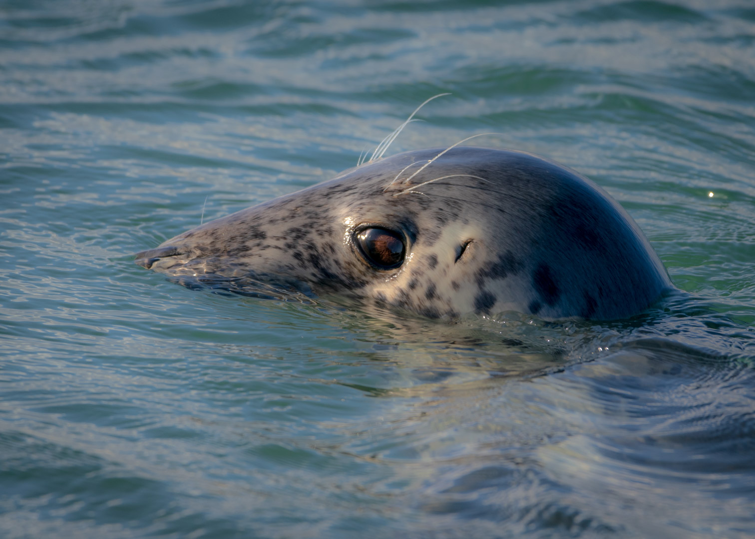
Summary
MNG is part of the UK’s evolving marine policy, especially in offshore wind and coastal development.
By integrating biodiversity gains into marine developments, it will encourage developers to contribute to long-term ecological improvements, such as restoring seagrass beds or enhancing fish habitats.
Integrating nature enhancement from concept to consent is becoming increasingly more common even without MNG in place.
Collaboration between industry, regulators, and researchers will drive a nature-positive marine future and is key to implementing MNG.
Consultancies are increasingly seeing nature enhancement opportunities within the marine infrastructure sector and APEM are well placed to deliver in this topic.
Notes:
Marine Net Gain is coming, and no doubt there will be complexities to navigate – but as the framework takes shape, we’re in a great position to help developers meet their commercial objectives whilst achieving meaningful ecological outcomes.
12

Slide 13
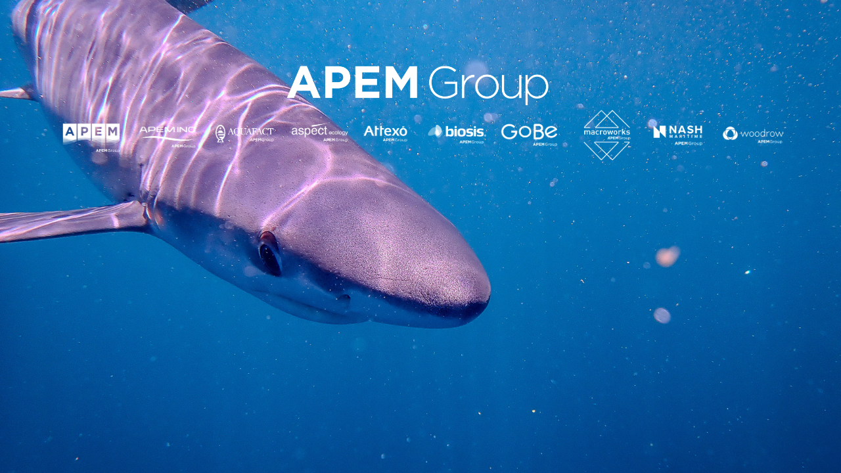
Thank You, Any Questions?
Kelly Greener
k.greener@apemltd.co.uk

