Slide 1
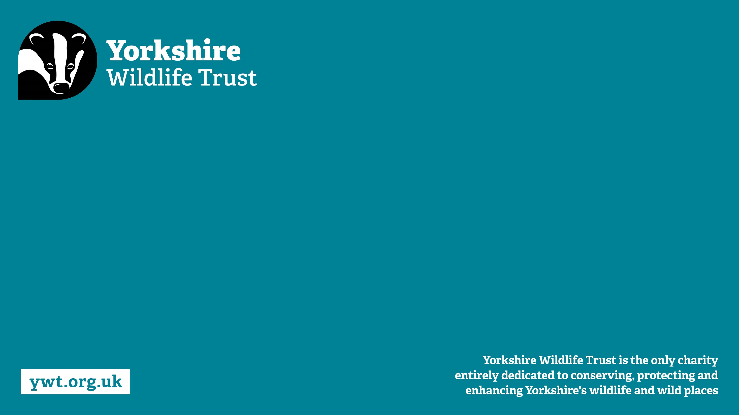
From Quarry to nature
North Cave Wetlands
Tony Martin
YWT Nature Reserves Manager

Slide 2
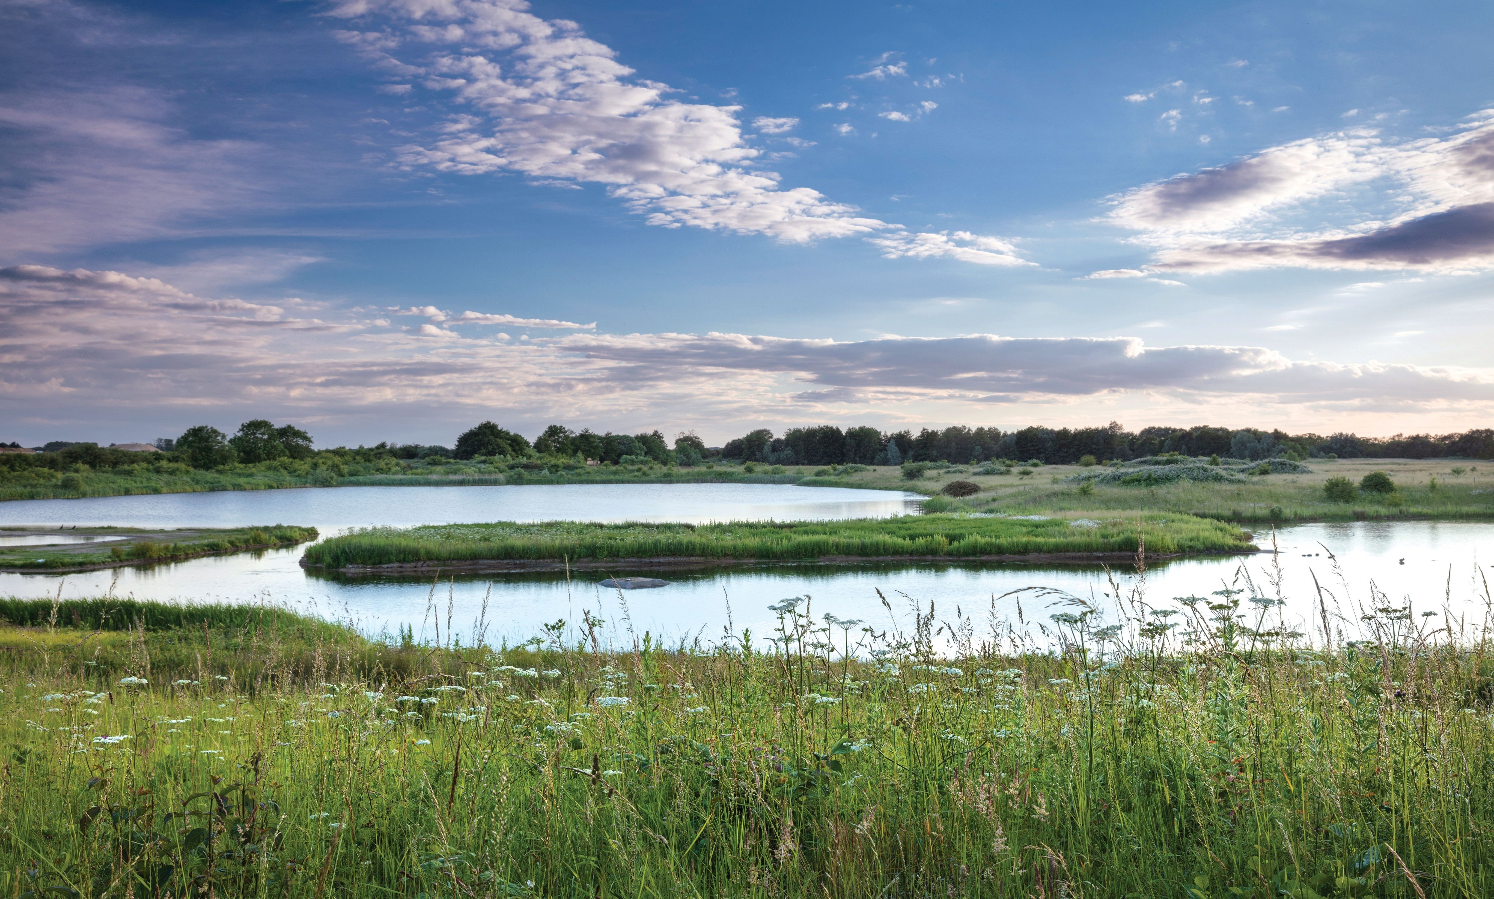

Reserve history
Sand and gravel extraction by Humberside Aggregates 1990 to 1998
Planning application
Freehold of reserve by YWT in Nov 2000

Slide 3
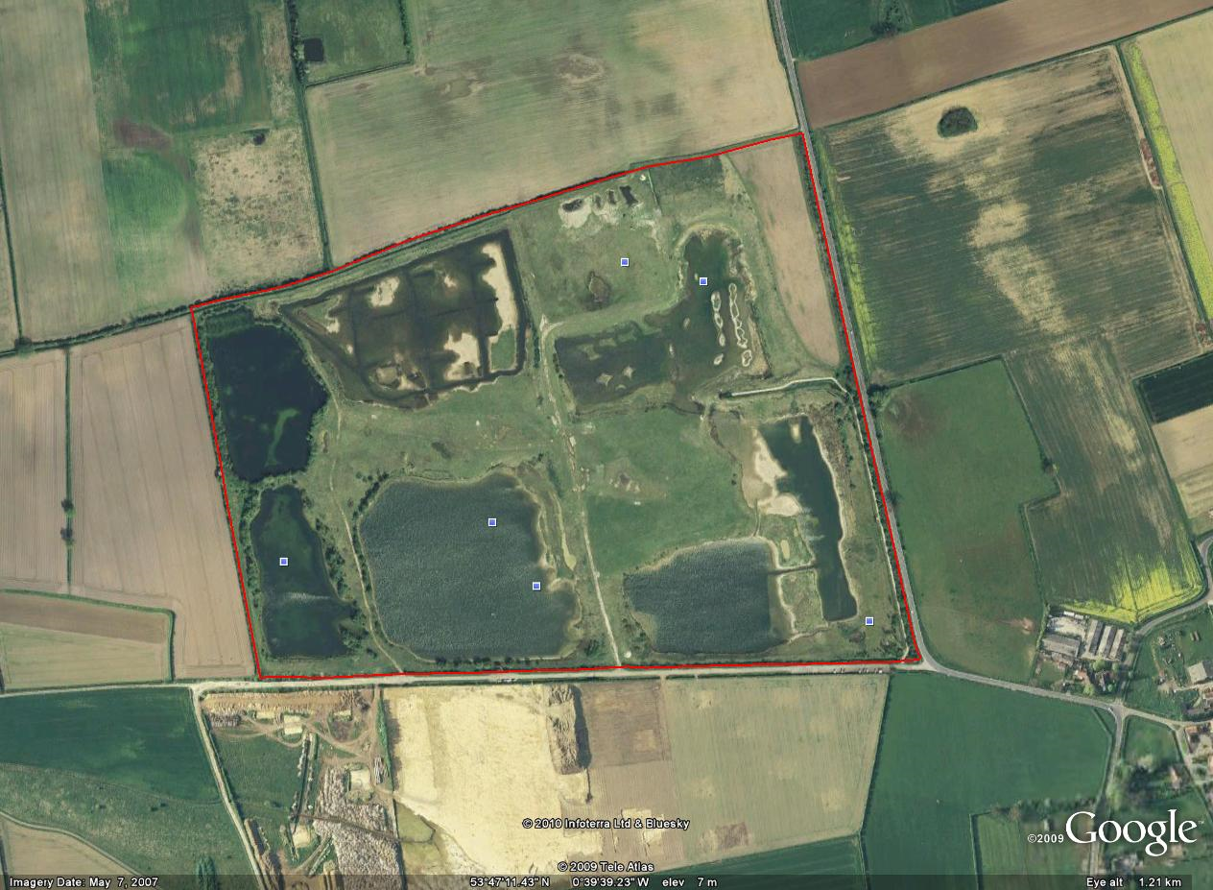
YWT inherited 6 large, deep, water filled holes
96 acre/ 39 ha original reserve
Reedbed lake
Island lake
Far Lake
Carp Lake
Main Lake
Village Lake

Slide 4
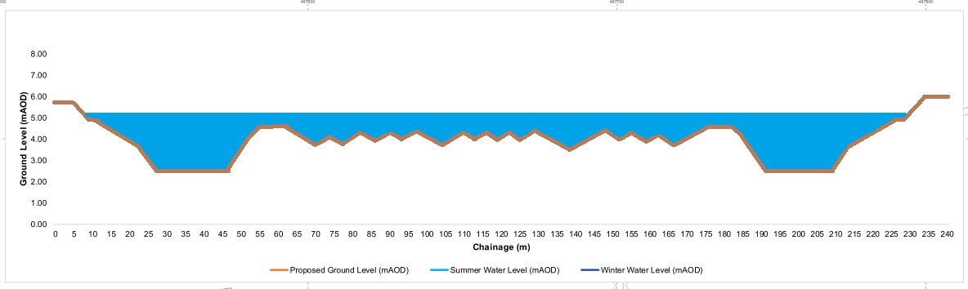
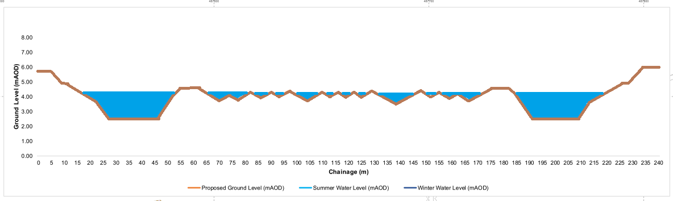

Slide 5
In 2004 Humberside aggregates acquired a 104 Acre/ 42 ha extension
Phase 1 original reserve
Phase 2

Slide 6
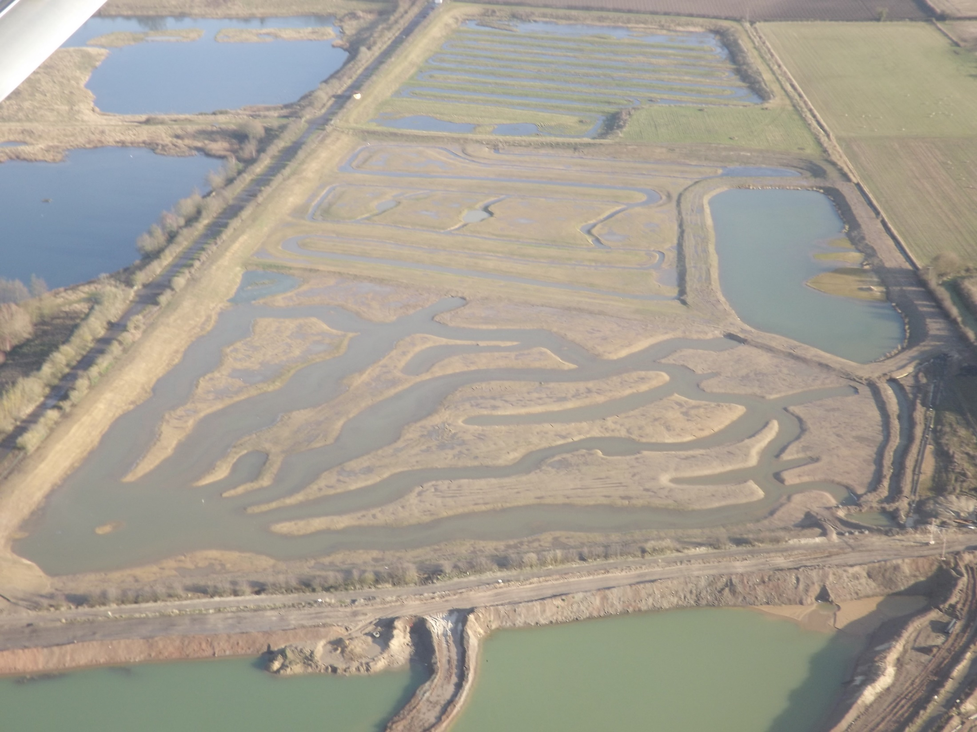
Cell C
Dryham Ings water management
Cell B
Reservoir
Cell A

Slide 7
140 acre/ 57 ha phase 3 extension
Phase 1 original reserve
Phase 2
Phase 3 North West
Phase 3 South West

Slide 8
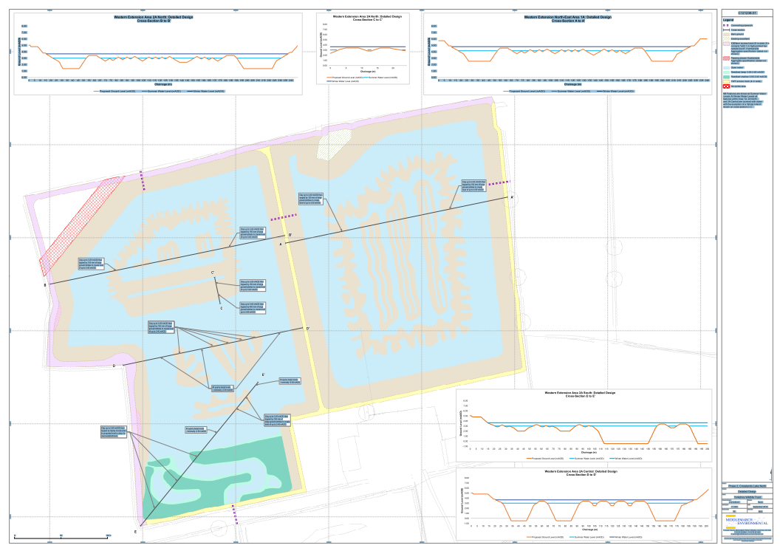
In 2015 Humberside aggregates start restoration of West Holm
West Holm
East Holm

Slide 9

In August 2017 Breedon group completed the acquisition of Humberside Aggregates
Phase 1 original reserve
Phase 2
Phase 3 North West
Phase 3 South West

Slide 10
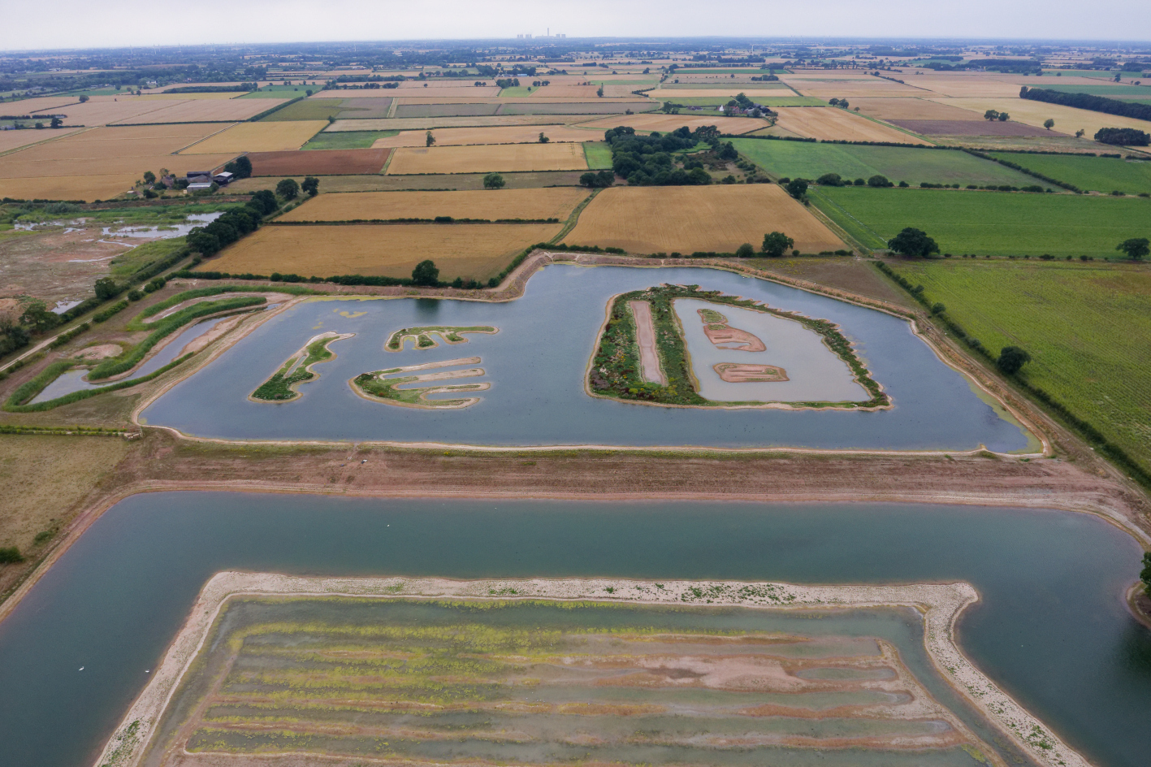
West Holm
SH Plant completed the restoration of West and East Holm

Slide 11
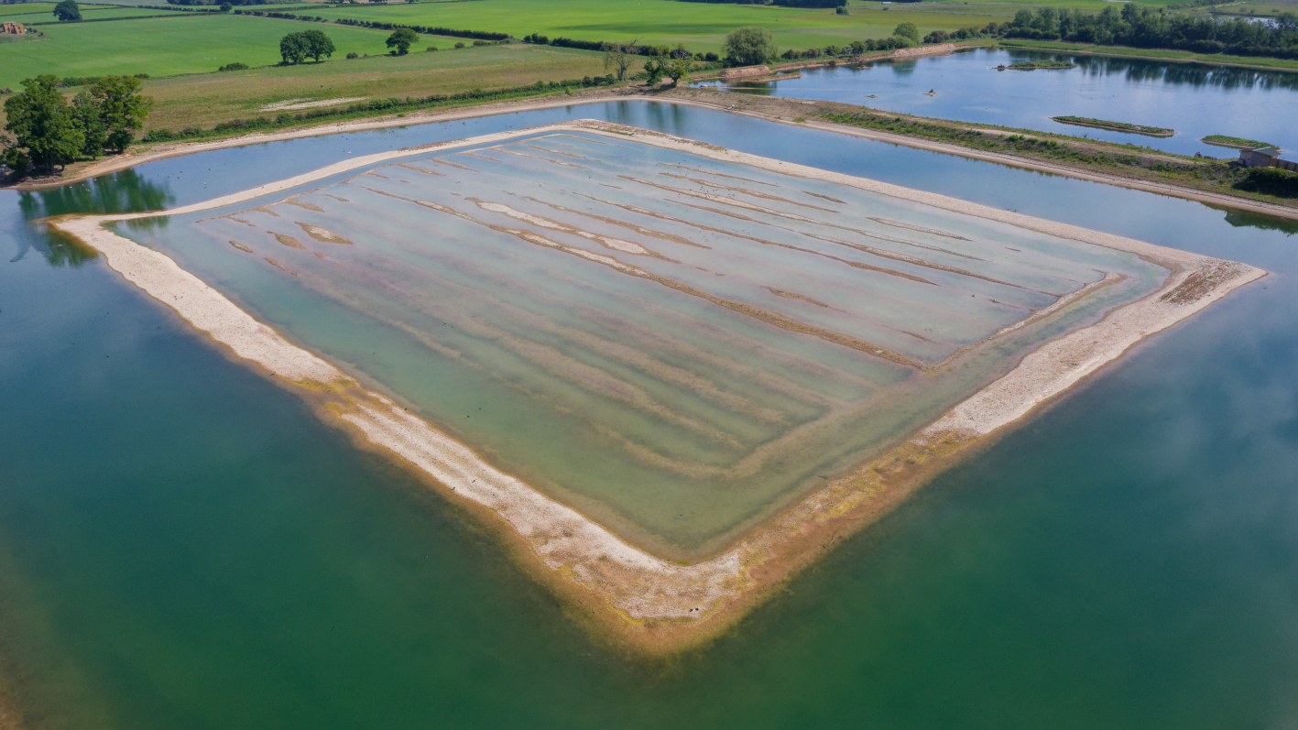
East Holm
Restoration completed in 2023

Slide 12
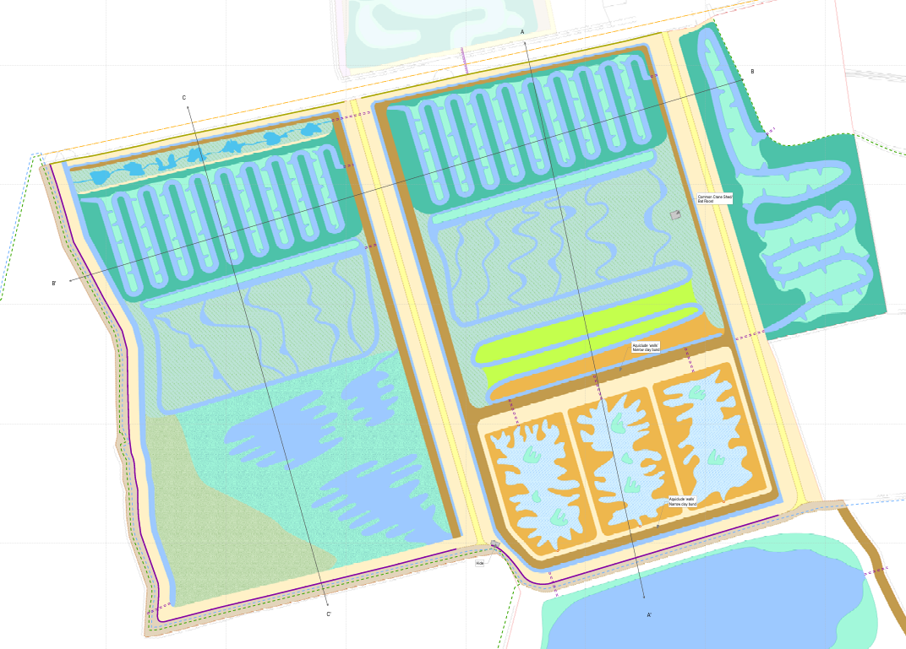
YWT working with Breedon on design and restoration of the SW extension
Some alterations required due to a new land acquisition and planning application

Slide 13
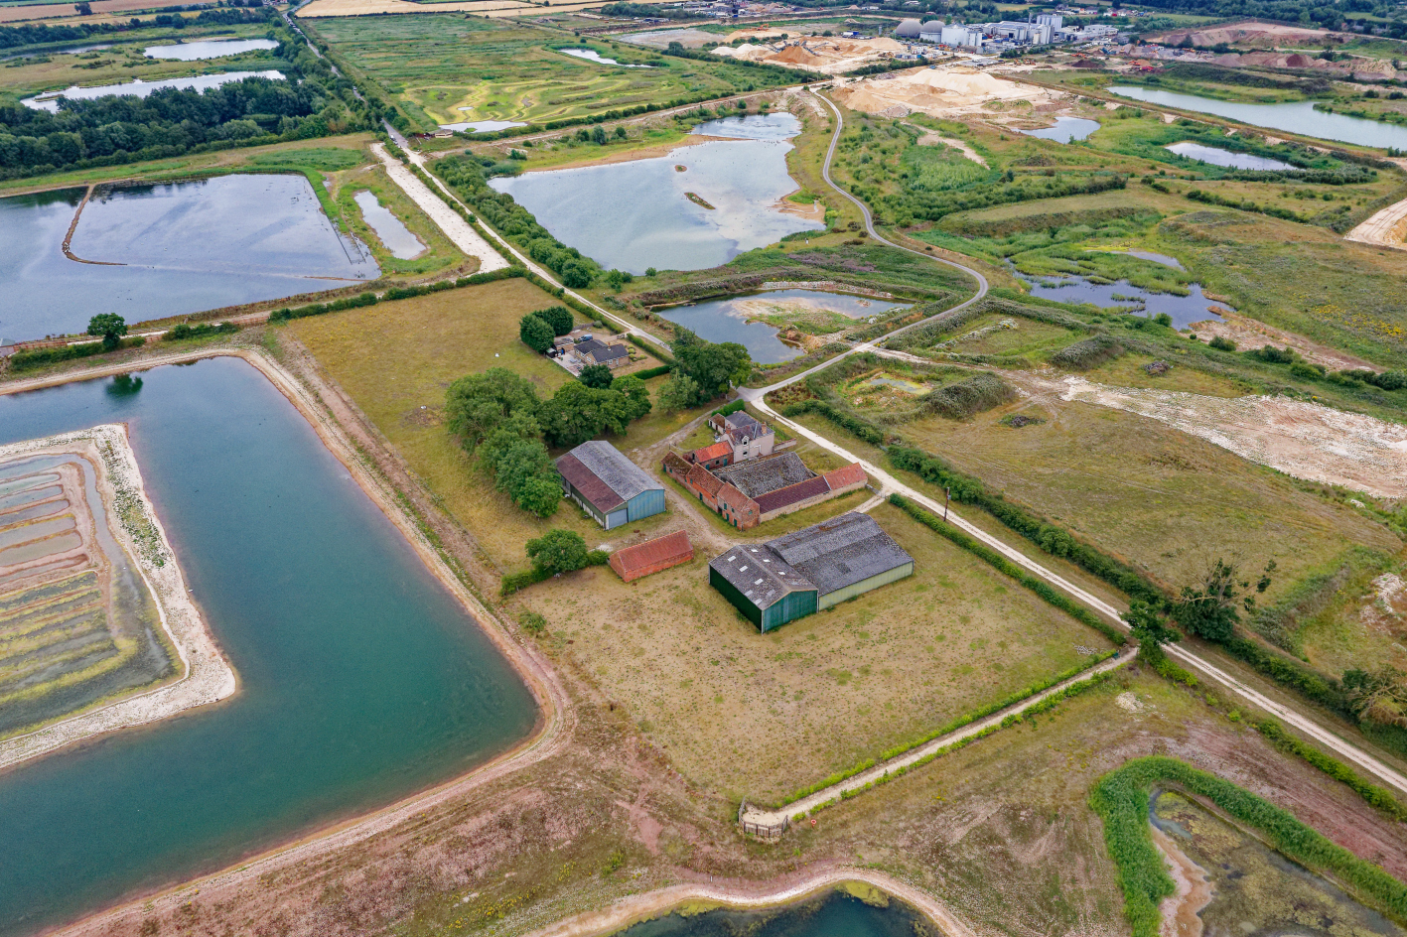
The future aspirations for North Cave Wetlands
New planning application by Breedon Group
Linking habitats on a landscape scale

Slide 14
Thank you for listening
Tony Martin
Nature reserves manager YWT

