Slide 1
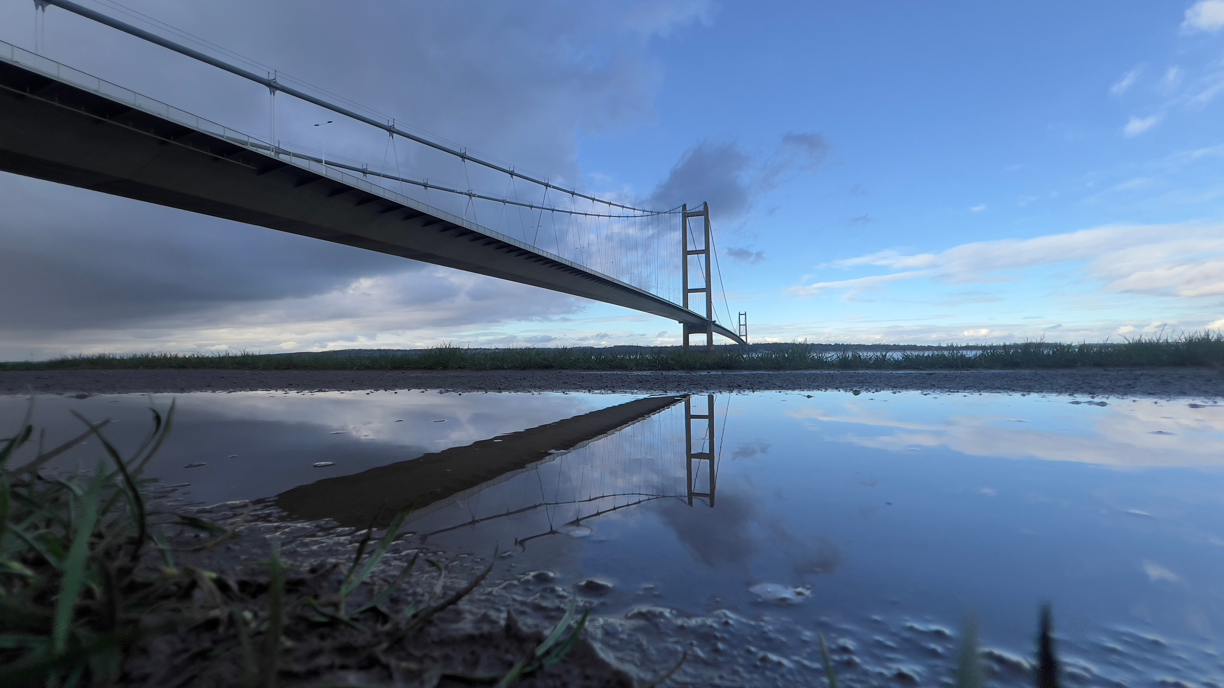

Humber Nature Partnership
Introduction and strategic update
13th November 2025

Slide 2
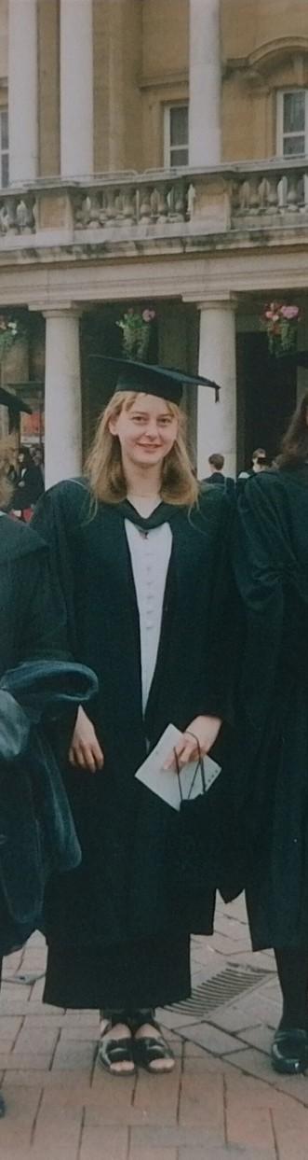
Alexandra Hajok
alexandra.hajok@humbernature.co.uk

Slide 3
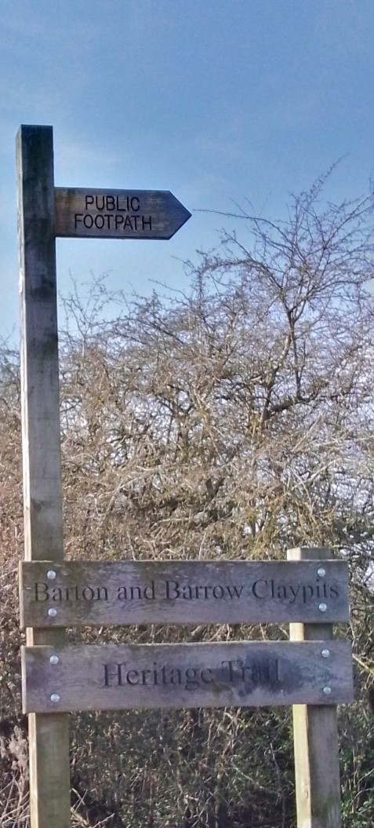


Introducing HNP
How did we come to exist?
What we’re here to do

Slide 4
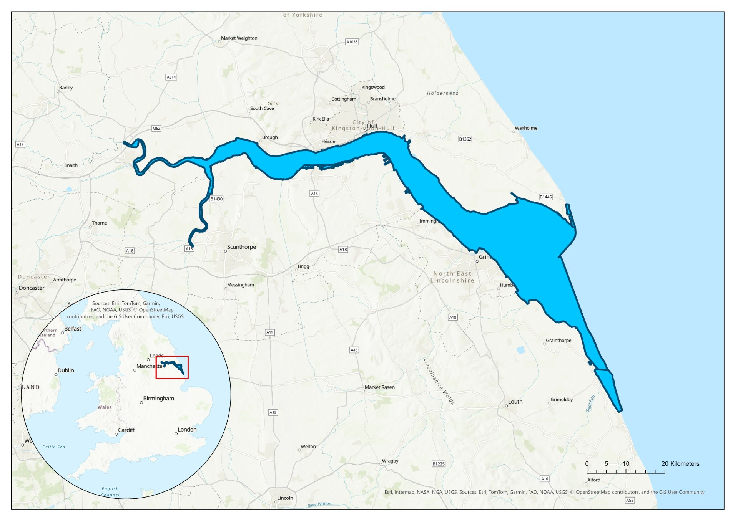
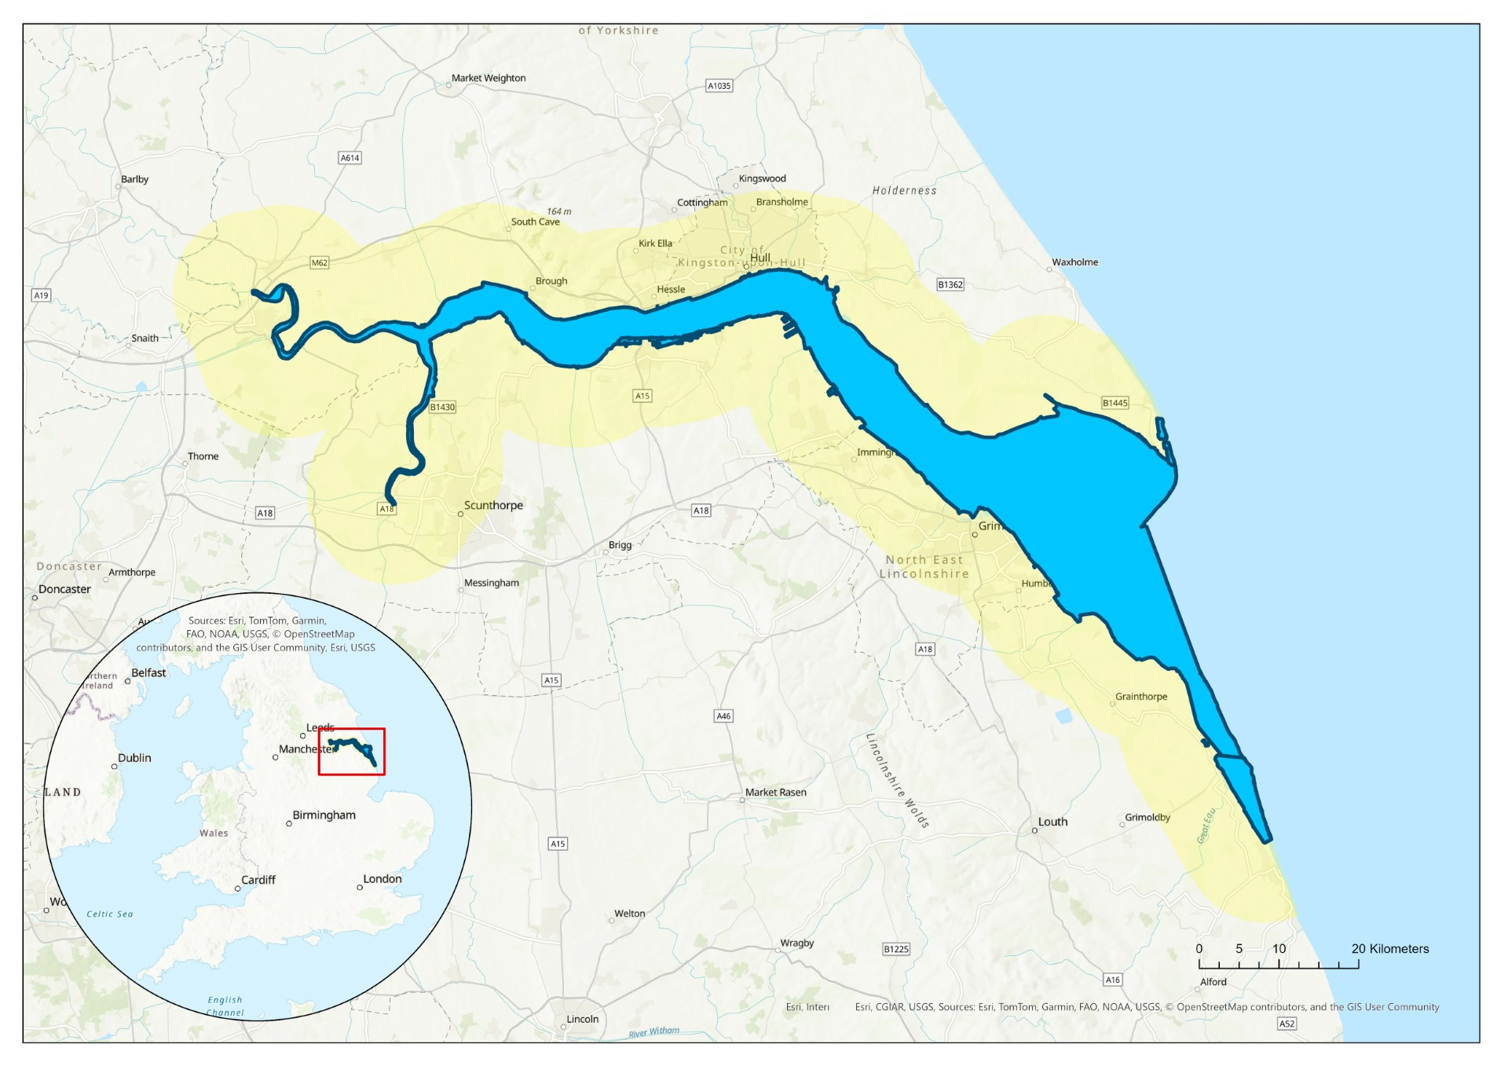
Area of operation
Humber Estuary EMS
+ 10km

Slide 5
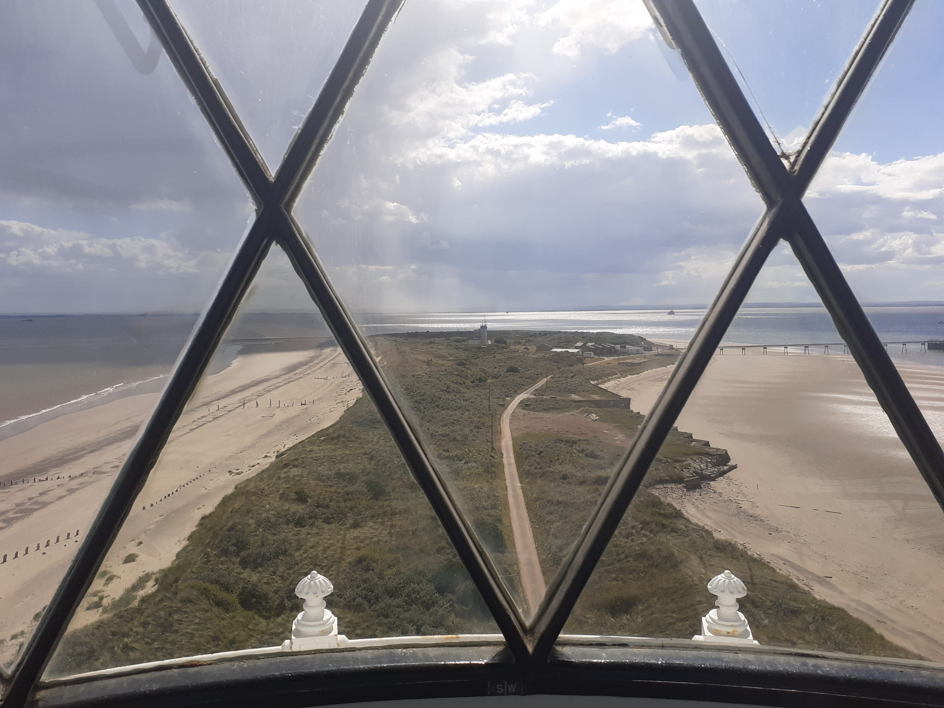
Humber Nature Partnership’s vision is for the Humber to be a rich and resilient environment
in which nature and industry coexist in harmony, bringing benefits for wildlife, business and local communities.

Slide 6
Our strategy framework
Climate change
Government policy
An ecologically functioning estuary
Nature and industry in harmony
Investing in Natural
Capital
Partnerships across the estuary

Slide 7
Thank you
Contact us:
info@humbernature.co.uk

